Slide 1

Predicting the 2013 NHL Eastern Conference Champion
Steve Previs
Brian Gosey
BQOM 2521 Decision Making in Complex Environments Spring 2013

Slide 2








Post Season Qualifying Teams
(Alternatives)

Slide 3
Key Statistics for BOCR Input
Performance
  Win %
  Home Win %
  Road Win %
  Goals Scored
  Goal Allowed
  Critical Game Stats
    GPG/GA/PP%/PK%
Goalie Ranking
  Combination of all team goalie playoff experience and wins
Average Experience Years
Hot Streak Coming into Playoffs
Depth
Head Coach Playoff Experience
Won Stanly Cup Last 5 Years
Playoff Appearances Last 10 Years
Desire to Win
Good Luck/Bad Luck
Home Ice Advantage
Tournament Seeding
Confidence

Slide 4
Key Statistics for BOCR Input
Benefits
Experience
Won Stanley Cup
Playoff Appearances
Depth
Experience of Team
Experience of Coach
Average age of Team
Home-Field Advantage
Record at Home
Intimidation
Playoff Seeding
Performance
Regular Season Stats
Past Playoffs
Streak
Consecutive Playoff Appear
End of Season Wins
Other
Motivation/Desire
Confidence

Slide 5
Key Statistics for BOCR Input
Opportunities
Home-Field Advantage
Seeding
Streak
Continue End of Season Hot Streak
Other
Late Season Acquisitions
Healthy Team
Good Luck

Slide 6
Key Statistics for BOCR Input
Costs
Experience
Won Stanley Cup
Playoff Appearances
Depth
Experience of Team
Experience of Coach
Average age of Team
Home-Field Advantage
Record at Home
Intimidation
Playoff Seeding
Performance
Regular Season Stats
Past Playoffs
Streak
Consecutive Playoff Appear
End of Season Wins
Other
Motivation/Desire
Confidence

Slide 7
Key Statistics for BOCR Input
Risks
Home-Field Advantage
Seeding
Streak
Continue End of Season Cold Streak
Other
No Late Season Roster Moves
Injuries
Bad Luck

Slide 8
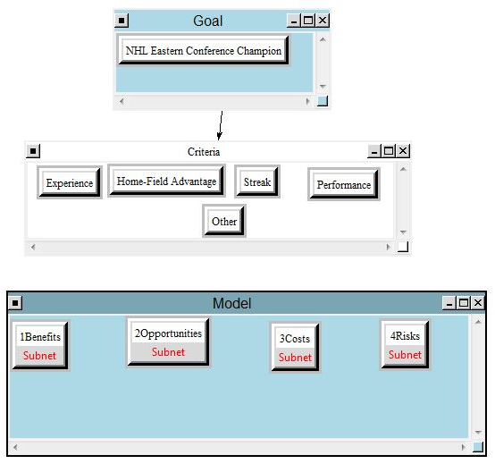
Model

Slide 9
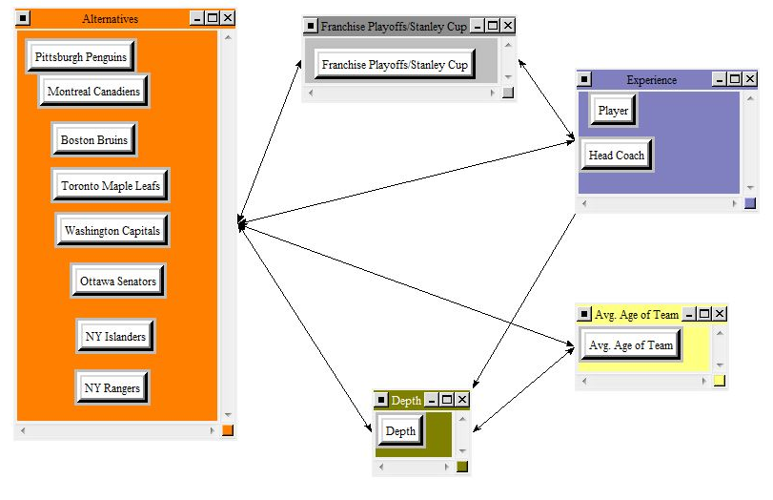
Benefits subnet for Experience

Slide 10
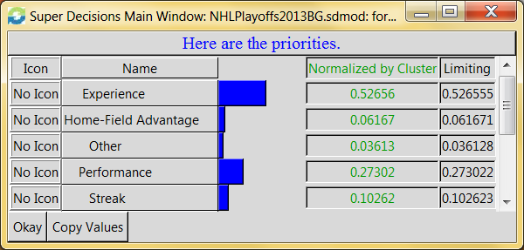
Priorities

Slide 11
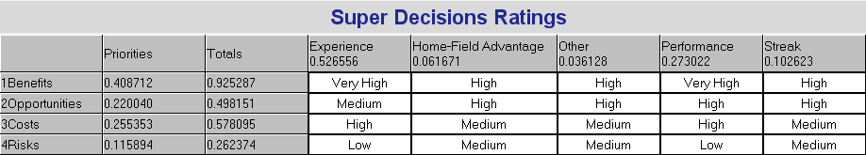
Ratings

Slide 12
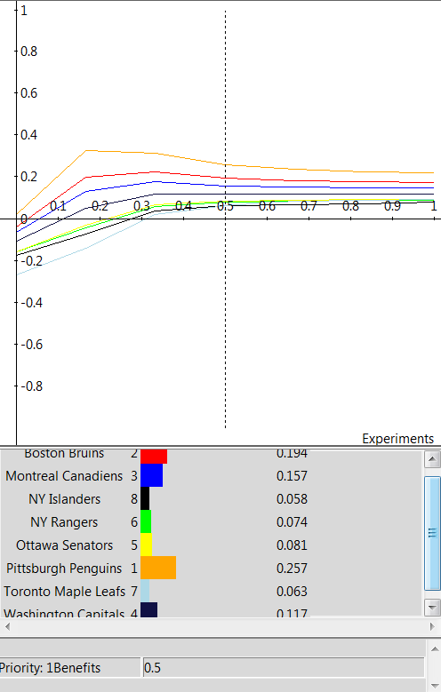
Sensitivity

Slide 13
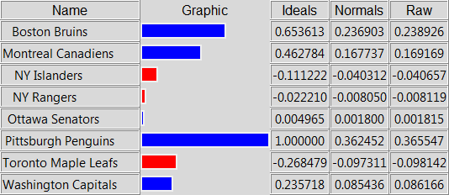
Synthesized Priorities

Slide 14

NHL Eastern Conference Champion (according to our model)
PITTSBURGH PENGUINS

Slide 15

NHL Eastern Conference Champion is……
Wait and see!

