Slide 1
Decision Making Project
What City is the Most Viable Market for an NHL Franchise?
Christian Evans
Matt Attinger
Oct. 17, 2011

Slide 2
The Problem
Following in the footsteps of the Atlanta Thrashers (Winnipeg Jets), it is likely that several more NHL teams will relocate
The NHL is expected to expand the league to 32 teams within the next few years

Slide 3
Goal
The goal of this project is to determine which city will soon have an NHL franchise:
Kansas City
Toronto
Quebec City
Seattle

Slide 4
What City is the most viable market for an NHL Franchise?
Benefits
Opportunities
Costs
Risk

Slide 5
What City is the most viable market for an NHL Franchise?
Infrastructure
City Characteristics
Market
Economic
Benefits
Opportunities
Costs
Risk

Slide 6
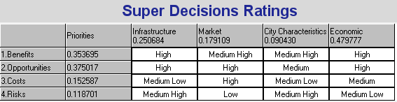
Rating the Strategic Criteria
Economic Criteria is the Most Important!

Slide 7
What City is the most viable market for an NHL Franchise?
Infrastructure
City Characteristics
Market
Economic
Benefits
Opportunities
Costs
Risk
Economic
Social
Kansas City, Toronto, Quebec City, & Toronto (Alternatives)

Slide 8
Benefits
Benefits
Economic
Social
Economic
Social
Alternatives
Alternatives
Infrastructure
City Characteristics
Hockey Interest
Corporate Presence
Population

Slide 9
Opportunities
Opportunities
Economic
Social
Economic
Social
Alternatives
Alternatives
Infrastructure
Sports Identity
Weather
Market Advantage
Market Size

Slide 10
Costs
Costs
Economic
Social
Economic
Social
Alternatives
Alternatives
Competition
Citizens
Tourists
Sustainability

Slide 11
Risks
Risks
Economic
Social
Economic
Social
Alternatives
Alternatives
Infrastructure - Facilities
Security
Other Allegiances
Transportation

Slide 12
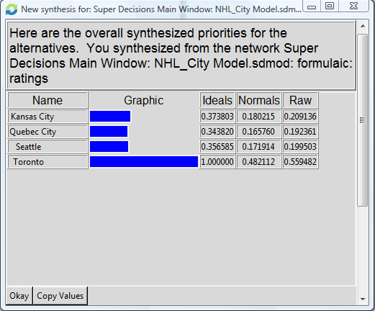
The Best Alternative: TORONTO!

Slide 13
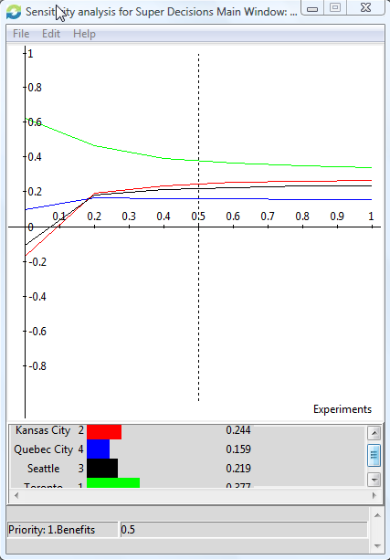
Sensitivity Analysis

Slide 14
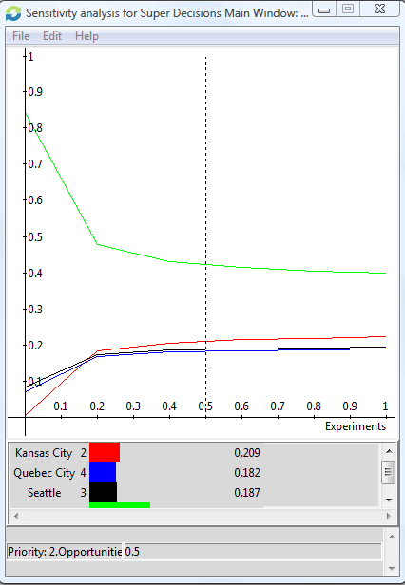

Slide 15
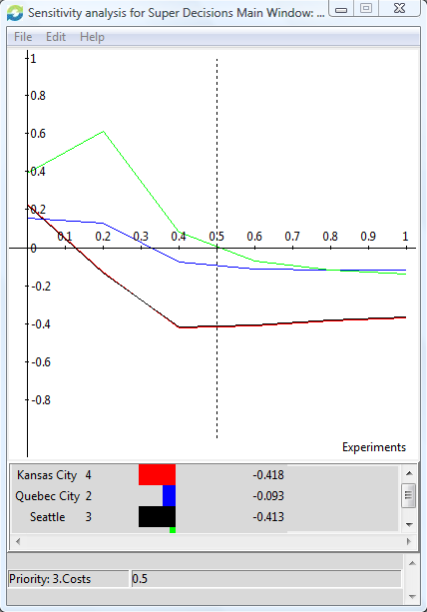

Slide 16
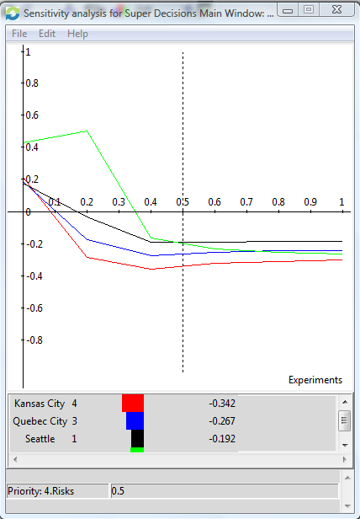

Slide 17
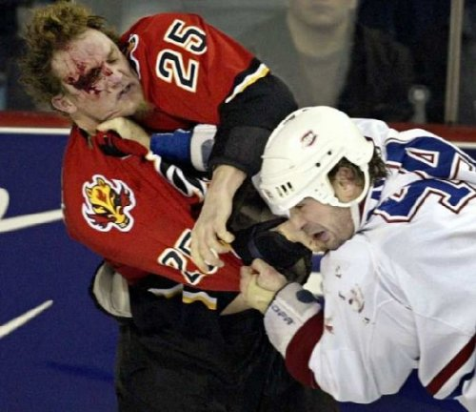
Questions?

