Slide 1
The Franklin Regional Lacrosse Club

Slide 2
Issue and Analysis
ISSUE
Should the Franklin Regional Lacrosse Club keep its current organizational structure, de-centralize, or separate completely?
ANALYSIS
A BOCR model was used in calculating the best outcome. The alternatives used for the model were 1)Status Quo; 2)De-Centralize; and 3)Separate Entities. The significance of these alternatives was explained above. The control criteria used to evaluate this model were: 1)Operating Efficiency; 2)Player Development; and 3)Long Term Sustainability. These are the main criteria that the Board of Directors is basing their decisions off of. Player development is crucial to these choices. To accompany this, the operating and managing efficiency of the club needs to determined with long term sustainability in mind.

Slide 3
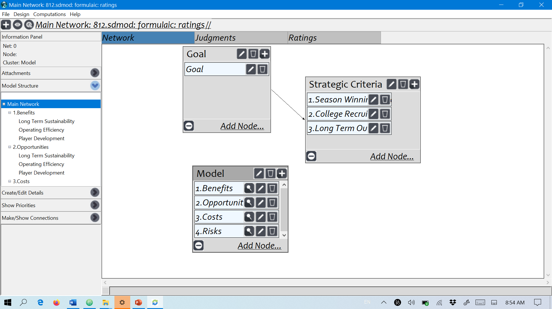
Model

Slide 4
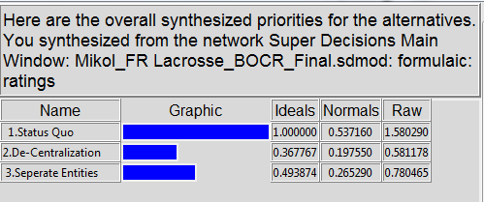
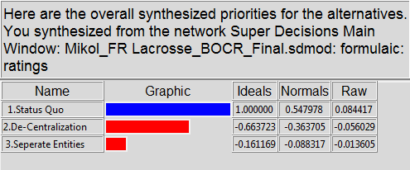
Results
Multiplicative (Short Term)
Additive (Long Term)

