Slide 1
Building a Super Conference – ACC Expansion Options

Slide 2
GOAL AND ALTERNATIVES
GOAL
  To determine which two universities the ACC should invite into their conference as the 15th and 16th members
ALTERNATIVES
  Connecticut & Rutgers
  Connecticut & Texas
  Notre Dame & Connecticut
  Notre Dame & Rutgers
  Notre Dame & Texas
  Notre Dame & West Virginia
  Rutgers & Texas
  West Virginia & Connecticut
  West Virginia & Rutgers
  West Virginia & Texas
  Do Not Expand Further

Slide 3
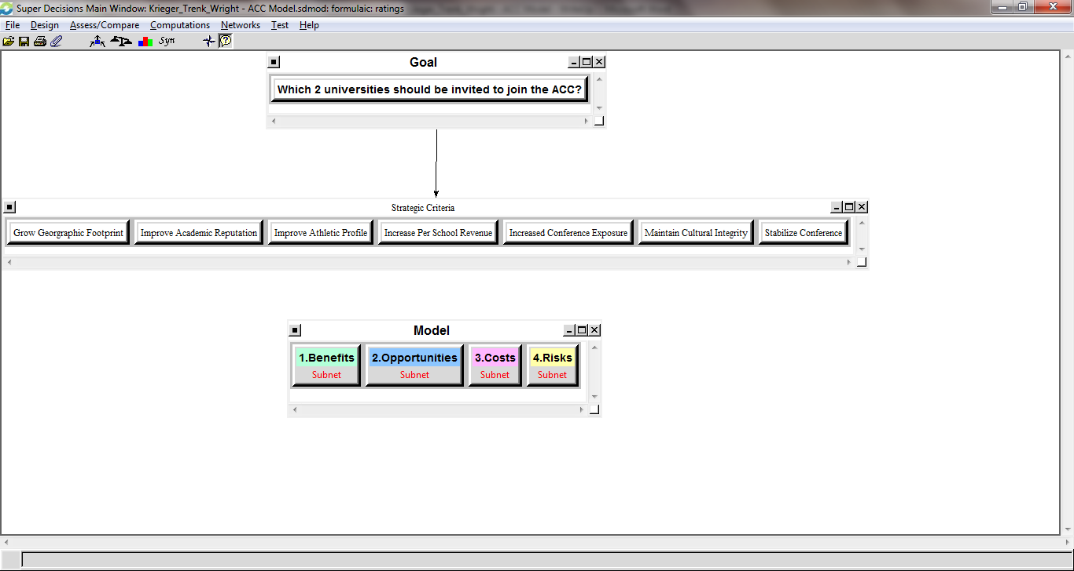
Model

Slide 4
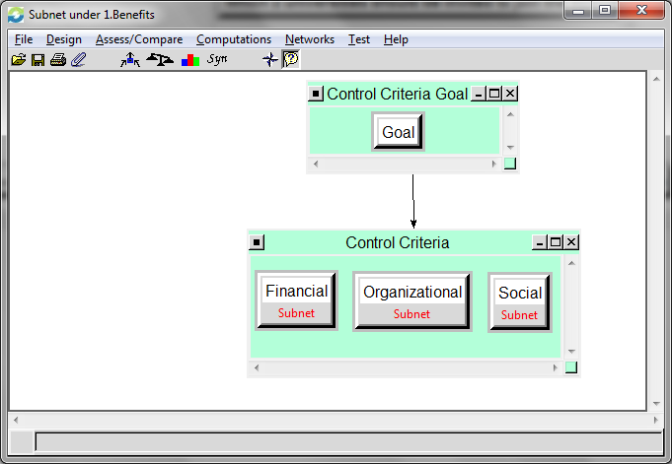
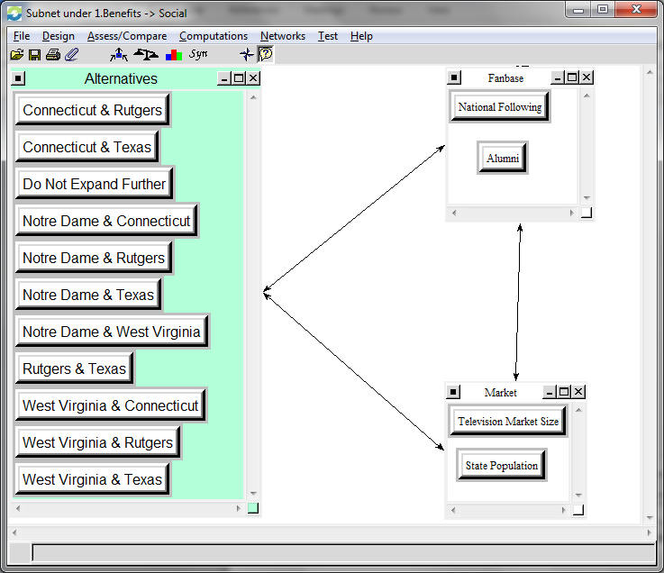
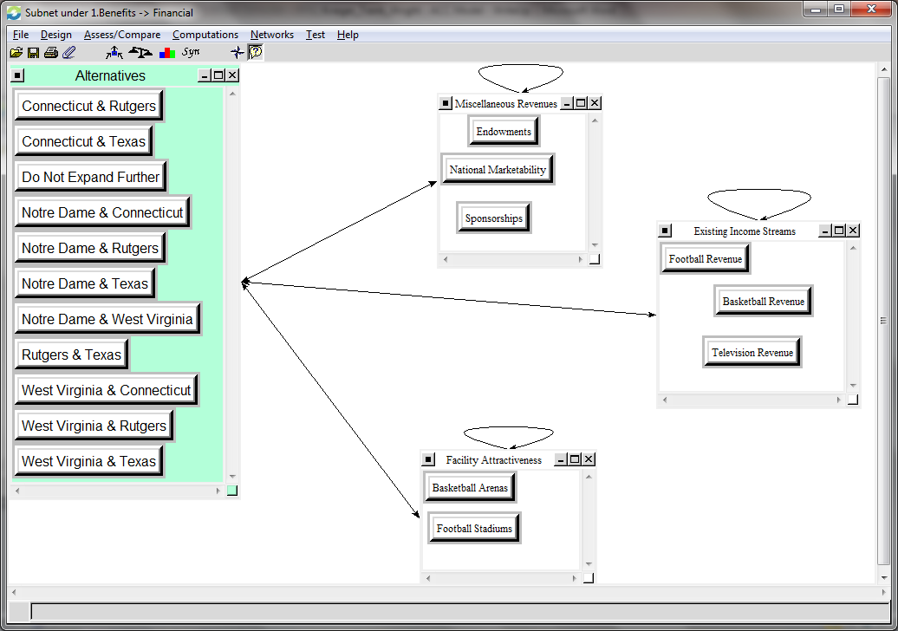
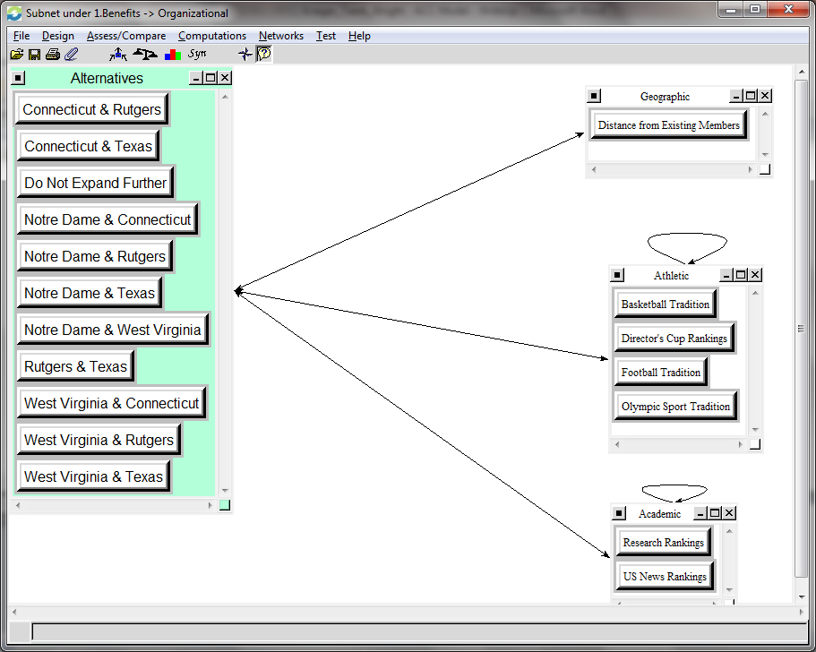
Model

Slide 5

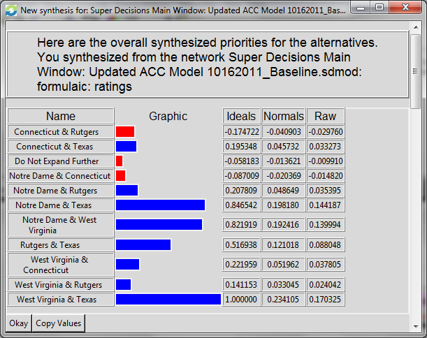
Results
Multiplicative (Short Term)
Additive (Long Term)

