Slide 1
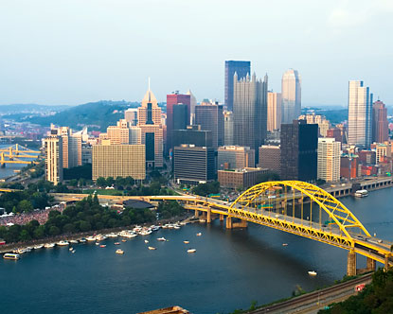

Should Pittsburgh Submit a Bid to Host the 2024 Summer Olympics?
Erica Jurkowski

Slide 2

Introduction
Pittsburgh among 35 U.S. cities to receive letters this February from the USOC to gauge interest in hosting the games
Olympic City needs 45,000 hotel rooms, a village for 16,500 athletes and officials, an international airport, a workforce of up to 200,000, and $3 billion

Slide 3
What People are Saying
“As our City grows and evolves, we welcome opportunities to tell our comeback story to the world. It wasn’t long ago that we hosted a safe and successful G20 Summit, and now, we may have the opportunity to bid for the 2024 Olympics…Pittsburgh should feel very proud and honored to have come this far. Certainly there would be extraordinary obstacles and challenges to meet in putting a bid together, and we will reach out to community members to gauge their interest.”
-Mayor Ravenstahl
“Pittsburgh doesn’t like to admit that certain things are beyond its grasp, but the Olympics might be too big. Let’s remember this is a city that had a crisis when a Pirates game, a concert and the Arts Festival all happened on the same Saturday.”
-John Mehno

Slide 4
Alternatives
Submit Bid
Do Not Submit Bid

Slide 5
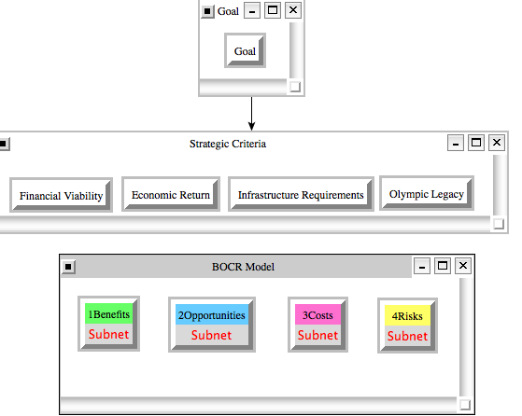
Model Overview

Slide 6
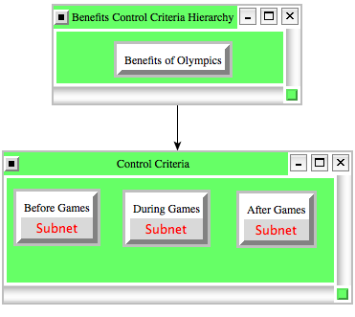
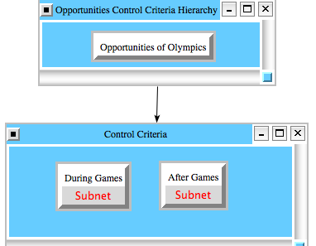
Benefits & Opportunities Control Criteria Subnets

Slide 7
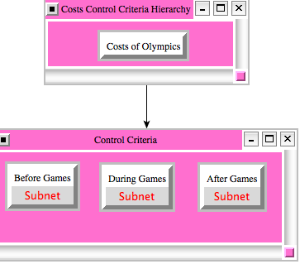
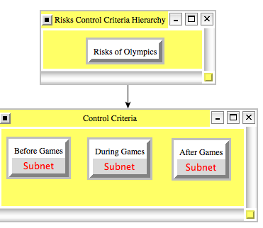
Costs & Risks Control Criteria Subnets

Slide 8
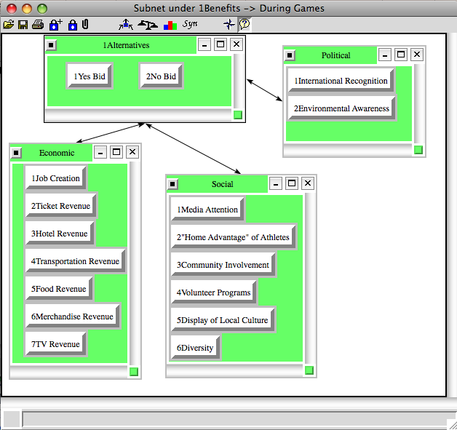
Decision Subnet for Benefits During Games

Slide 9
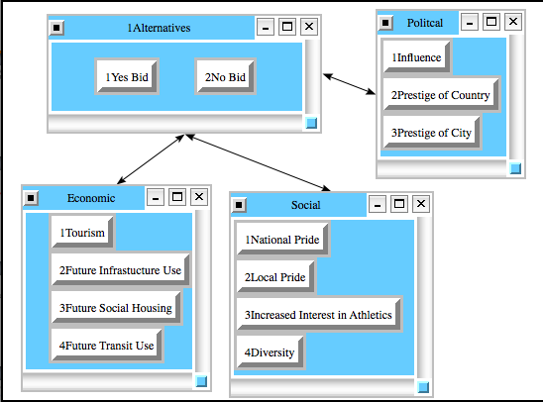
Decision Subnet for Opportunities After Games

Slide 10
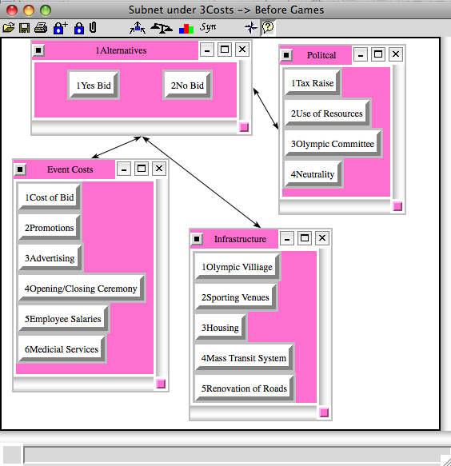
Decision Subnet for Costs Before Games

Slide 11
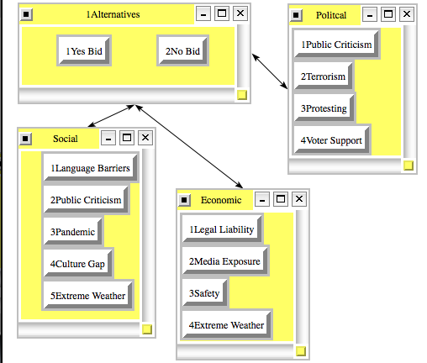
Decision Subnet for Risks During Games

Slide 12
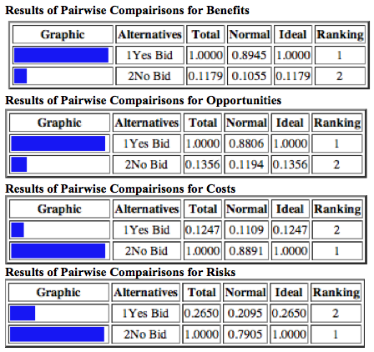
Results of Pairwise Comparisons

Slide 13
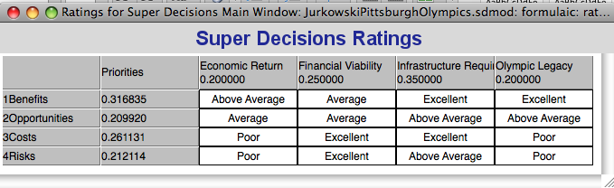
Ratings

Slide 14
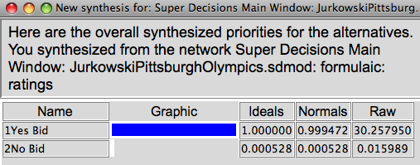
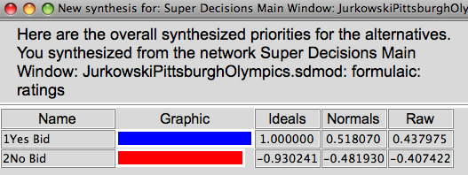
Results
Multiplicative (Short-term)
Additive Negative (Long-term)

Slide 15
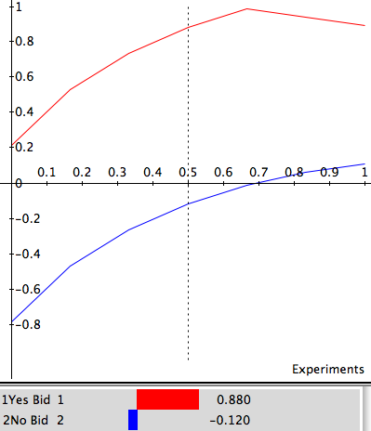
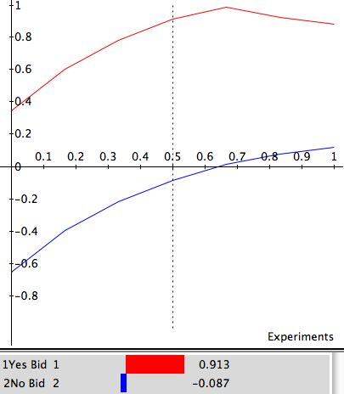
Sensitivity Analysis (Benefits & Opportunities)

Slide 16
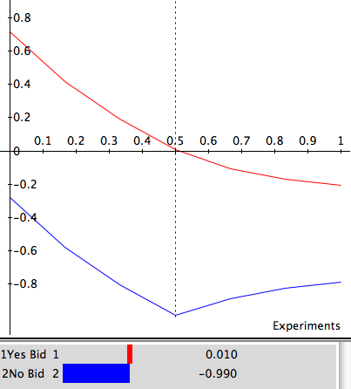
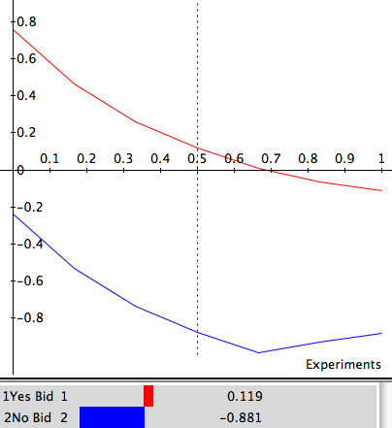
Sensitivity Analysis Costs & Risks

Slide 17
Summary
“While the games require a formidable commitment, they also provide an unparalleled opportunity for a city to evolve and grow.”
-Olympic Committee CEO Scott Blackmun

Slide 18
GO FOR GOLD, PITTSBURGH!

