Slide 1


Drafting the Best Future NFL Quarterback
Decision Making in a Complex Environment
Final Project
Nick Besh
Steve Ellis

Slide 2
Selection appears to be a Crap-Shoot
Many top ranked QB’s coming out of college turn out to be busts
Some middle to late round picks turn out to be Super Bowl MVP’s
Is there a way to quantify all of the stats and “gut feelings” of players to select a future NFL star?

Slide 3
What is Our goal?
Optimize a high selection in the NFL draft by drafting a solid contributor to your team, if not a Pro-Bowl caliber player while at the same time avoiding the selection of a player who can set your franchise back years.
This is a critical decision that does not leave much room for error.

Slide 4
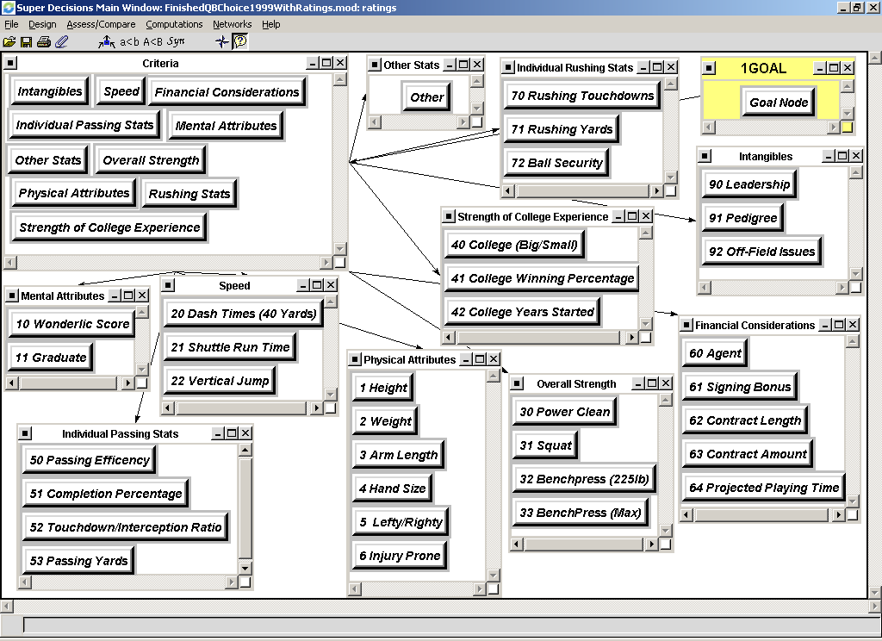
Creating the model

Slide 5
Criteria
Strength of college experience
Individual passing stats
Mental attributes
Physical attributes
Speed
Overall strength
Intangibles
Financial considerations
Other stats

Slide 6
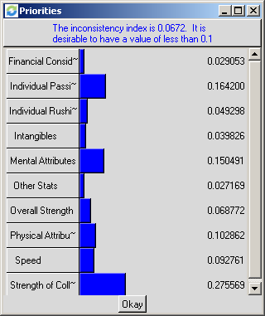
Priorities

Slide 7
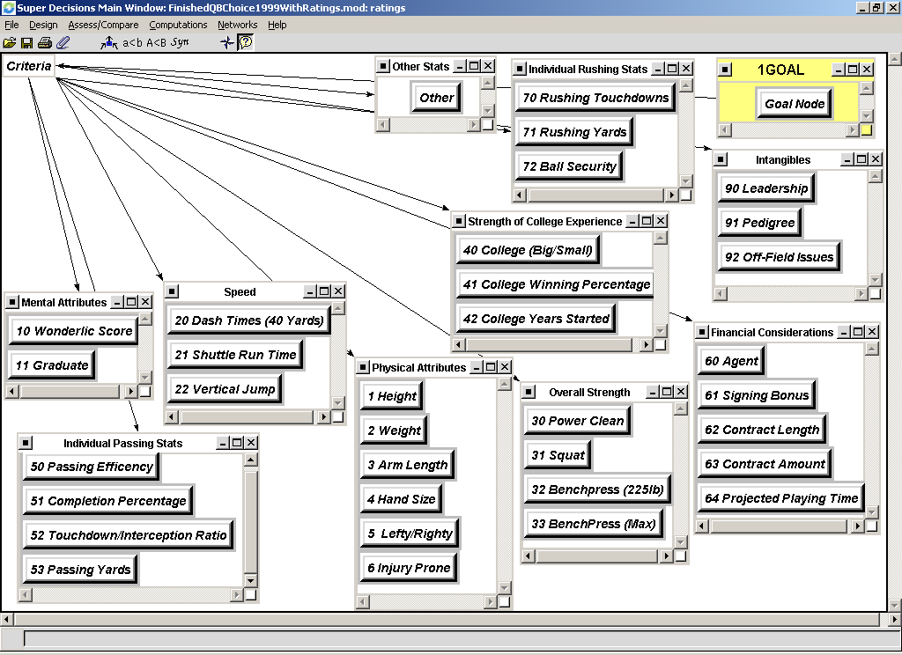
Sub-Criteria

Slide 8
Alternatives in the 1999 Draft
Tim Couch
Donovan McNabb
Akili Smith
Daunte Culpepper
Cade McNown

Slide 9
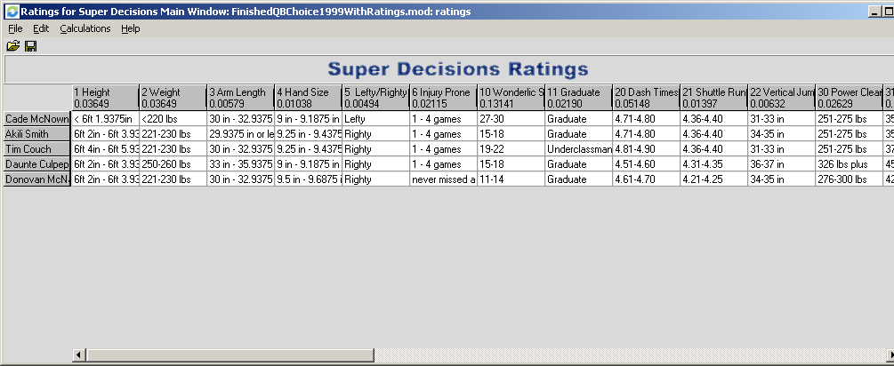
SuperDecisions Ratings

Slide 10
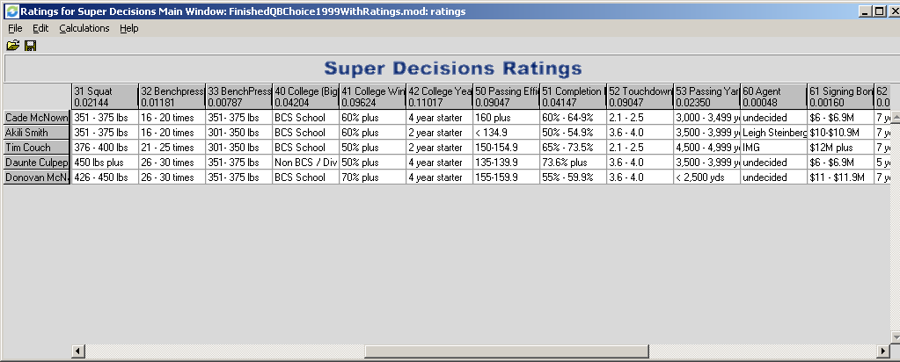
SuperDecisions Ratings cont.

Slide 11
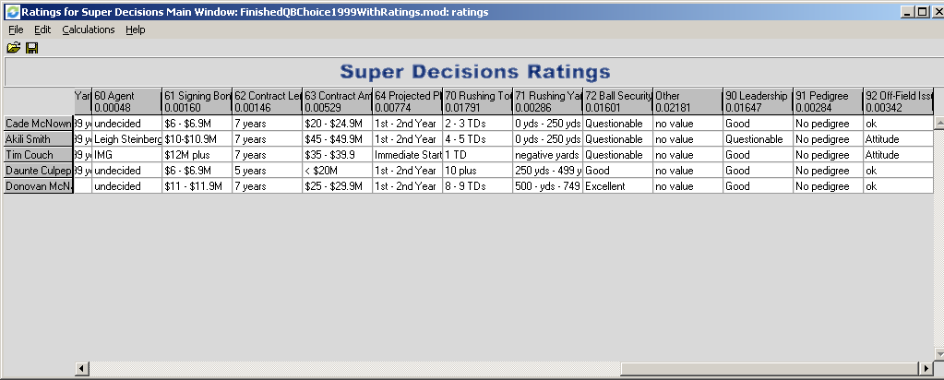
SuperDecisions Ratings cont.

Slide 12
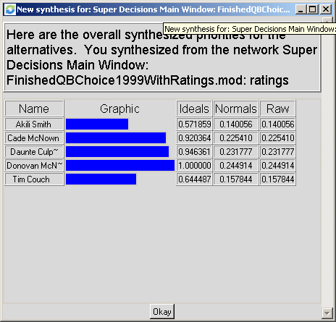
Synthesis

Slide 13
1999 Quarterback’s Sensitivity Analysis Mental Attributes Strength of College Experience

Slide 14
1999 Quarterback’s Sensitivity Analysis Physical Attributes Individual Passing Stats

Slide 15
Here is what some of the experts said:
Tim Couch (Kentucky) Widely considered a franchise quarterback…more mobile and athletic than Peyton Manning. Consensus #1 quarterback in the draft.
Donovan McNabb (Syracuse) Great athlete but needs substantial work to convert from option QB to a pro style QB. Has all of the tools.
Akili Smith (Oregon) Has all the physical tools to be a premier NFL quarterback. Regarded as the second best QB in the draft.

Slide 16
1999 NFL draft continued
Daunte Culpepper (Central Florida) Looks like a bigger Steve McNair with touch and accuracy; small school affiliation is a concern.
Cade McNown (UCLA) Proven winner; definitely a big game QB. Looks like a young Phil Simms. Only average arm strength.
So lets see how they were drafted…..

Slide 17
1999 NFL Draft Order
1st overall pick – Tim Couch – Cleveland
2nd overall pick – Donovan McNabb to Philadelphia. He has booed loudly by the fans in attendance. They wanted the…
3rd pick Akili Smith, who went to the Cincinnati Bengals.
Daunte Culpepper went 11th to the Minnesota Vikings.
Cade McNown went 12th overall to the Chicago Bears.
Which results are better?

Slide 18
Tim Couch
Played 5 yrs in Cleveland before being cut at the beginning of the 2004 training camp.
He lost his job in 2003 to an undrafted journeyman, Kelly Holcomb.
He started 62 games (out of 80) and threw for 11,131 yards, completing 59.8% of his passes with only 64 TDs and 67 career interceptions.
He was cut again a couple of weeks later by the Green Bay Packers and it currently out of football.

Slide 19
Akili Smith
Played 4 yrs in Cincinnati before being cut in two different training camps (Cin & Green Bay) in 2003.
Started only 21 out of 64 games completing 48% of his passes for 2,122 yds. He threw 5 TDs and 13 Ints.
Considered one of the biggest bust in the history of the NFL Draft (Ryan Leaf is considered the biggest).

Slide 20
Cade McNown
Started 2 years for the Bears before being cut after the 2000 season. Was a back up in Miami for 2001 and 2002 and in SF for 2003.
Passed for 3,111 yds completing 54% of his passes while throwing for 16 TDs and 19 Ints.
Currently, out of football.

Slide 21
Daunte Culpepper
He has started 61 out of 83 games for the Vikings. He has completed 63% of his passes for 14,832 yards. He has thrown 98 TDs and 64 Ints.
He has gone to 2 Pro-Bowls and is considered one of the elite quarterbacks in the NFL.

Slide 22
Donovan McNabb
Has been to the Pro-Bowl 4 times, the Eagles are NFC East powers, and considered the class of the NFC.
He has started 74 games, completed 58% of his passes for over 14,000 yds with 96 TDs and 50 Ints.
He has also rushed for over 2,000 yards with 19 TDs.
Considered one of the best players in the NFL.

Slide 23
Now lets apply the model to the 2004 NFL Draft
Eli Manning (Mississippi) No. 1 overall - N.Y Giants
Philip Rivers (N.C. State) No. 4 overall – San Diego Chargers
Ben Roethlisberger (Miami-Ohio) No. 11 overall – Pittsburgh Steelers
J.T. Losman (Tulane) No. 22 overall – Buffalo Bills

Slide 24
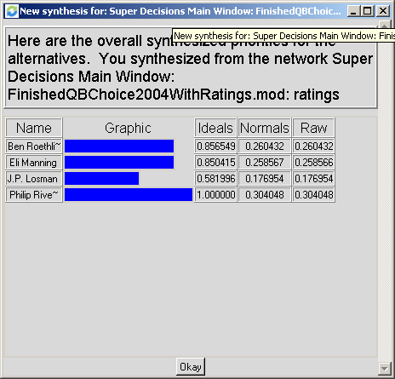
Synthesis

Slide 25
2004 Quarterback’s Sensitivity Analysis Mental Attributes Strength of College Experience

Slide 26
2004 Quarterback’s Sensitivity Analysis Physical Attributes Individual Passing Stats

Slide 27

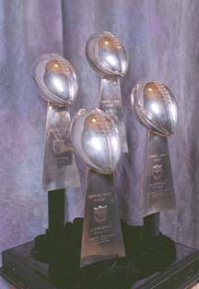
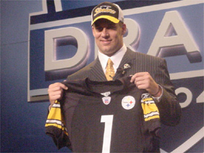
The model likes Big Ben…….Lets Go Steelers!

