Slide 1
Apartment selection with ratings
Goal: Apartment decision
Alternatives:
1 Alvern Gardens
2 Carriage Park
3 Hyland Hills
4 Leland Point
5 Squires Manor

Slide 2
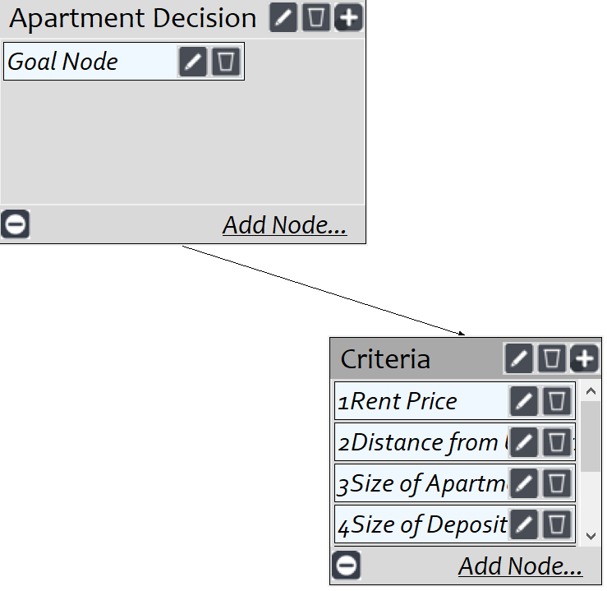
Model
Screenshot of SuperDecisions software Version 3.x

Slide 3
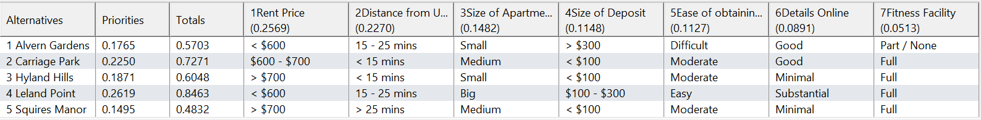
Ratings
Screenshot of SuperDecisions software Version 3.x

Slide 4
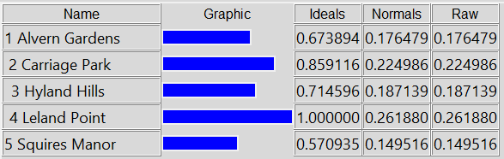
Results

