Slide 1
Vacation Selection
Goal: Vacation Selection
Alternative:
Orlando
San Francisco
New York

Slide 2
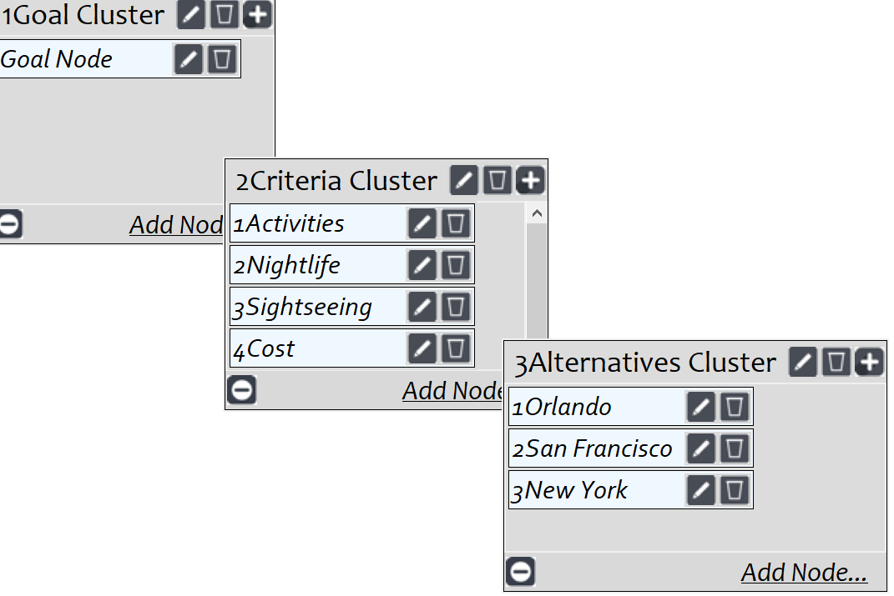
Model
Screenshot of SuperDecisions software Version 3.x

Slide 3
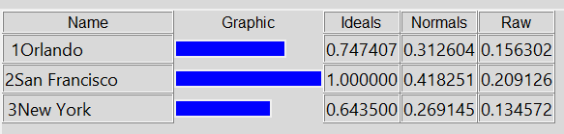
Results

