Slide 1
School Selection
Goal: Select the best school
Alternative:
LOWER MERION –PUBLIC-
HAVERFORD – PRIVATE –
CHARRION – PUBLIC-

Slide 2
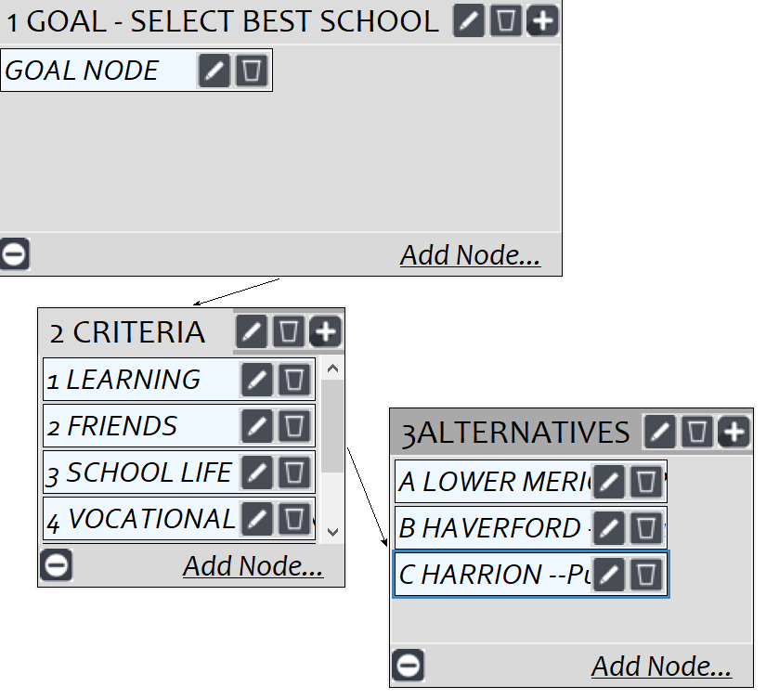
Model
Screenshot of SuperDecisions software Version 3.x

Slide 3
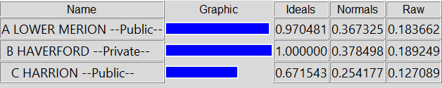
Results

