Slide 1
House Selection
Goal: House Selection
Alternatives:
House A
House B
House C

Slide 2
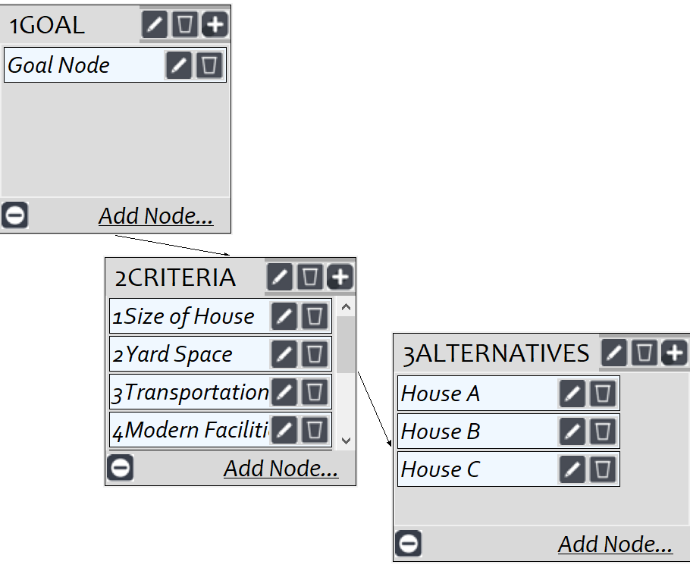
Model
Screenshot of SuperDecisions software Version 3.x

Slide 3
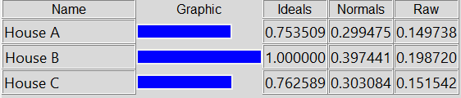
Results

