Slide 1
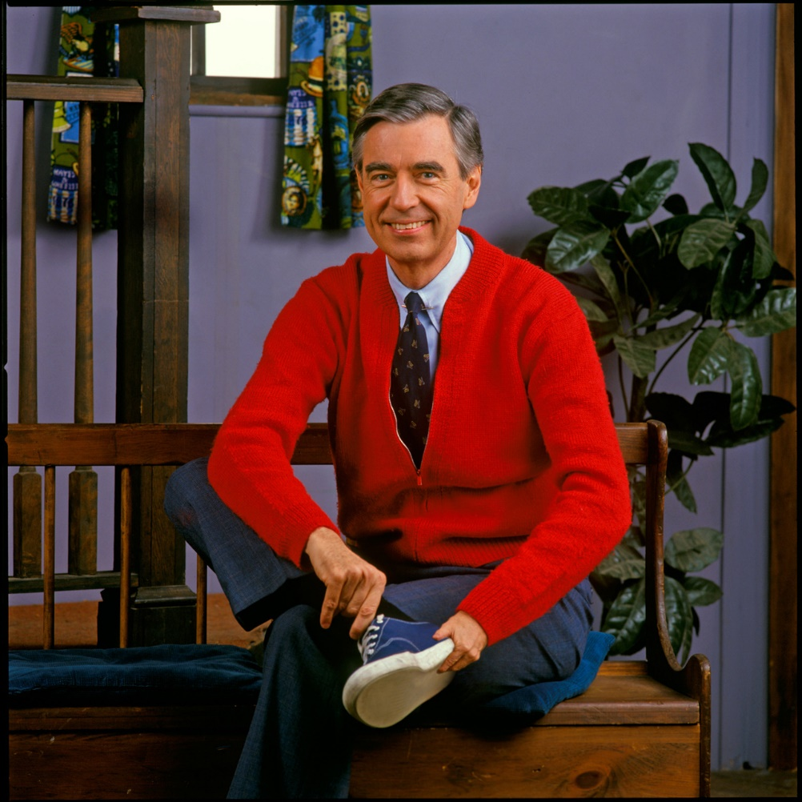
Mr. Roger’s Neighborhood
Roger Boff

Slide 2
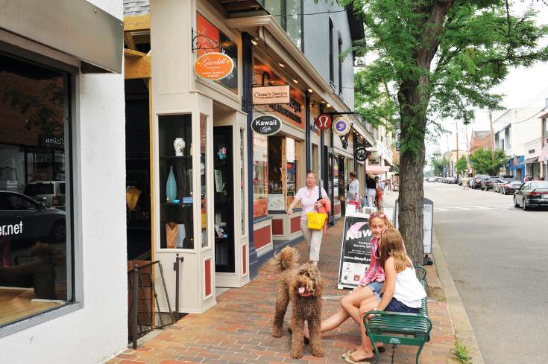
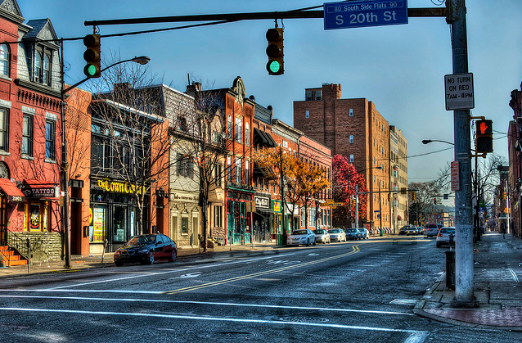
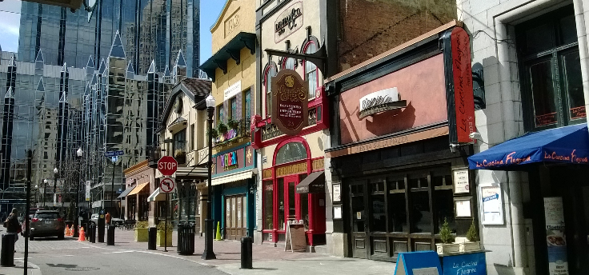
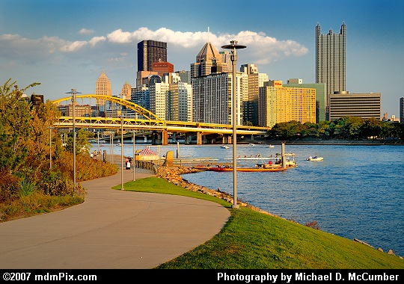
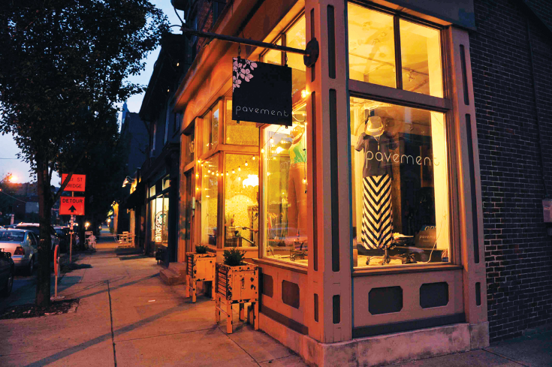
Alternatives
Shadyside
Southside
Downtown
North Shore
Lawrenceville

Slide 3
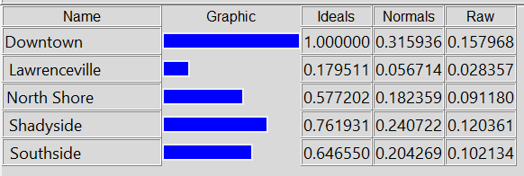
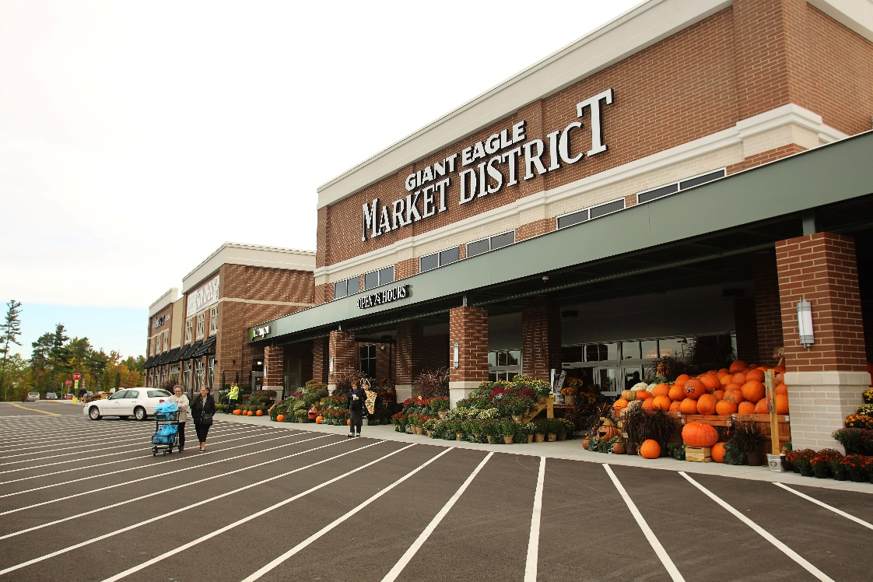
Benefits - Economic
Grocery Store
Walkable
Public Transit

Slide 4
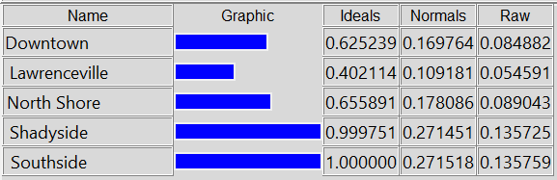

Benefits - Social
Parks & Rec
Friends
Food & Drink
Close to Attractions

Slide 5
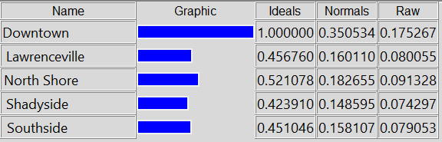
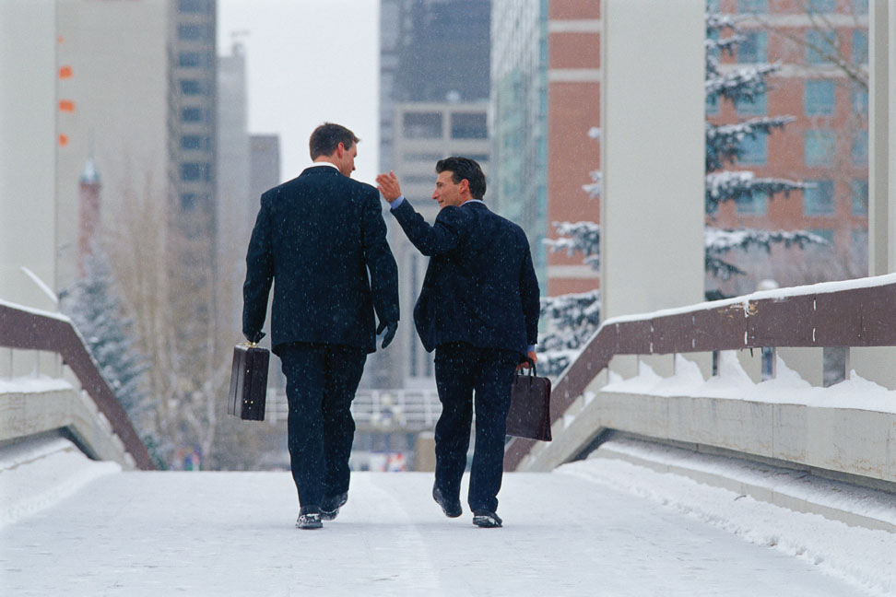
Opportunities – Economic
Walk to Work
Cheap Parking

Slide 6
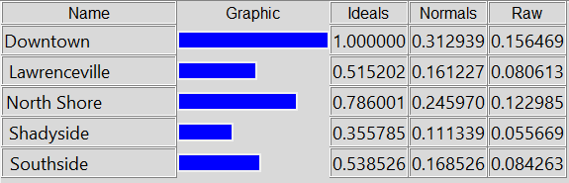
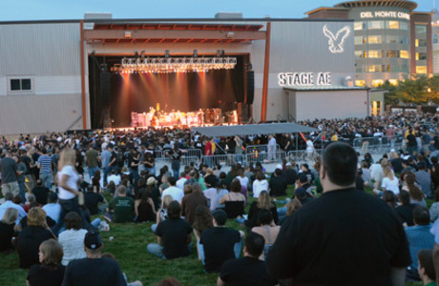
Opportunities – Social
New Restaurants & Bars
Events & Concerts
Networking

Slide 7
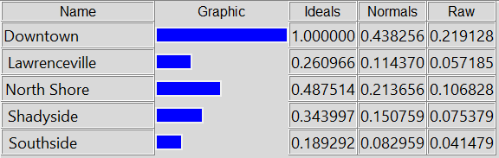

Costs - Economic
Rent
Food & Drink
Parking

Slide 8
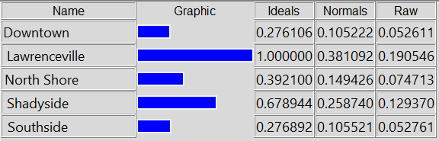

Costs - Social
Difficulty to get Around
Difficulty to Leave City
Lack of Population / Diversity
Hipsters

Slide 9
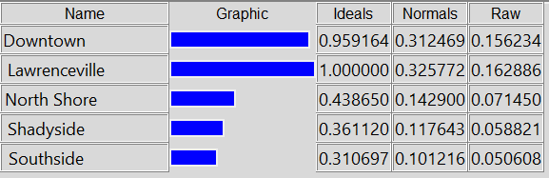

Risks - Economic
Increasing Rent
Difficult to Switch Jobs
Expensive if Unemployed
Difficult to Find Roommate

Slide 10
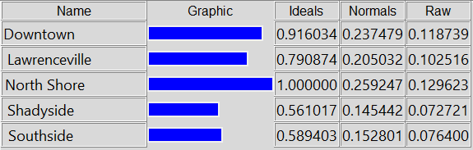
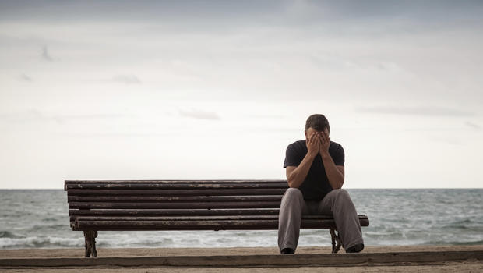
Risks - Social
Friends Moving Out
Limited Night Life
Not so Popular
Not so Nice

Slide 11
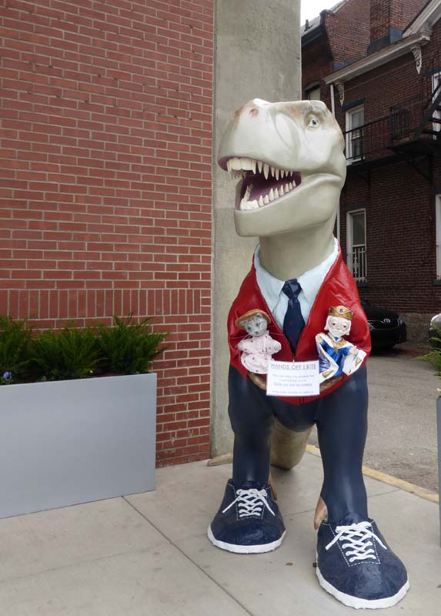
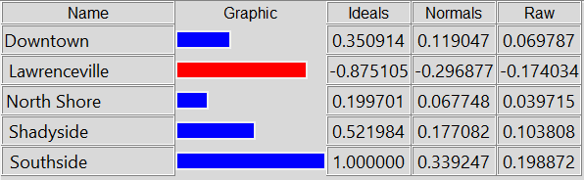
So, where is Mr. Roger’s Neighborhood?
Southside
Shadyside
Downtown
North Shore
Lawrenceville

Slide 12
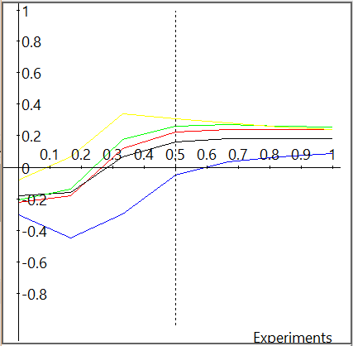
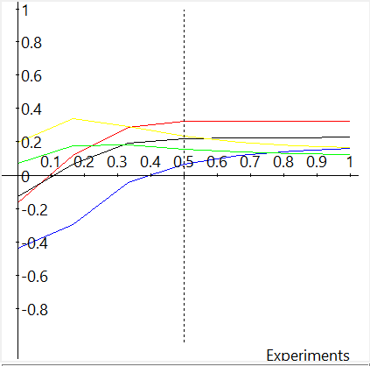
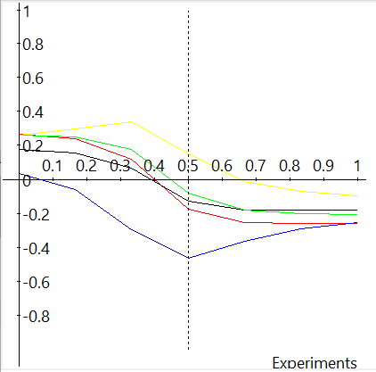
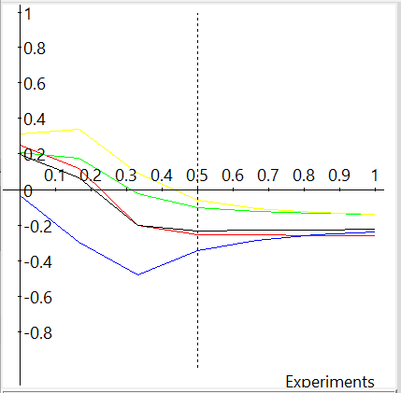
Sensitivity Analysis
Benefits
Opportunities
Costs
Risks
Shadyside (Green)
Southside (Yellow)
Downtown (Red)
North Shore (Black)
Lawrenceville (Blue)

