Slide 1
Choosing the best diet?
Goal: Weight Loss
Alternatives:
Atkins
Slim Fast
South Beach
Weight Watcher

Slide 2
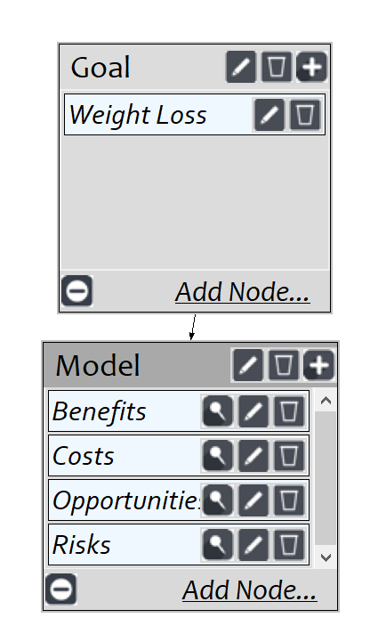
Model
Screenshot of SuperDecisions software Version 3.x

Slide 3
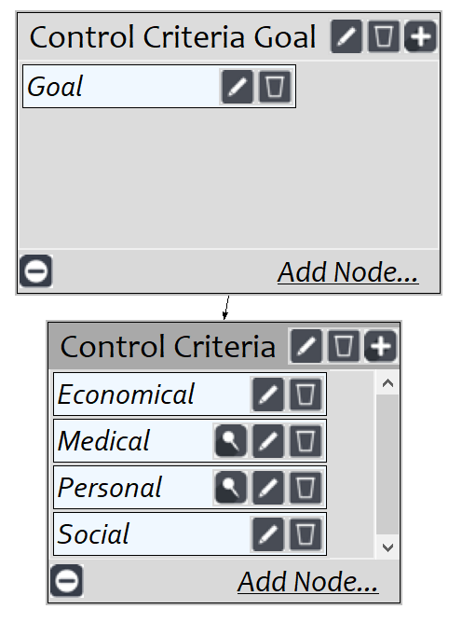
Benefits Subnet

Slide 4
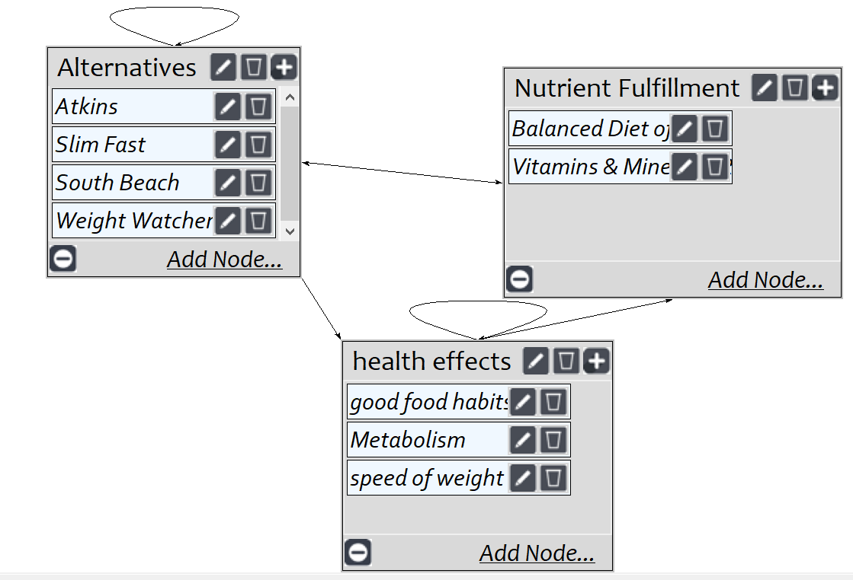
Benefits->Medical

Slide 5
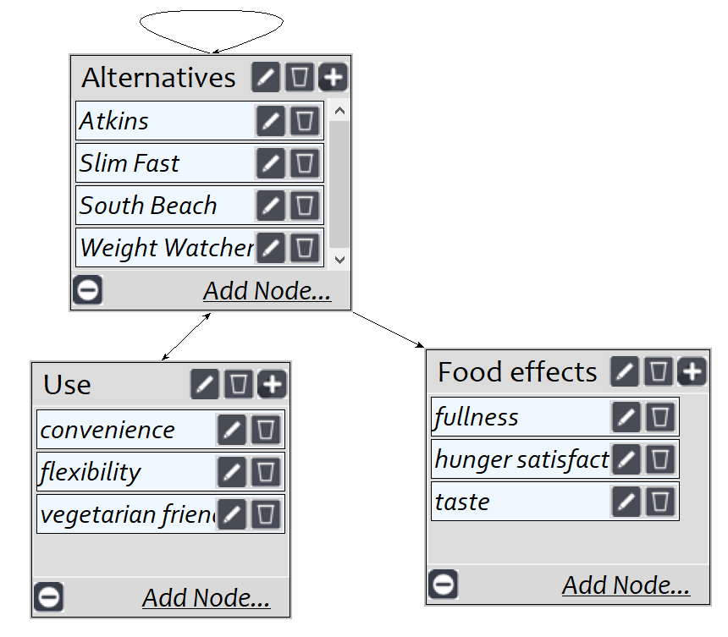
Benefits -> Personal

Slide 6
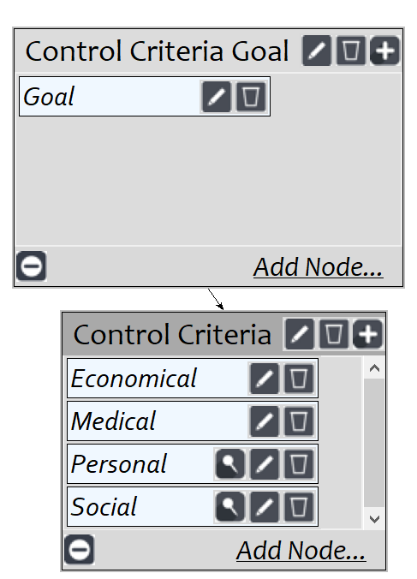
Opportunities Subnet

Slide 7
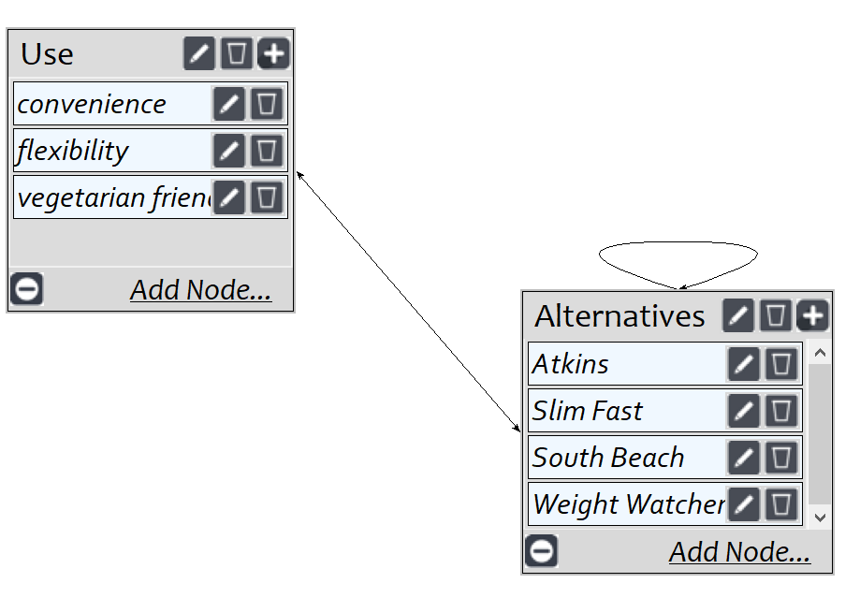
Opportunities -> Personal

Slide 8
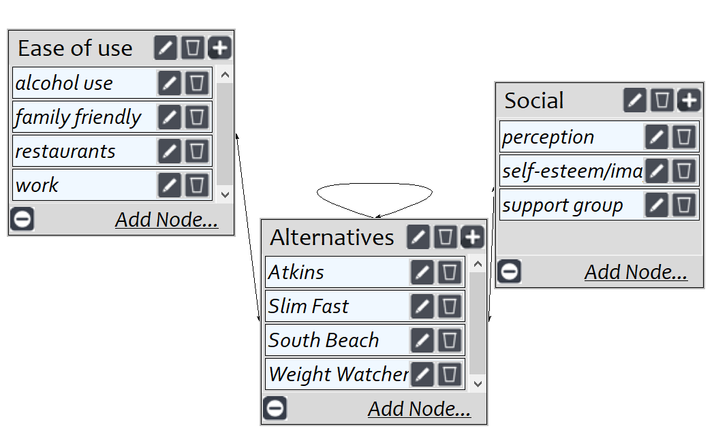
Opportunities -> Social

Slide 9
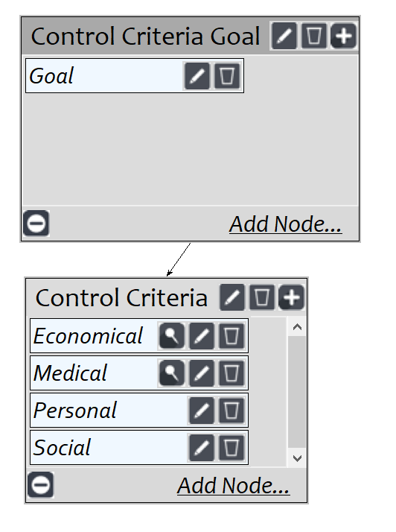
Costs Subnet

Slide 10
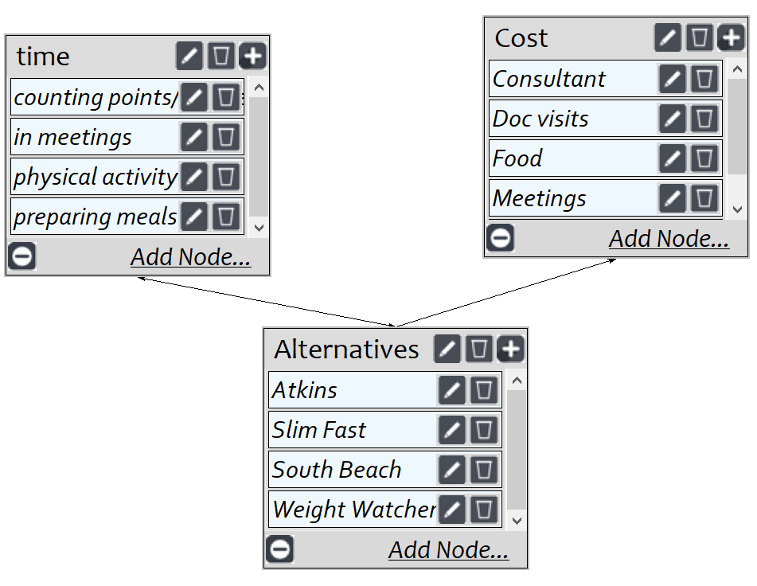
Costs -> Economical

Slide 11
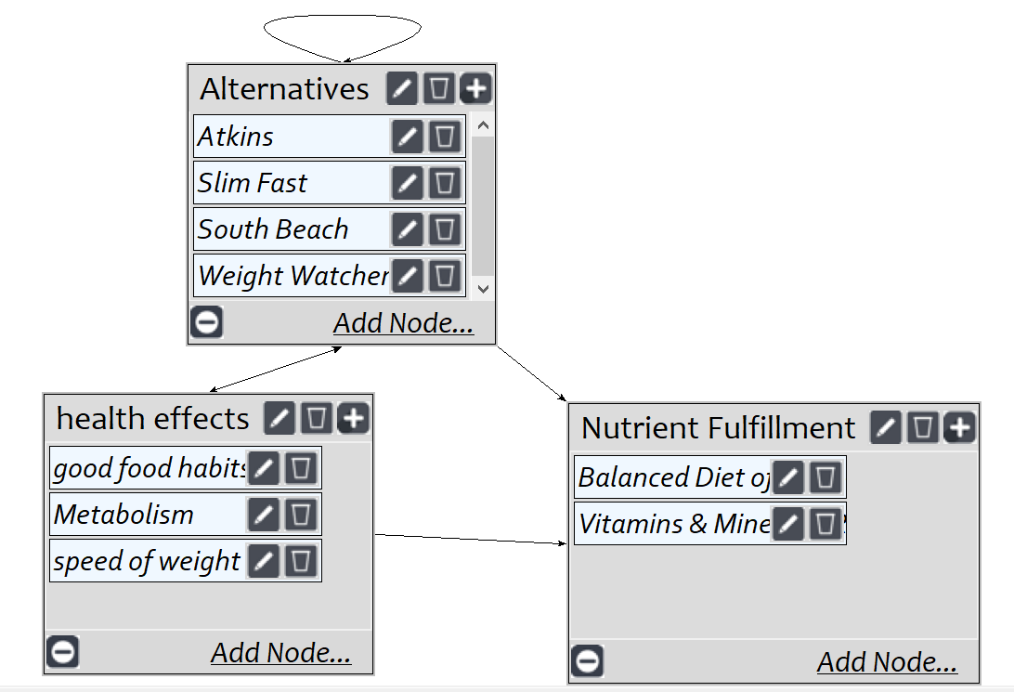
Costs -> Medical

Slide 12
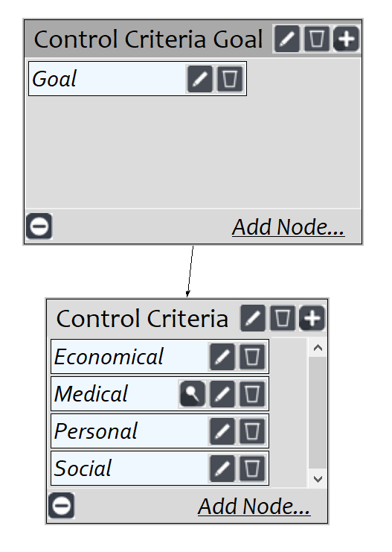
Risks Subnet

Slide 13
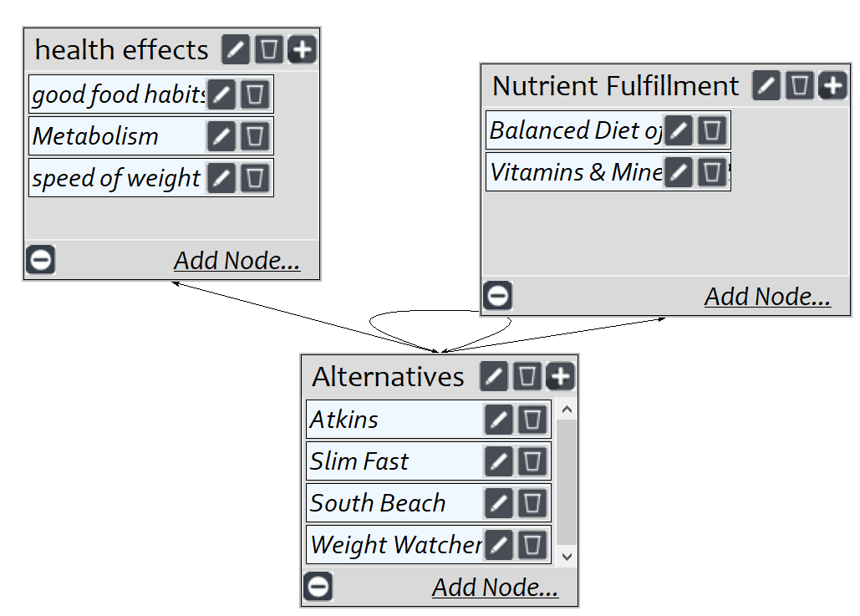
Risks -> Medical

Slide 14
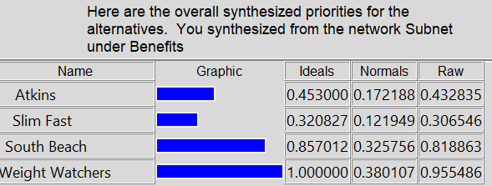
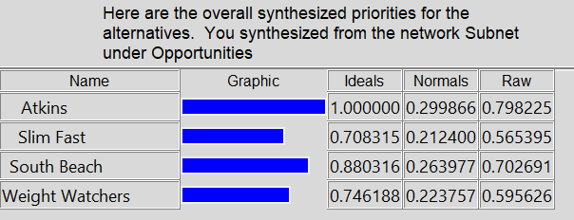
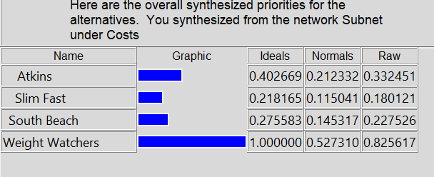
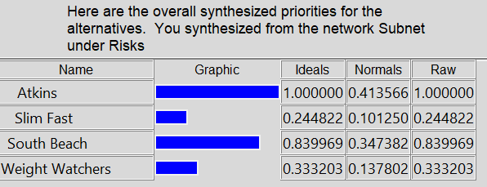
Results under BOCR

Slide 15
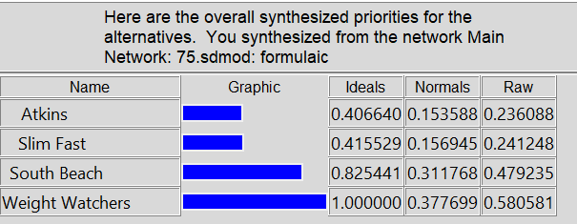
Overall Results

