Slide 1
Brett Dugan
April 20, 2016

Slide 2
Goal
To Determine which degree(s) to pursue
MBA
MBA/MSMSE
Quit!

Slide 3
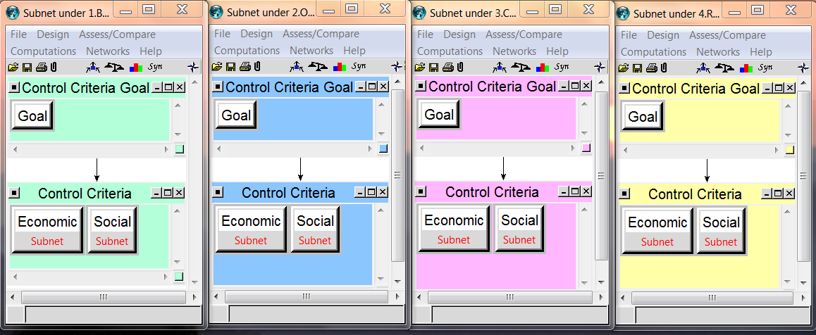
BOCR MODEL
Economic
Social

Slide 4


Benefits
Predominant focus
Long term Earnings
Short term Free time

Slide 5
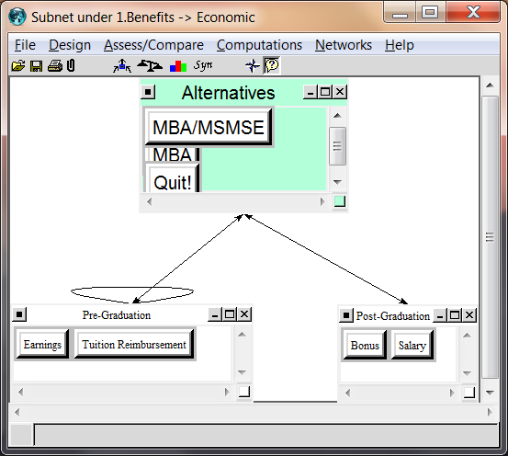
Benefits: Economic

Slide 6
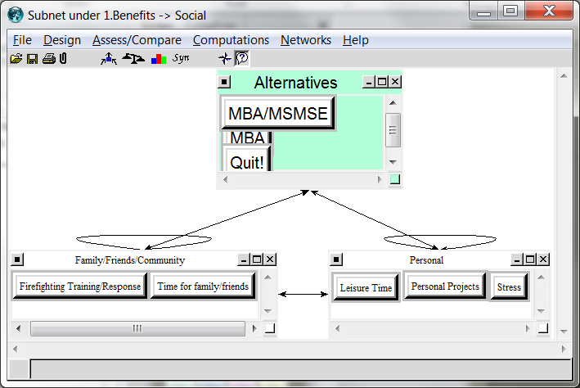
Benefits: Social

Slide 7
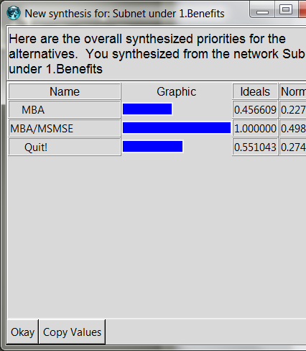
Benefits Synthesis

Slide 8

Opportunities
Predominate Focus
Personal Accomplishment
Future Job Opportunity Probability

Slide 9
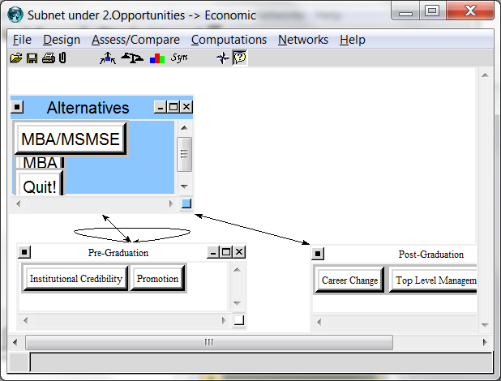
Opportunities: Economic

Slide 10
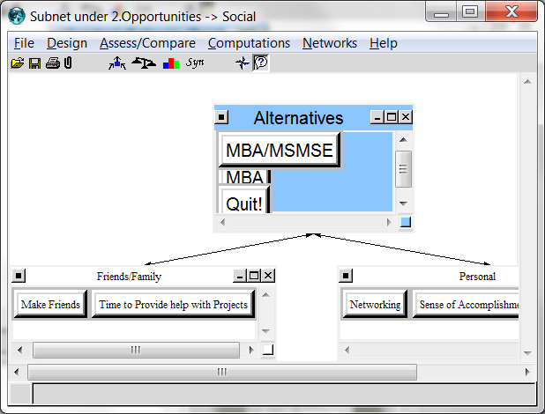
Opportunities: Social

Slide 11
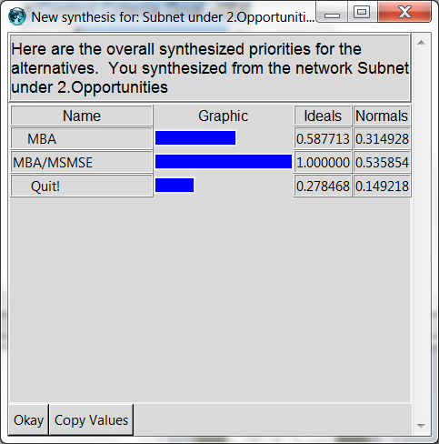
Opportunities: Synthesis

Slide 12
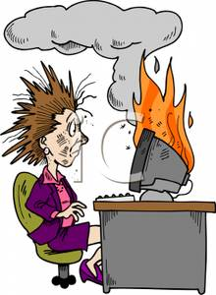
Costs
Predominant Focus
Time (or lack thereof)
Opportunity costs

Slide 13
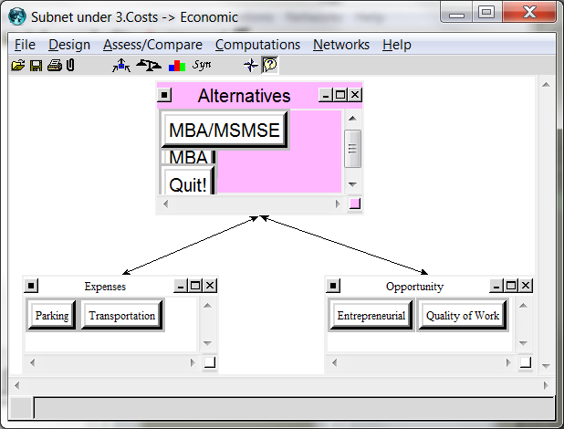
Costs: Economic

Slide 14
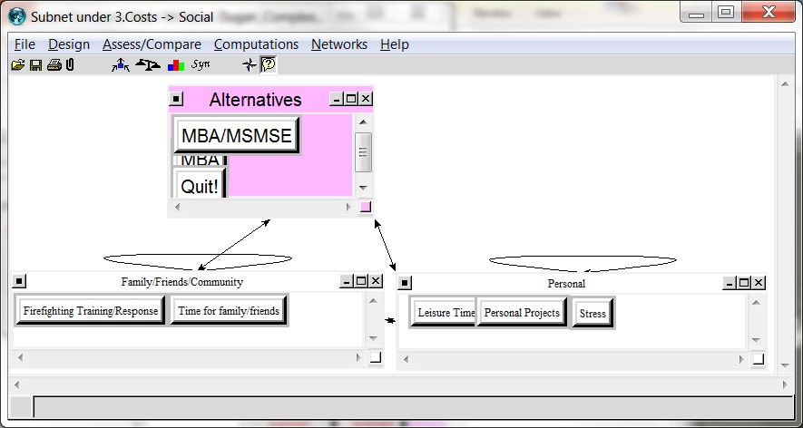
Costs: Social

Slide 15
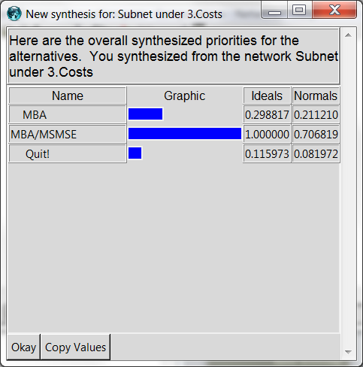
Costs: Synthesis

Slide 16

Risks
Predominant Focus
Forfeit tuition reimbursement
Missed professional opportunity due to extended contractual commitment to current company

Slide 17
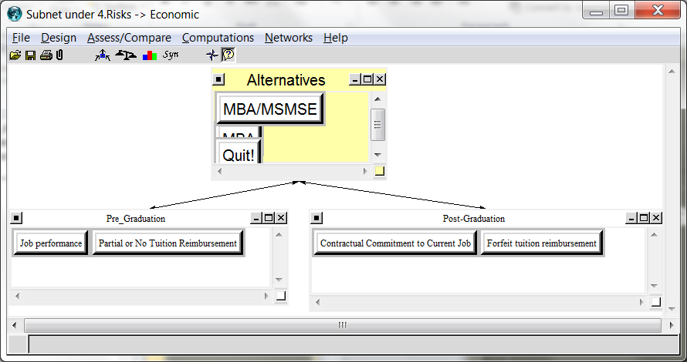
Risks: Economic

Slide 18
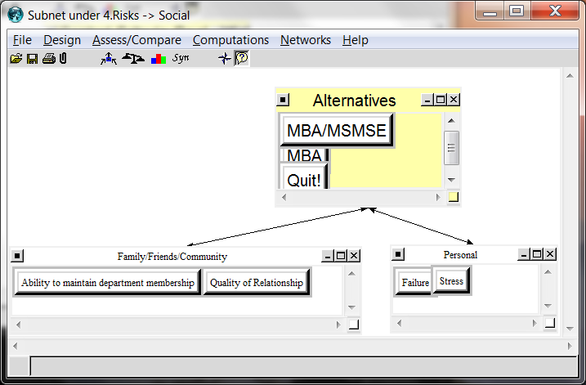
Risks: Social

Slide 19
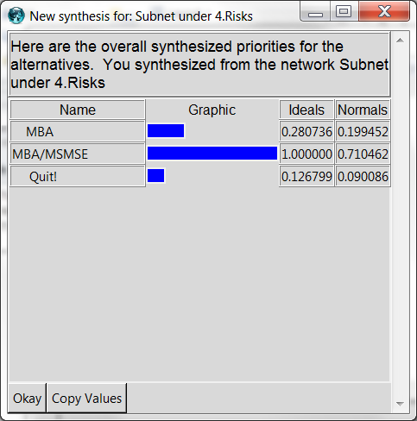
Risks: Synthesis

Slide 20
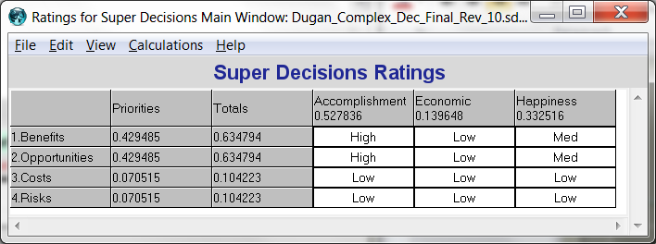
Ratings

Slide 21
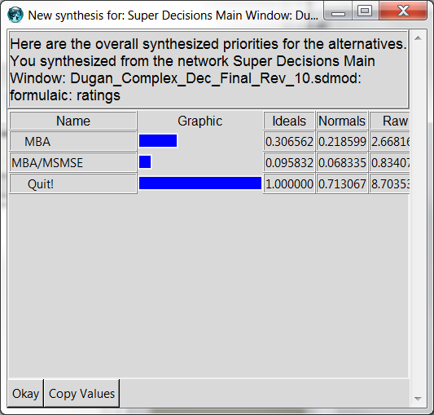
Multiplicative Synthesis

Slide 22
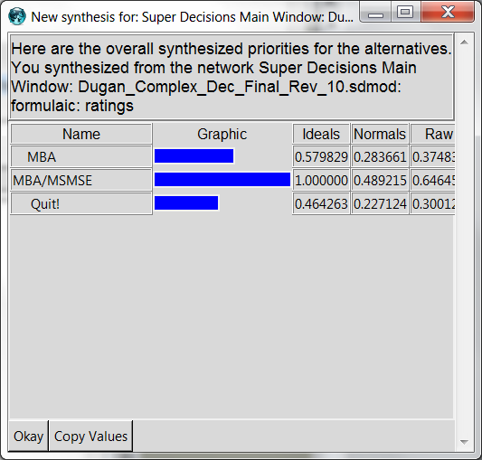
Additive Synthesis

Slide 23
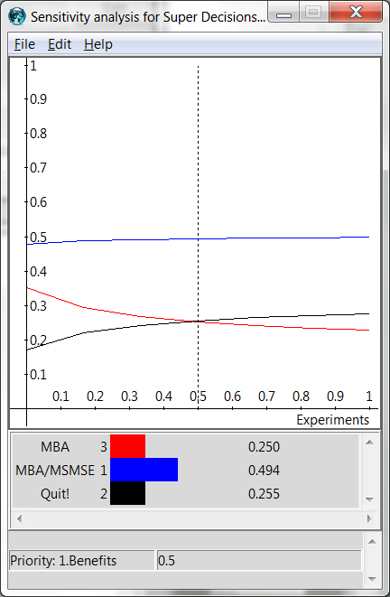
Benefits Sensitivity
MBA/MSMSE always highest benefits
Tradeoff between MBA and Quit! Occurs at the .5 rating

Slide 24
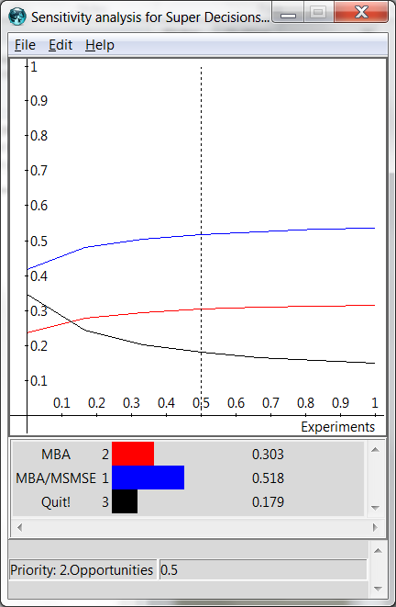
Opportunities Sensitivity
MBA/MSMSE always highest opportunities
Tradeoff between quit and MBA at .`5 rating

Slide 25
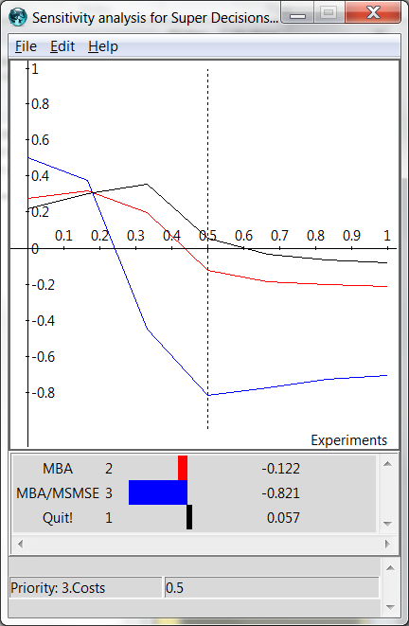
Costs Sensitivity
Critical intersection point at .17 rating

Slide 26
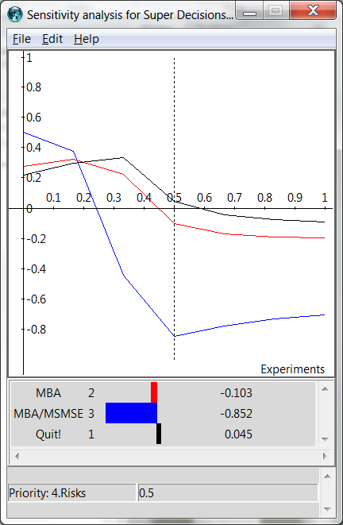
Risks Sensitivity
Similar to costs with slightly higher negative slope for alternatives after the critical point of .18

Slide 27
Conclusion
Results were very suprising
“Gut feel”
1. MBA
2. MBA/MSMSE
3. Quit!
I believe discrepancy between gut feel and results can be attributed to abnormally high costs for MBA/MSMSE

