Slide 1
High school Basketball Post-Grad Opportunities
Colin Macon

Slide 2
Background on high school recruits
student athletes still can't get paid for their participation (or performance) in a sport, because they have to be treated similarly to non-athlete students.
allowed to take up to five official visits to college campuses of their choice. The college can pay the travel and lodging expenses associated with these visits
ELITE ATHLETES ARE ALLOWED TO HIRE AN AGENT UNDER CIRCIMSTANCES
Stipend and travel money is currently the only payment to college athletes outside scholarships
Efforts have been made to potentially allow Athletes to get paid

Slide 3
goal
The GOAL is to find the best alternative for someone who is a highly rated basketball prospect out of high school
The model is being analyzed from the perspective of a top ranked high school athlete who’s main objective is to:
  Get drafted as highly as possible
  Be paid for their time/likeness

Slide 4
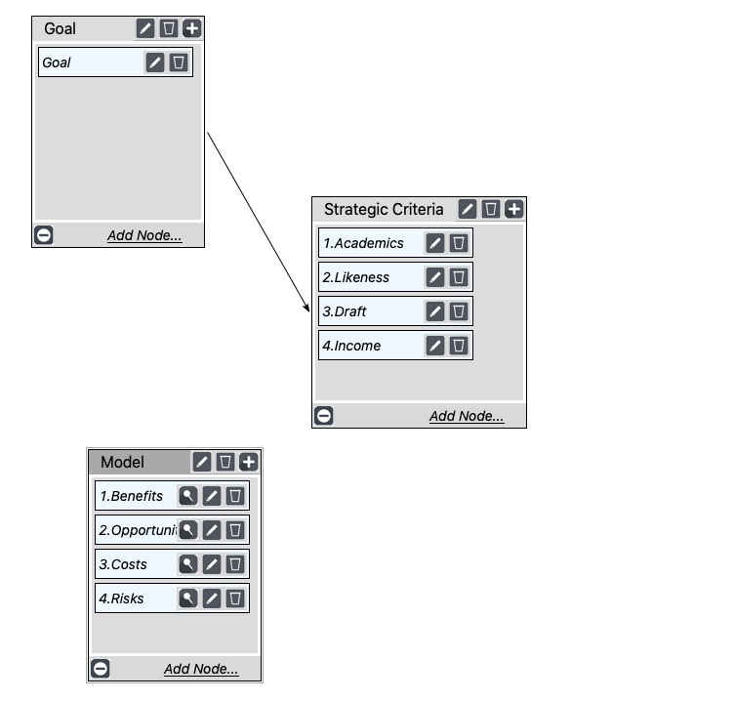
What does our model look like?

Slide 5
Alternatives
Top Tier School
NBA G-League
Overseas Professional League

Slide 6
benefits
Power over own future
choice of education like others
More choices than just colleges & universities

Slide 7
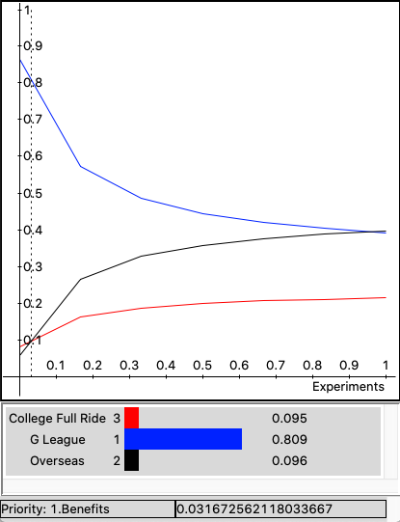
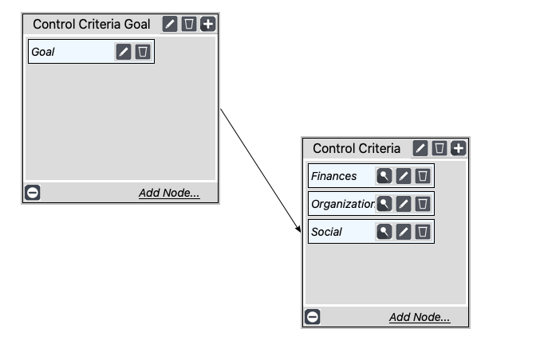
Benefits SUB & Sensitivity

Slide 8
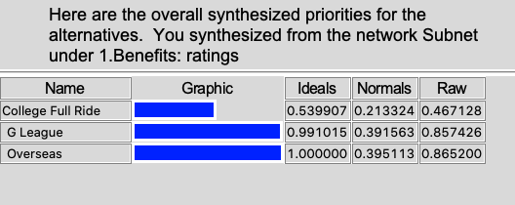
BENEFITS RESULTS

Slide 9
Opportunities
Compensation
Branding
Travel

Slide 10
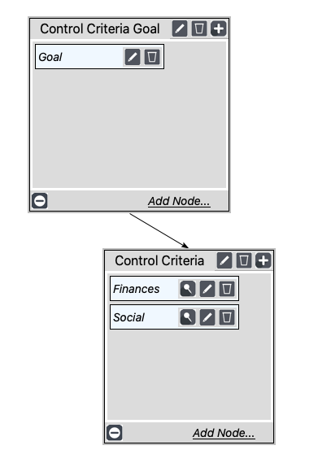
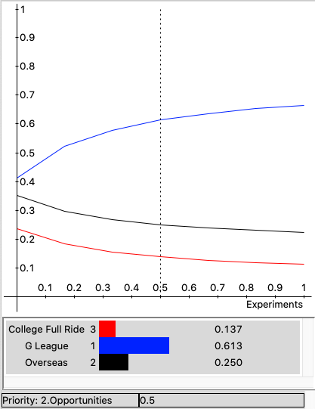
Opportunities SUB & Sensitivity

Slide 11
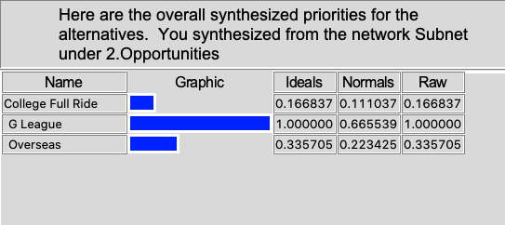
Opportunities RESULTS

Slide 12
COSTS
Living expenses
League Dues/Fees
Other costs (books, going out, etc..)

Slide 13
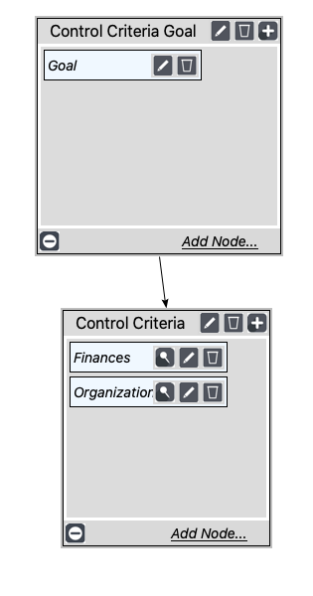
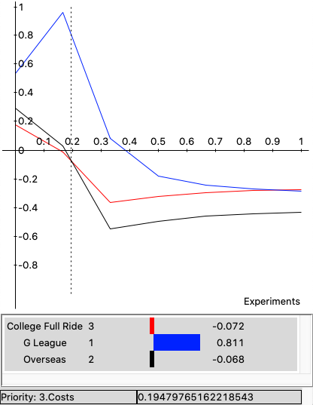
COSTS SUB & Sensitivity

Slide 14
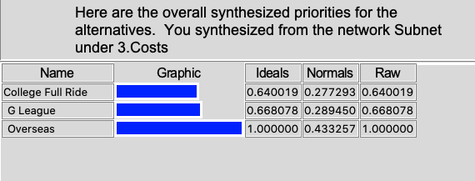
COSTS RESULTS

Slide 15
RISKS
Financial risks
Persona with team
Likeness
Media Coverage
Draft stock

Slide 16
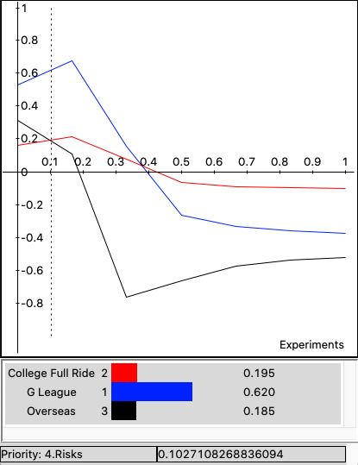
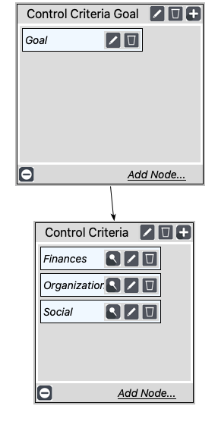
RISKS SUB & Sensitivity

Slide 17
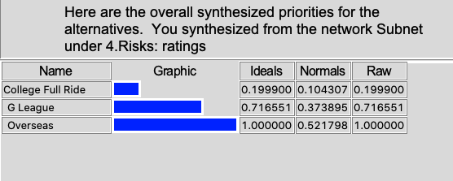
RISKS RESULTS

Slide 18
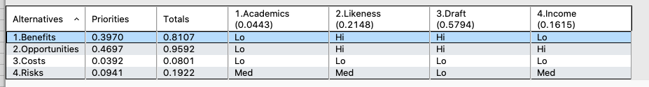
Strategic Criteria
Academics
Likeness
Draft
Income

Slide 19
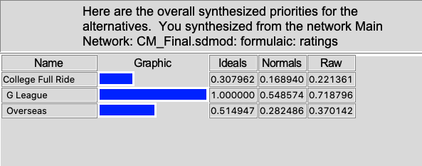
Overall Decision - additive

Slide 20
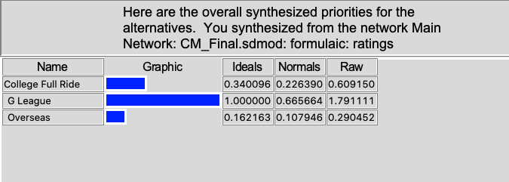
Overall decision - multiplicative

Slide 21
conclusion
G League is the best option for high level recruits coming out of high school with the goal of going to the NBA in mind
INFLUENTIAL FACTORS:
  Overall decision showed a clear separation
  Draft position is the most important for us
  Highest chance of opportunities in the g-League

Slide 22
References
Ravenelle, Anna. “NCAA Votes to Allow Paid Athlete Endorsements - What This Means.” CollegeVine, 25 Mar. 2020, blog.collegevine.com/ncaa-votes-to-allow-paid-athlete-endorsements/.
Teel, David. “Cost-of-Attendance Allowances for ACC Athletes Vary Widely.” Dailypress.com, Daily Press, 13 Aug. 2019, www.dailypress.com/sports/columns/david-teel/dp-teel-time-acc-cost-of-attendance-post.html.
“Meet Jalen Green, Isaiah Todd, Daishen Nix & Kai Sotto: The Newest NBA G League Prospects & Coach.” NBA G League, 10 June 2020, gleague.nba.com/news/meet-new-nba-g-league-prospects-and-coach/.
O'Donnell, Ricky. “How Elite High Schoolers Are Skipping College to Get to the NBA.” SBNation.com, SBNation.com, 8 Aug. 2019, www.sbnation.com/college-basketball/2019/8/8/20753788/nba-draft-college-basketball-recruiting-lamelo-ball-rj-hampton.
“The One-and-Done Dilemma: An NCAA Champion Feature.” NCAA.org - The Official Site of the NCAA, www.ncaa.org/static/champion/the-one-and-done-dilemma/.

