Slide 1
ANP BOCR - Choosing a career path
ALTERNATIVES:
Civil Engineering
Operations Management
Management Consulting.

Slide 2
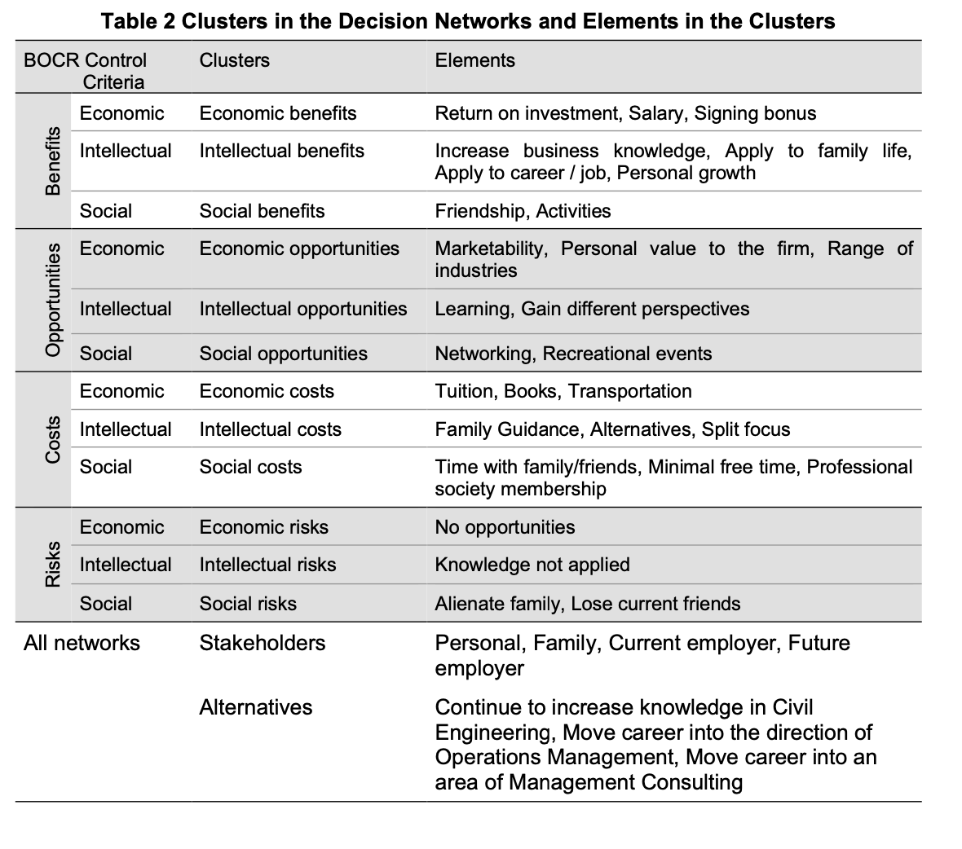
Model – BOCR subnets

Slide 3
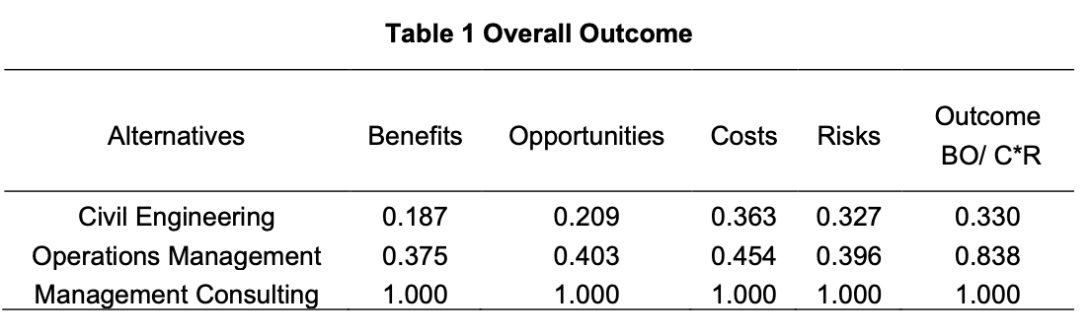
Result

