Slide 1
ANP BOCR - BEST CAREER
ALTERNATIVES:
Consulting
Health (Physician)
Legal (Attorney)
Information technology
Investment banking
Teaching/Research.

Slide 2
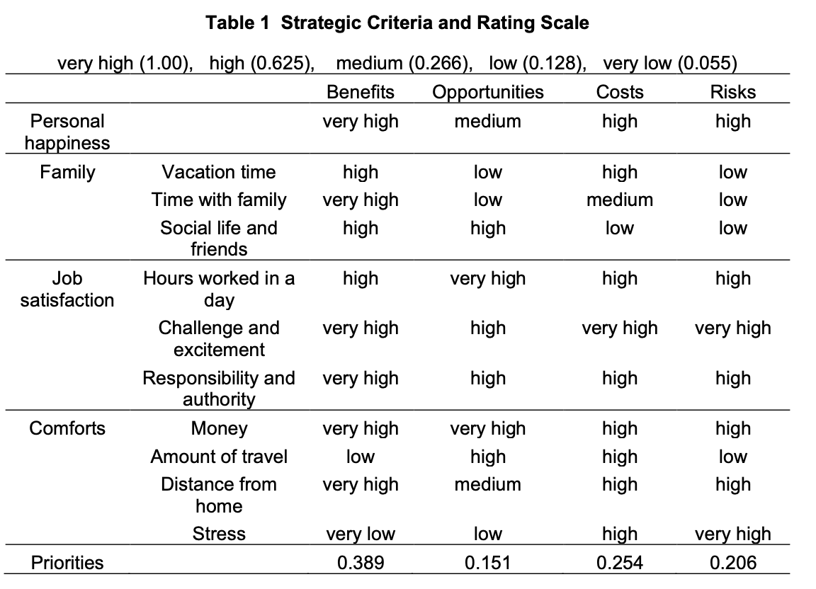
Strategic Criteria

Slide 3
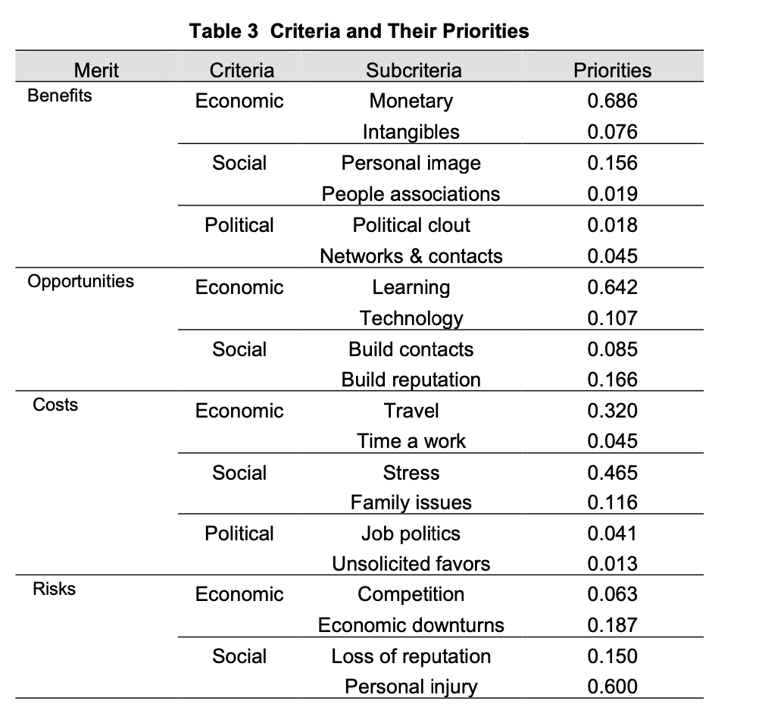
Model – BOCR subnets

Slide 4
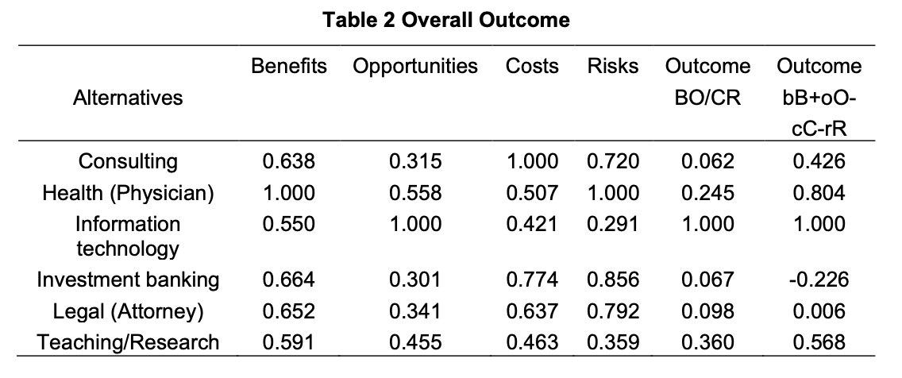
Result

