Slide 1
Car Selection
Goal: Car Selection
Alternatives:
Acura TL
Toyota Camry
Honda Civic

Slide 2
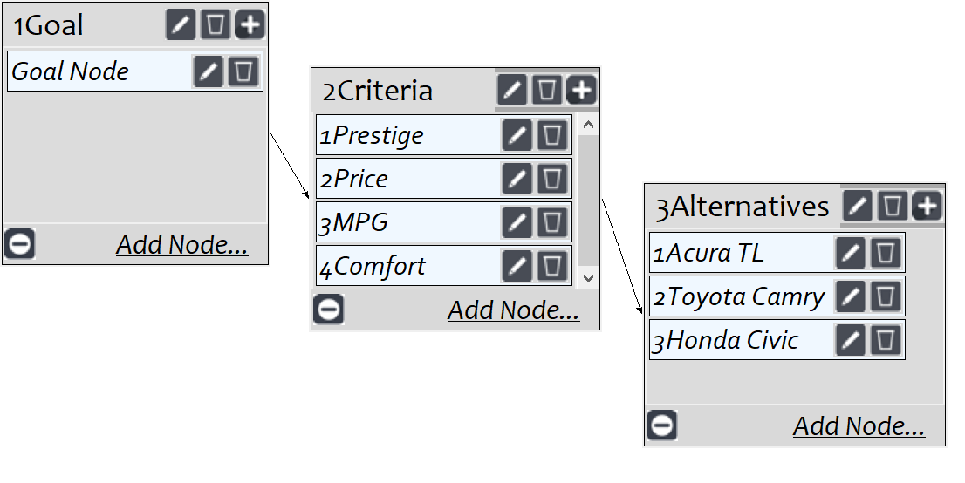
Model
Screenshot of SuperDecisions software Version 3.x

Slide 3
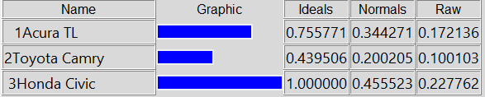
Results

