Slide 1

BOCR Model FOR LEASE RENEWAL OR MOVING SCENARIOS
Courtney M. Kerler

Slide 2
Moving Alternatives
Renew Current Lease
Live in Friendship
Close to Campus, Work at Station Square, buslines, bike friendly area, close grocery stores
Move within same Neighborhood
Expend less effort moving
But requires time to research/view apartments
Move to New Neighborhood
Expends maximum effort moving
Requires research/viewing times, unknown areas, possible traffic congestion

Slide 3
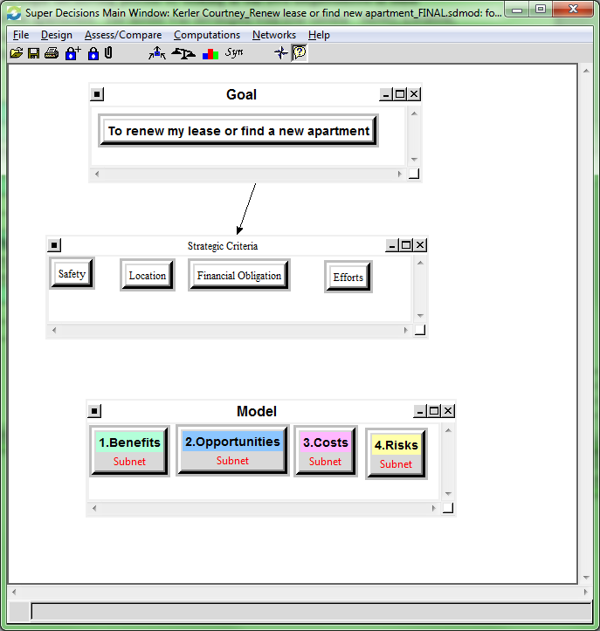
Model Overview
BOCR
Alternatives
Renew Lease
Move within Neighborhood
Move to new Neighborhood
Strategic Control Criteria

Slide 4
BOCR Structure
Benefits | Opportunities | Costs | Risks
Safety | Safety | Financial Obligation | Safety
-Environmental | -Environmental | -Move in Costs | -Environmental
-Internal | -Internal | -Monthly Costs | -Internal (building)
Location | Location | Efforts | Financial Obligation
-Amenities | -Conveniences | -Time Requirements | -Potential Losses
-Position | -Commute |  | -Potential Pain/Suffering
Financial Obligation | Financial Obligation |  | Efforts
-Move In Costs | -Responsibilities |  | -Labor
-Monthly costs | -New costs |  | -Decision Making
Efforts | Efforts
-Time | -Physical
-Effort | -Decision Making

Slide 5
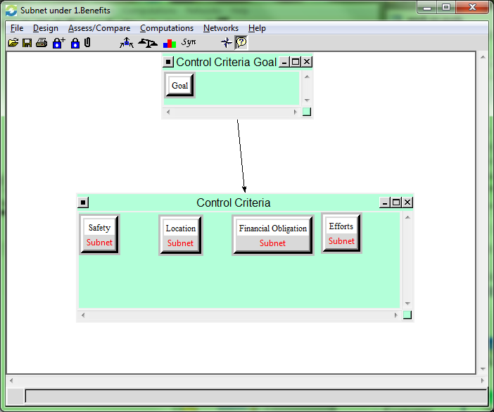
Subnets

Slide 6
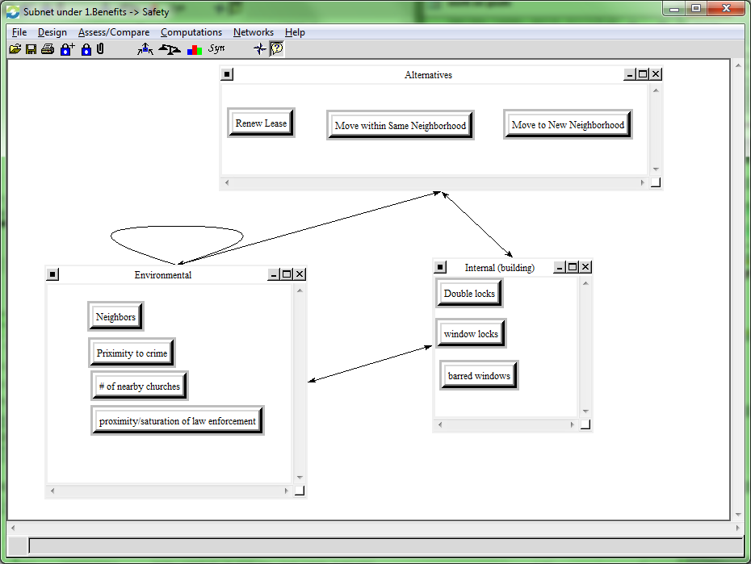
Inter subnet example Benefits->Safety

Slide 7
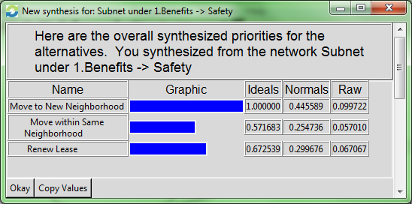
Inter Subnet Example benefits-> Safety-> synthesis

Slide 8
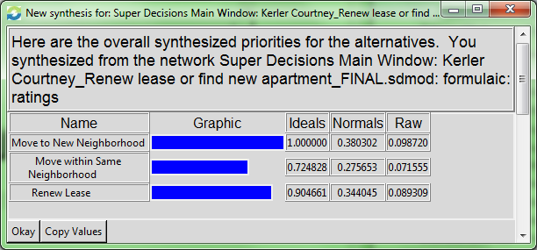
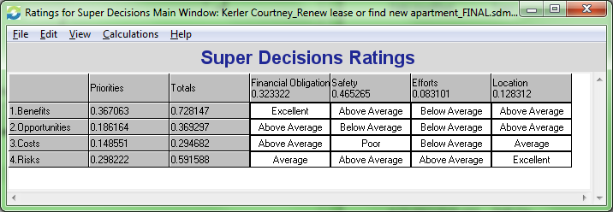
BOCR WHOLE MODEL synthesis

Slide 9
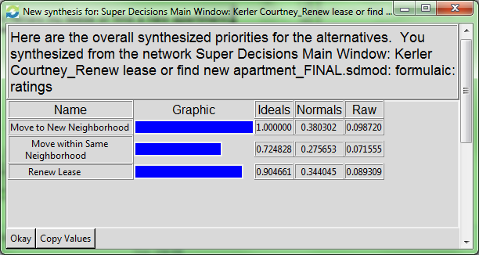
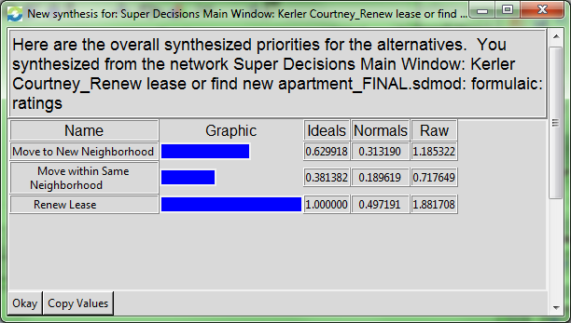
BOCR Ratings
Short Term Long Term
Multiplicative Additive

Slide 10
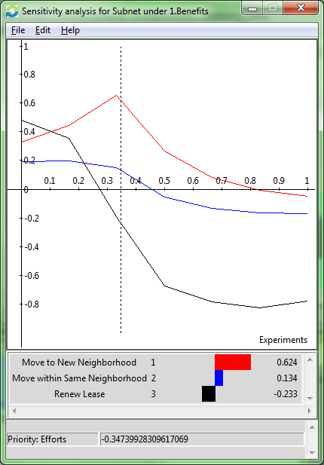
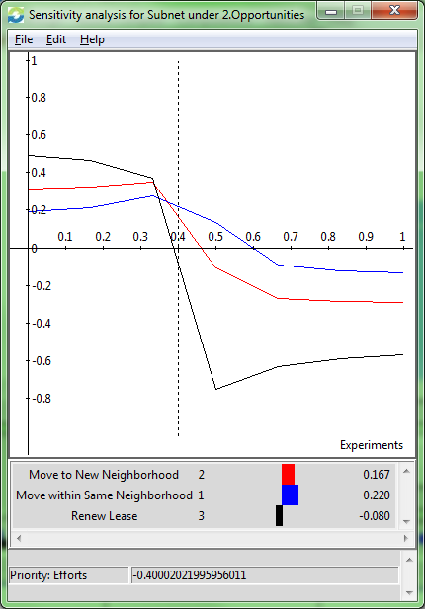
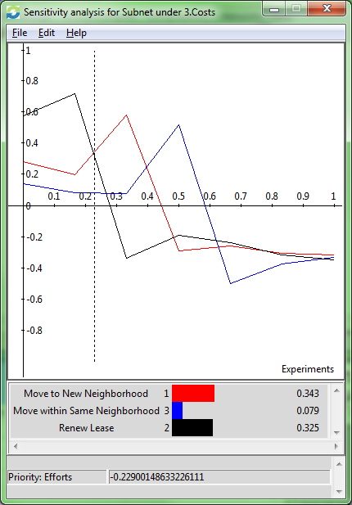
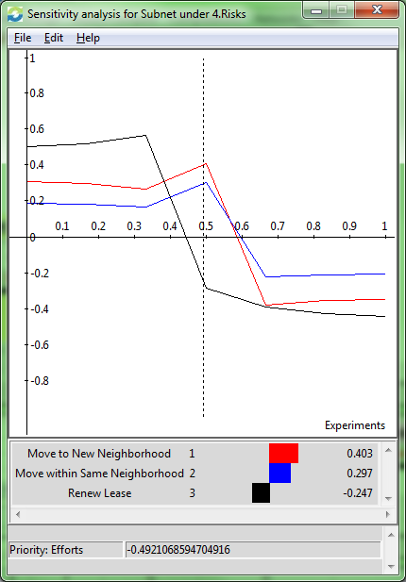
Sensitivity analysis
Benefits Opportunities Costs Risks

Slide 11

Final decision:
Move to New Neighborhood (short term results)

