Slide 1
ANP - Decision-Making in a Complex Environment
Countertop Selection
Alternative Solutions:
Butcherblock
Granite
Soapstone
Quartz

Slide 2
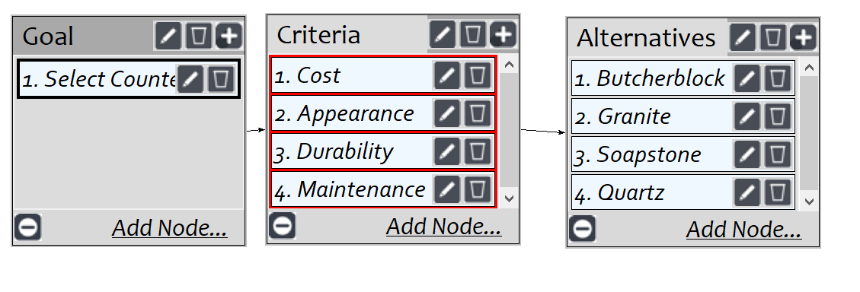
Model

Slide 3
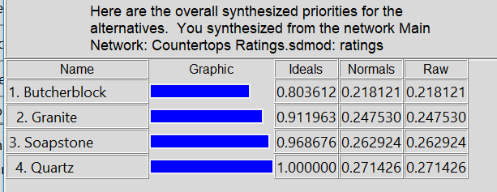
Result

