Slide 1
ANP - Decision-Making in a Complex Environment
Hotel selection in New York City
Alternative Solutions:
  Lex Hotel NYC
  Park South Hotel
  The New York EDITION

Slide 2
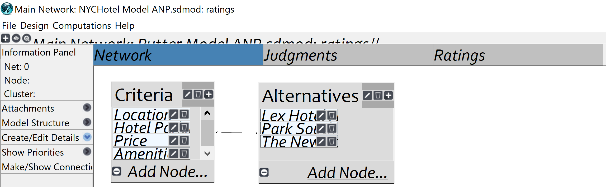
Model

Slide 3
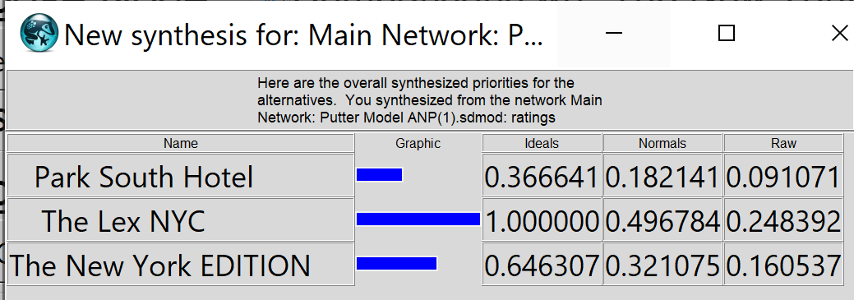
Result

