Slide 1
Apartment Selection
Goal: Rent Apartment
Alternatives:
North Hills
Squirrel Hill
Southside

Slide 2
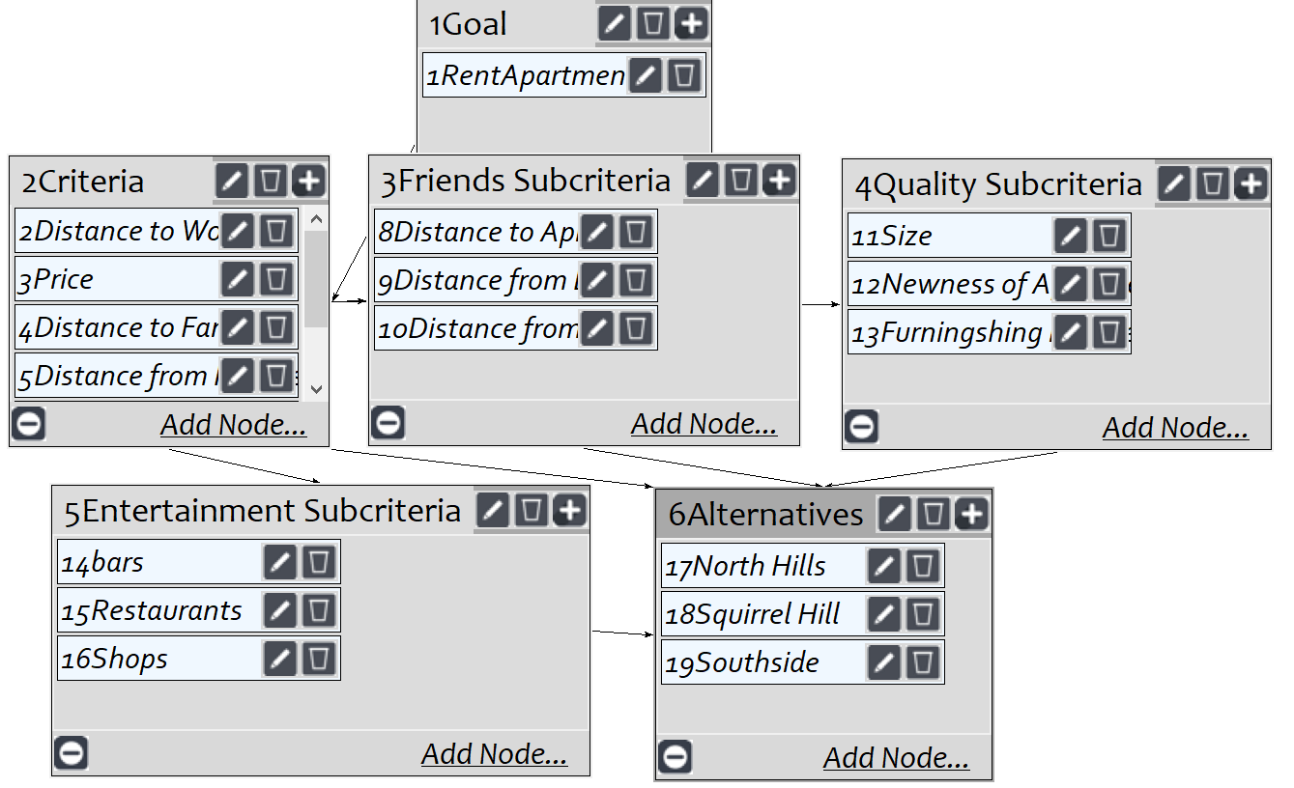
Model
Screenshot from SuperDecisions Version 3.x

Slide 3
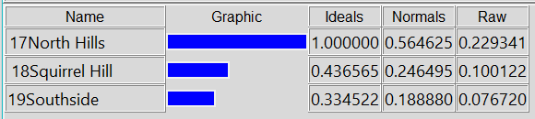
Synthesized Results

