Slide 1
ANP - Decision-Making in a Complex Environment
Grocery Store Selection
Alternative Solutions
  Trader Joe’s
  Target
  Whole Foods
  Aldi
  Giant Eagle

Slide 2
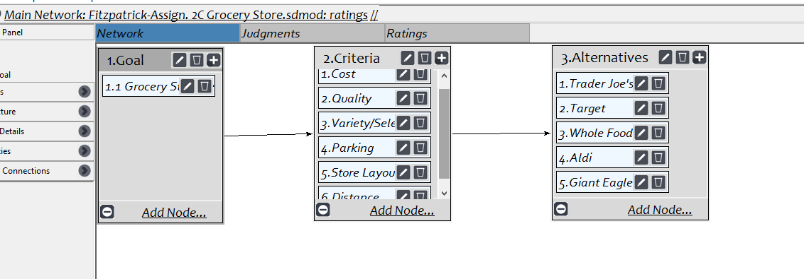
Model

Slide 3
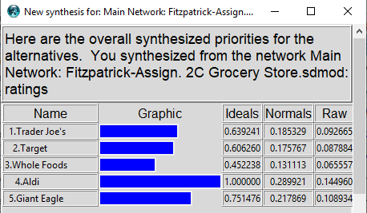
Result

