Slide 1
AHP – Ratings model
Where to live in Pittsburgh?

Slide 2
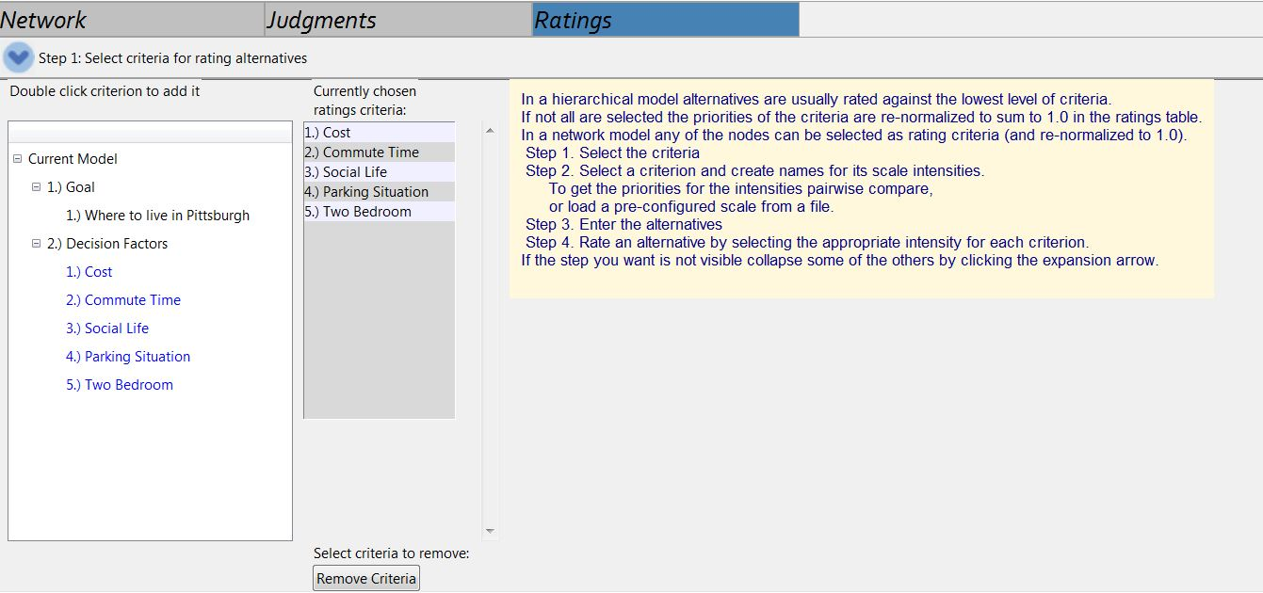

Slide 3
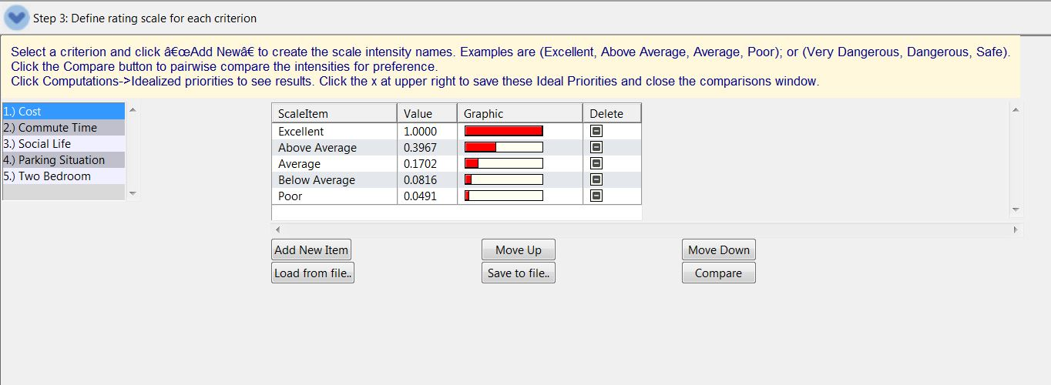

Slide 4
