Slide 1
AHP ratings – Going on Vacation?
Goal: where to go on vacation?
ALTERNATIVES:
  Ocean City
  The Caribbean
  Overseas to Europe

Slide 2
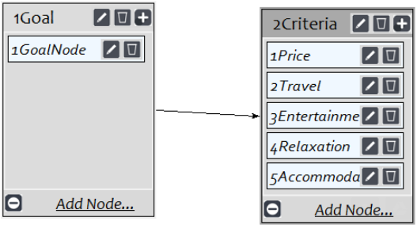
MODEL

Slide 3
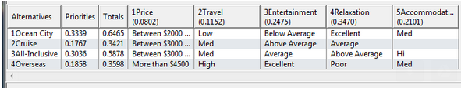
Ratings

Slide 4
Results
Normal: | AHP | Ratings | ANP | Variation:
Ocean City | 0.33922 | 0.333906 | 0.320585 | 0.018635
Cruise | 0.164521 | 0.176668 | 0.168392 | 0.012147
All-Inclusive | 0.287645 | 0.303585 | 0.269735 | 0.03385
Overseas | 0.208613 | 0.18584 | 0.241288 | 0.055448

