Slide 1
AHP ratings – Select the best countertop material
Goal: to select the best countertop material
ALTERNATIVES:
Butcherblock
Granite
Soapstone
Quartz

Slide 2
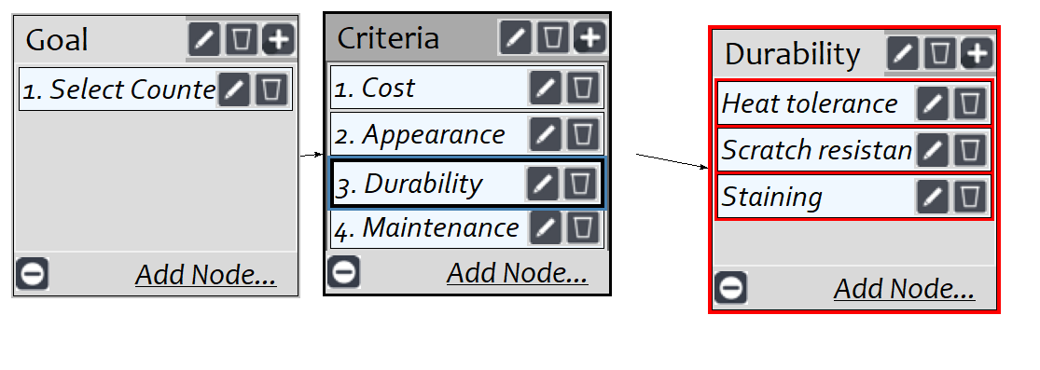
MODEL

Slide 3
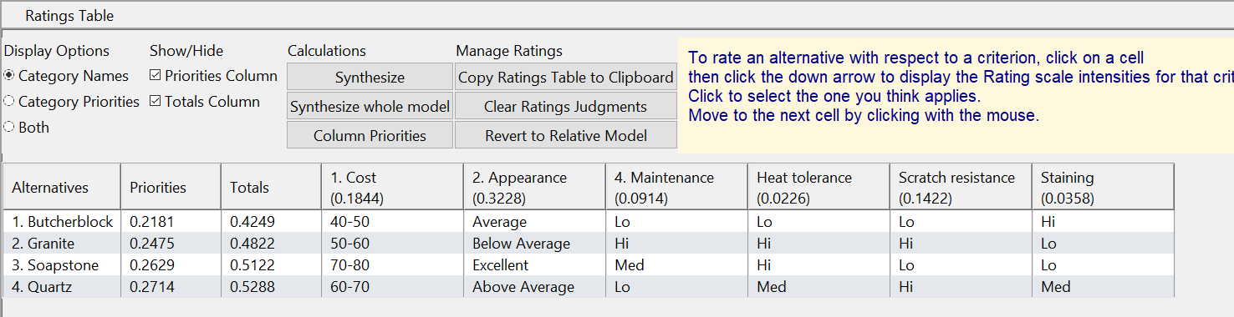
Ratings

Slide 4
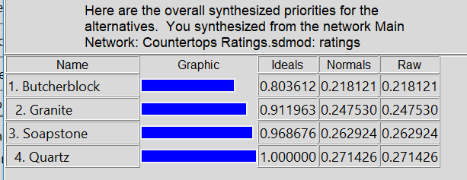
Results

