Slide 1
AHP ratings - Graduate School Selection
ALTERNATIVES:
Clemson University:
Georgia Southern University:
Radford University:
University of Pittsburgh:

Slide 2
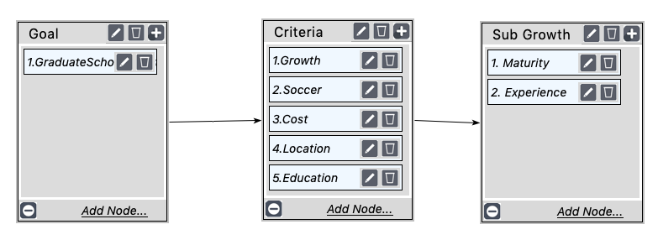
MODEL

Slide 3
Ratings

Slide 4
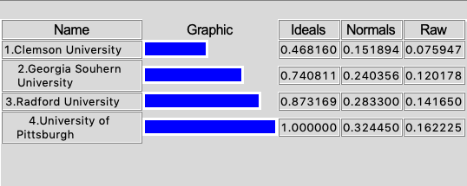
Results

