Slide 1
AHP - ratings - Vocation
Goal: choose a preferred vocation destination
Alternatives:
Europe
Caribbean Cruise
Australia

Slide 2
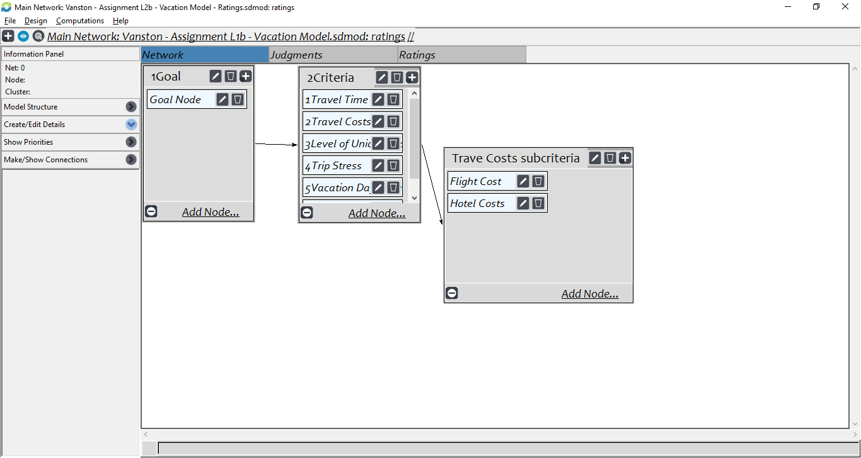
Model

Slide 3
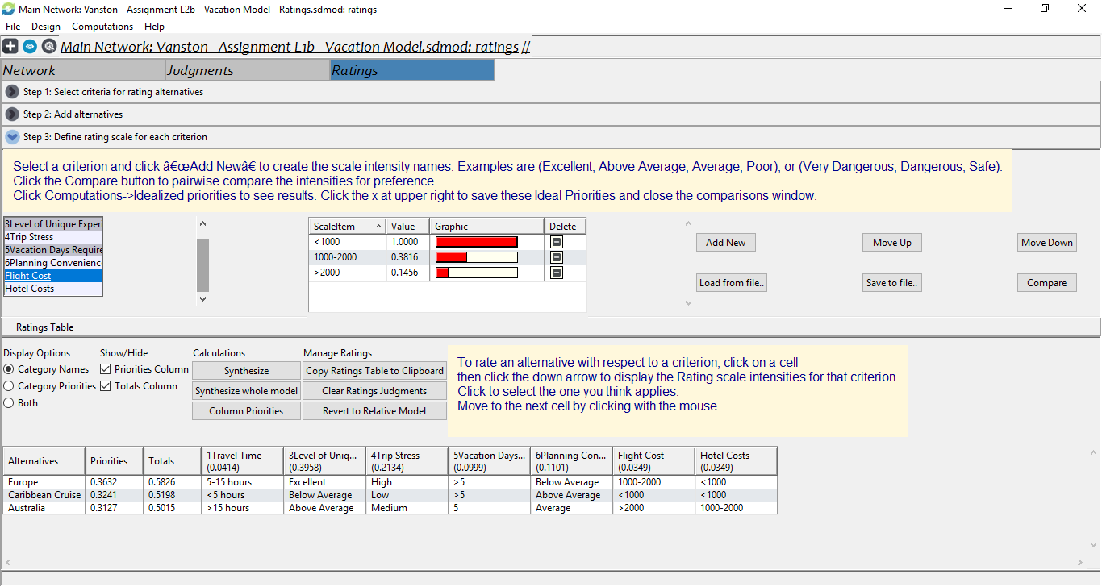
Ratings

Slide 4
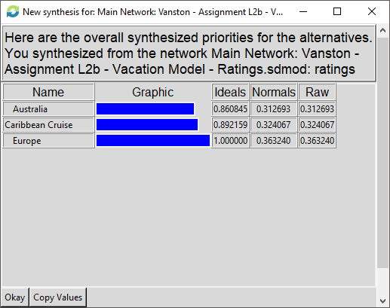
Results

