Slide 1
AHP - ratings - Place to see the Northern Lights
Goal: which place will provide me the best experience to see the Northern Lights
Alternatives:
Alaska
Canada
Greenland
Norway
Russia

Slide 2
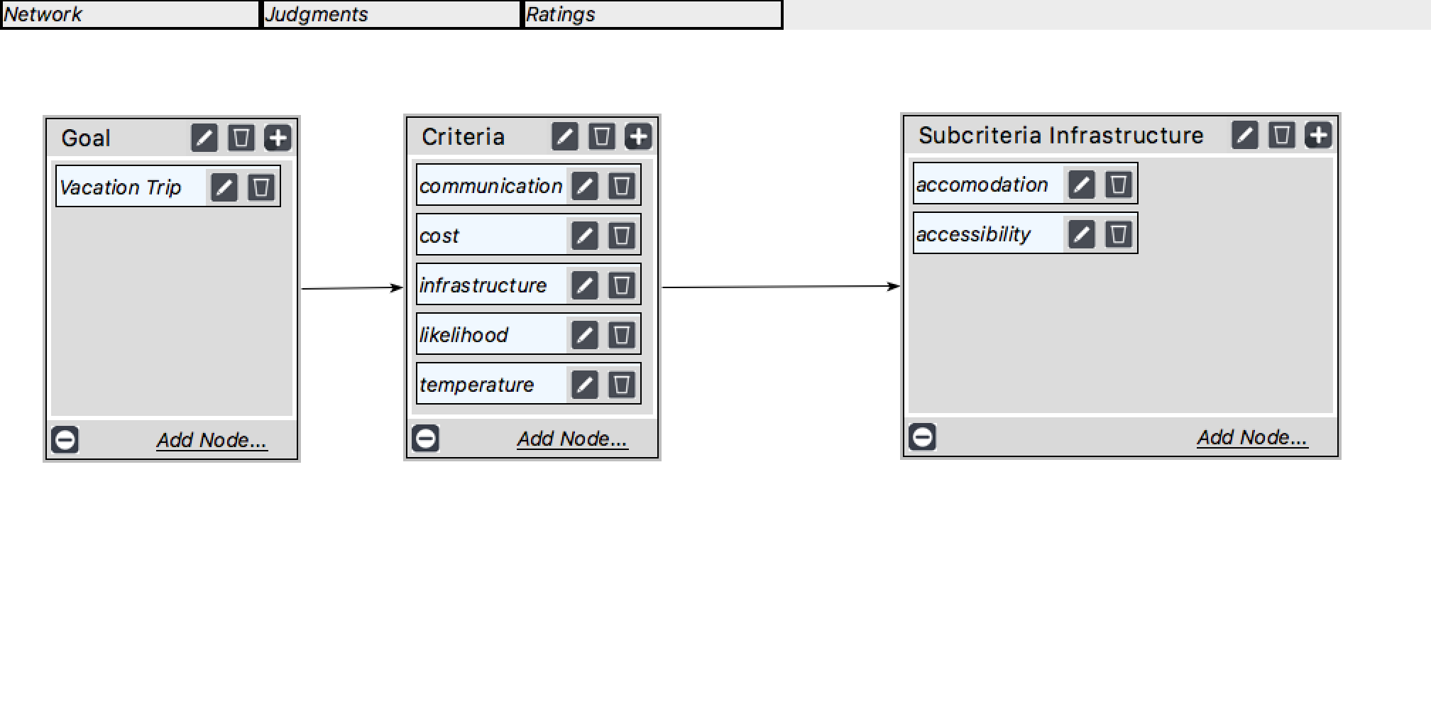
Model

Slide 3
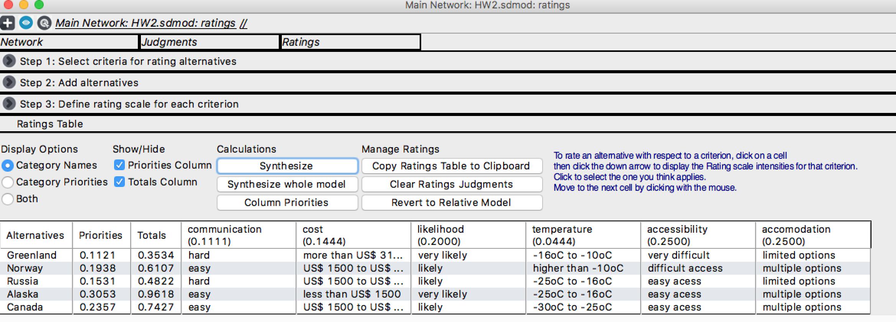
Ratings

Slide 4
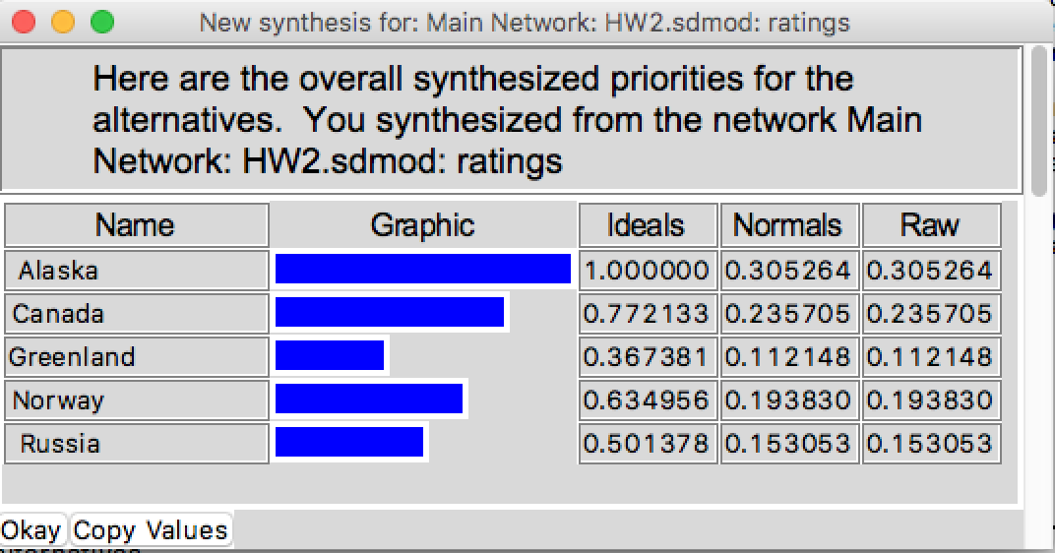
Results

