Slide 1
Wedding venue selection
Goal: to pick the venue for wedding reception.
Alternatives:
  Resort
  Studio
  Hotel

Slide 2
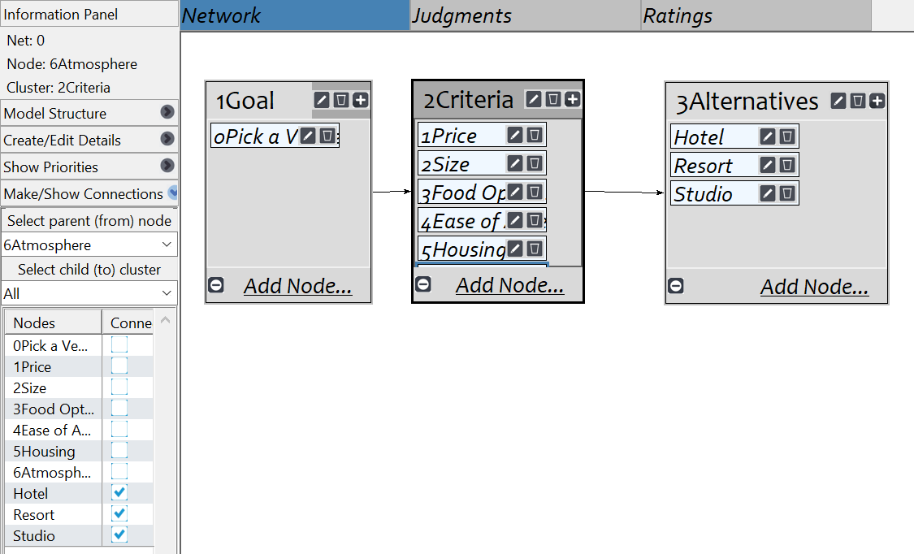
Model

Slide 3
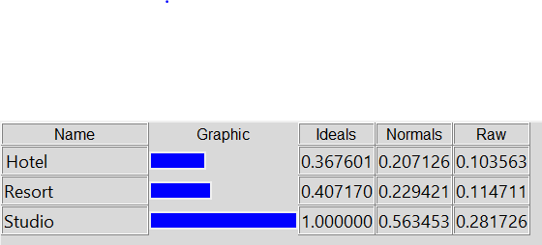
Results

