Slide 1
Labor Day weekend vocation selection
Goal: choose a preferred alternative for 5-night Labor Day weekend girls’ vacation.
Alternatives:
  SLS Baha Mar, Nassau, Bahamas
  Aruba Marriott Resort & Stellaris Casino
  Ocean Club, Turks & Caicos

Slide 2
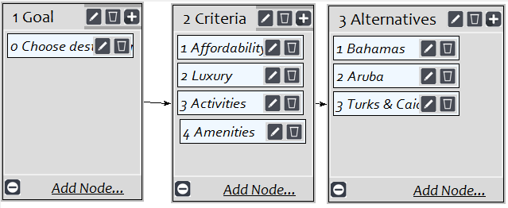
Model

Slide 3
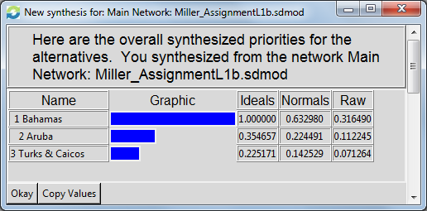
Results

