Slide 1
Best transportation mode for traveling in New Zealand
Goal: find the best transportation mode for traveling in New Zealand
Alternatives:
rent a car
Rent a RV/Camper
travel by bus

Slide 2
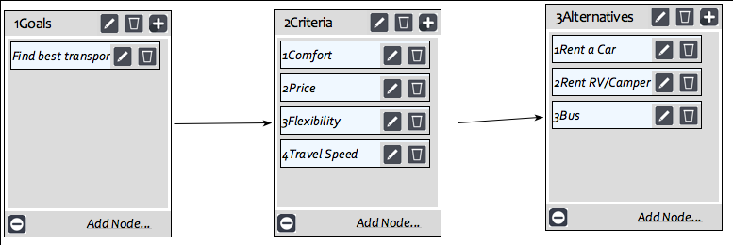
Model

Slide 3
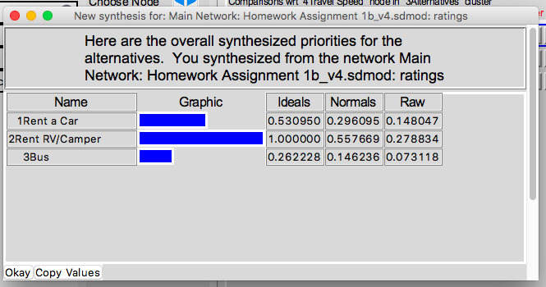
Results

