Slide 1
Schooling
Christian Miedel
Decision Making in a Complex Environment.

Slide 2
Disclaimer
This was not undertaken to prove a point, to assert an opinion or to validate one argument or another. This “problem” is for discussion and exploration only. Any views stated or inferences made are not in an attempt to validate any particular view.

Slide 3
The Goal
Determine successes and pitfalls and overall general best option for determining the appropriate schooling form for a child:
Home Schooling
Public Schooling
Private Schooling

Slide 4
Criteria and Highlights
Schools play a large part in children’s lives
Future Prospects
Personal Impacts
Social Impacts
Schools also greatly impact parents
Financial Impact

Slide 5
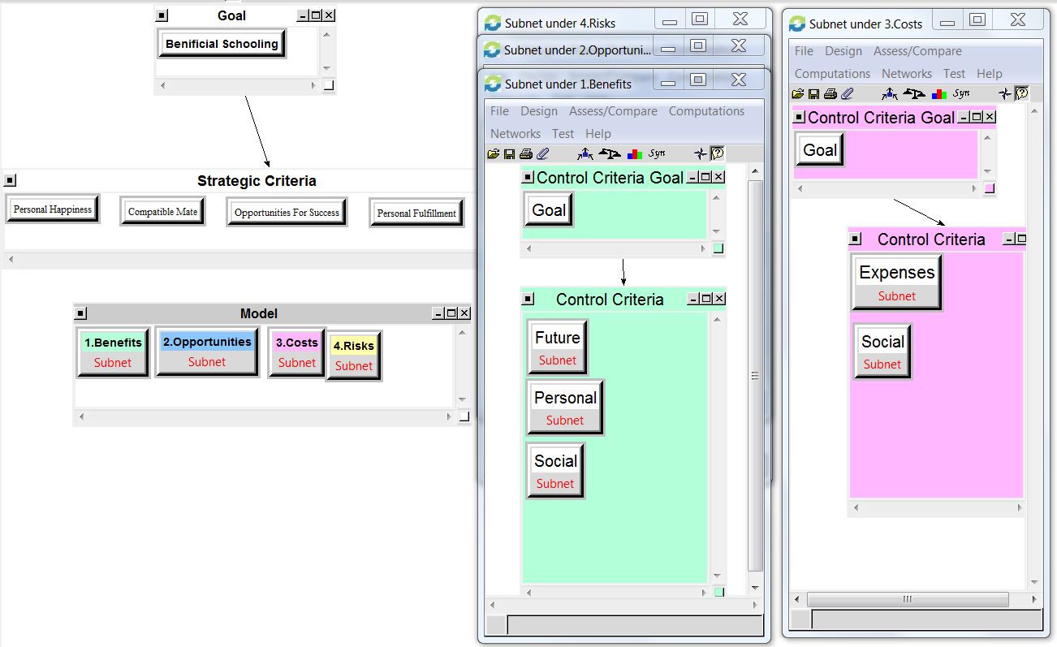
The Model
Notes:
Risks, Benefits and Opportunities shared similar control Criteria. Costs alone included Expenses.

Slide 6

Clusters
Future
Jobs and Colleges
Personal
Knowledge
Skills
Social
Fun
Aptitude
Friendships
Expenses
Time
Costs
*Risks are slightly different

Slide 7
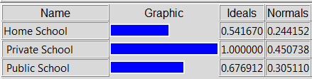
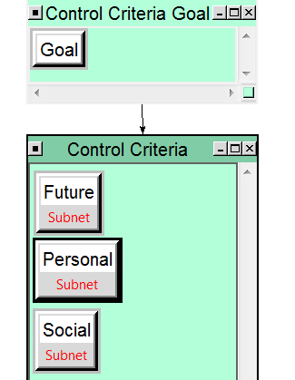
Benefits
Important Takeaways
Homeschooling was not the lowest in all three categories, only Social

Slide 8
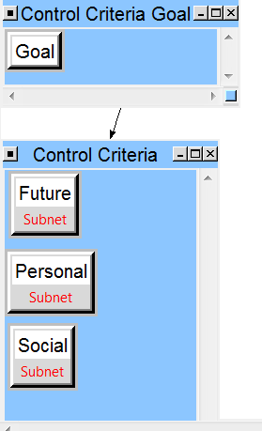
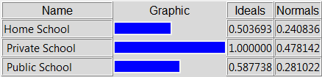
Opportunities
Take Aways
Again, homeschooling was NOT the lowest in all three criteria. I will speak more to this in the Important Results slide.

Slide 9
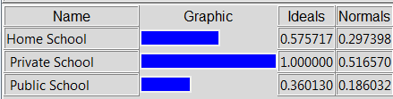
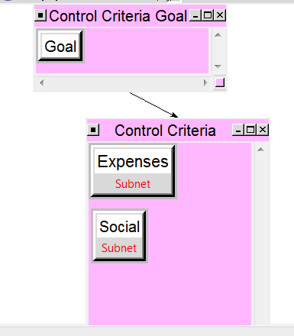
Costs
As would be expected, the greatest costs come from tuition
Home schooling has some expenses in teaching equipment, books etc.
Social costs are higher with home schooling

Slide 10
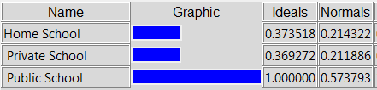
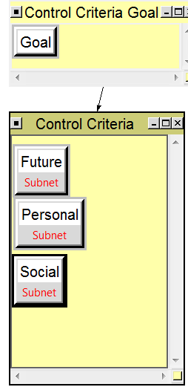
Risks
Risks had modified clusters
Nodes changed to fit “risk” scenarios
Colleges and jobs were now classified in terms of negativity
Friendships changed to dangerous and detrimental friendships
Results showed consistency with expectations

Slide 11
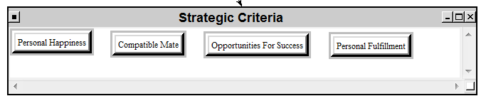
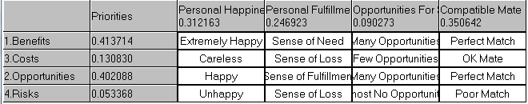
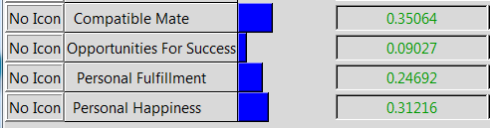
Strategic Criteria and Ratings

Slide 12
Ratings Question Example
For example, taking the benefits given from each criterion, what is the extent to which a person would find themselves happy? Well, a person who has the knowledge that they desire and adequate skills to pursue their wants would be extremely happy. However, with this knowledge, there would be a need for fulfillment, not necessary complete fulfillment. Also, they would have opportunities for success that would be abounding and would have great chances to meet a compatible mate because they would have understanding of whom they would most desire.

Slide 13
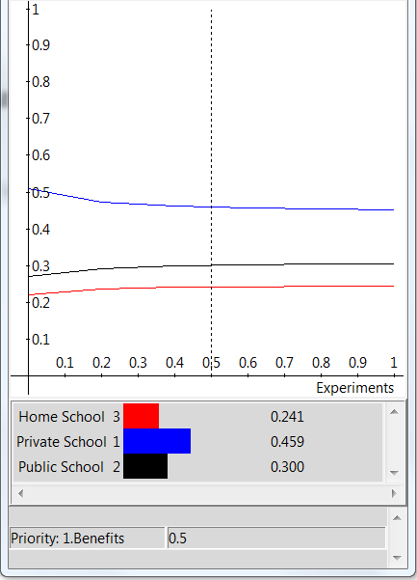
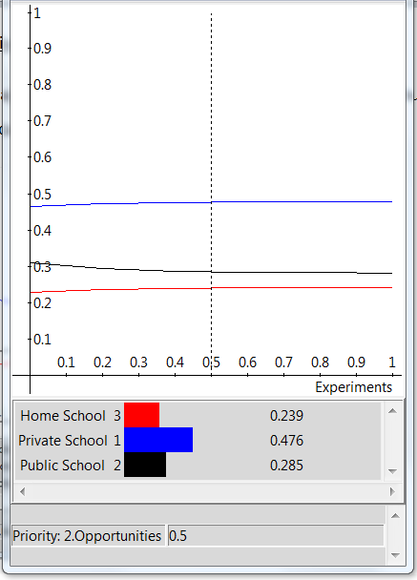
Sensitivity
Benefits/Opportunities
Not a large amount of extremely useful information

Slide 14
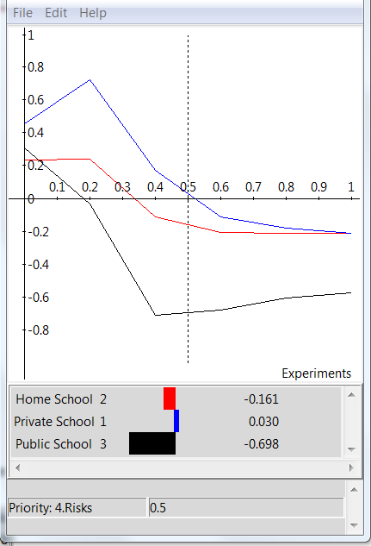
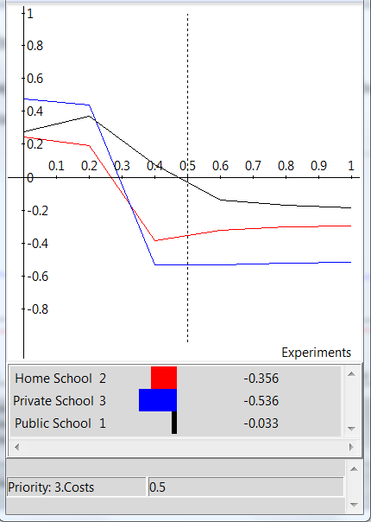
Sensitivity Cont.
Risks/Costs
Note: Very little priority on risk and cost drastically affect the model’s outcome

Slide 15
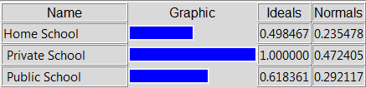
Overall Results
Problem Solved!
…not really.

Slide 16
Important Results
Home Schooling Weaknesses
Social-Lower in General
Requires substantial parent effort
Recognition of weaknesses
Public School Weaknesses
Lower in general in Personal and Future
Potentially Dangerous
Private Schools Weaknesses
Expensive
Model under the assumption that parents researched and that a school was available

Slide 17
Important Results Cont.
Homeschooling Strengths:
Direct involvement can target strengths and weakness more directly
Students have more input on what they desire to know
Parents can more accurately track progress
Colleges and other universities are recognizing the benefits of homeschooling
Public Schooling Strengths
Good Social options
More extracurricular activities easily available
True interaction with all types of peers
Cheap and available knowledge
Private Schooling Strengths
Parents can research options
More availability for experts in specific subjects
Potential for a better “College” understanding

Slide 18
Model Understanding
Benefits of the model:
Parents can tweak the model for their specific situations to weigh the options personally
Because of the strategic criteria weights, results can change DRASTICALLY
Each parent can choose their own strategic criteria or weight them to their own beliefs or desires
Weaknesses of the model:
Necessary assumptions

Slide 19
Final Thoughts
Parents need to recognize strengths and weaknesses of all options.
Encourage Strengths
Attack Weaknesses

Slide 20
Questions?

