Slide 1
Vacation Selection with ratings
Goal: Vacation Selection
Alternatives:
Orlando
San Francisco
New York

Slide 2
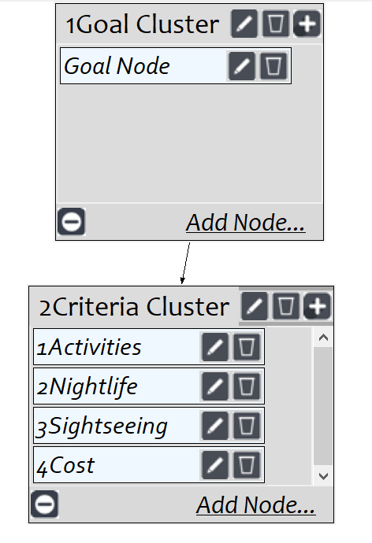
Model
Screenshot of SuperDecisions software Version 3.x

Slide 3
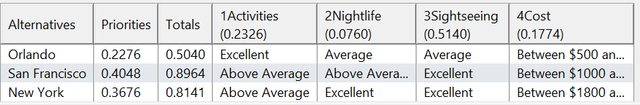
Ratings
Screenshot of SuperDecisions software Version 3.x

Slide 4
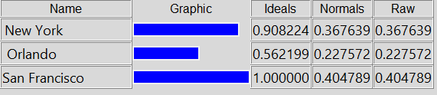
Results

