Slide 1
House selection
Goal: House selection
Alternatives:
House A
House B
House C

Slide 2
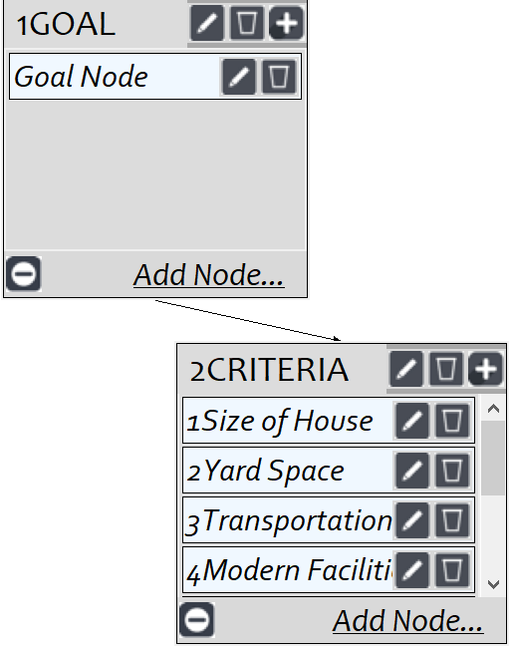
Model
Screenshot of SuperDecisions software Version 3.x

Slide 3
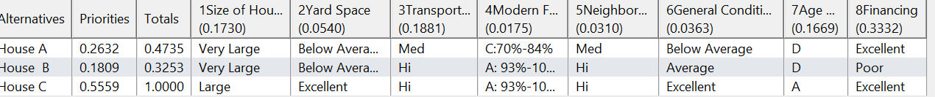
Ratings
Screenshot of SuperDecisions software Version 3.x

Slide 4
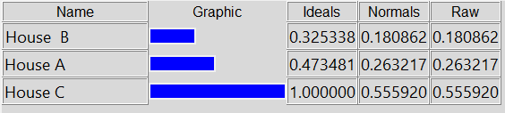
Results

