Slide 1
Choose the best Web Browser
Choose the best web browser from :
Chrome
Firefox
Internet Explorer
Safari

Slide 2
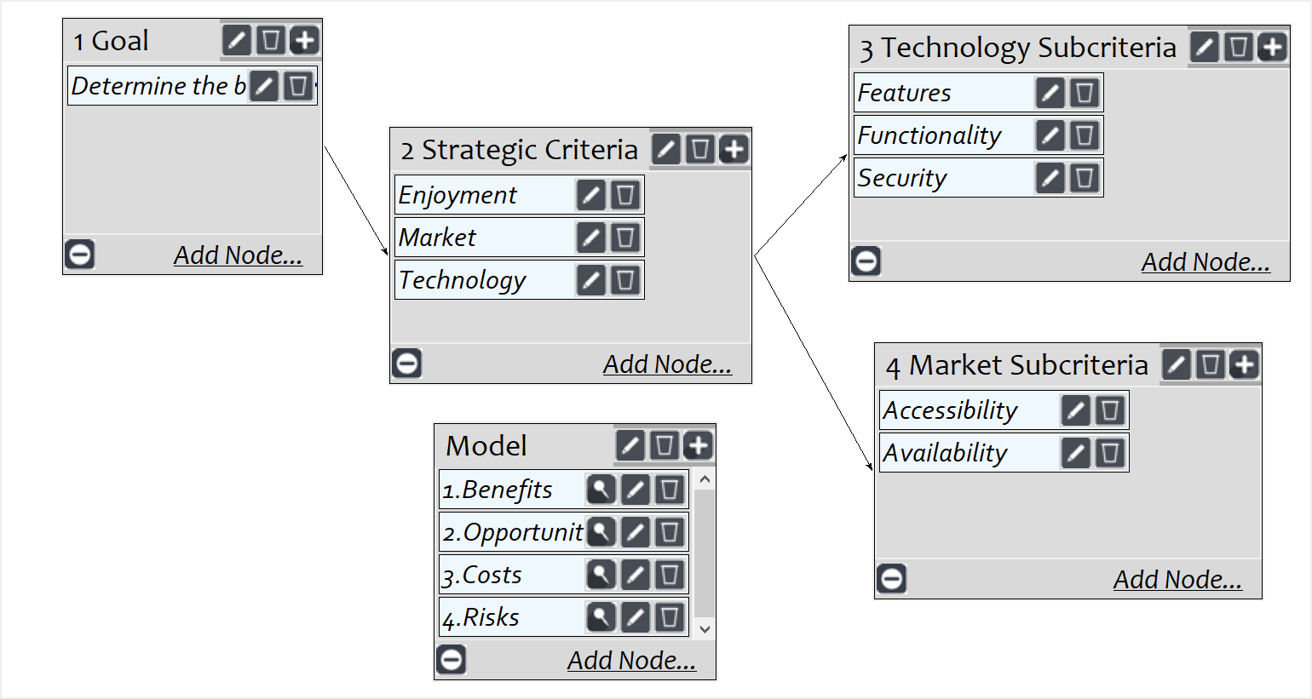
Strategic Criteria and Model
Screenshot of SuperDecisions software Version 3.x

Slide 3
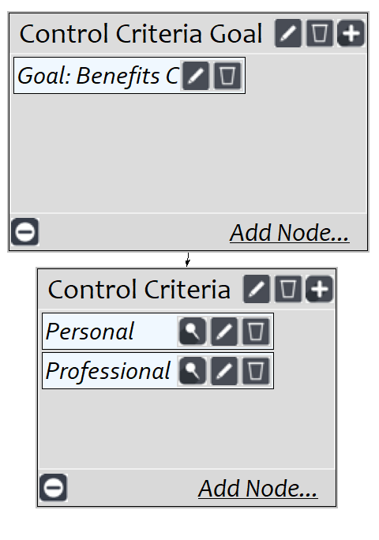
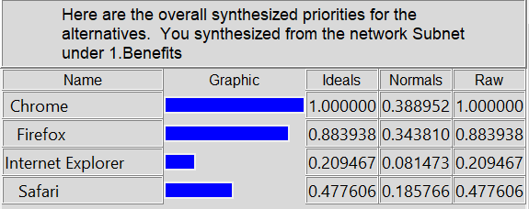
BOCR subnets - Benefits

Slide 4
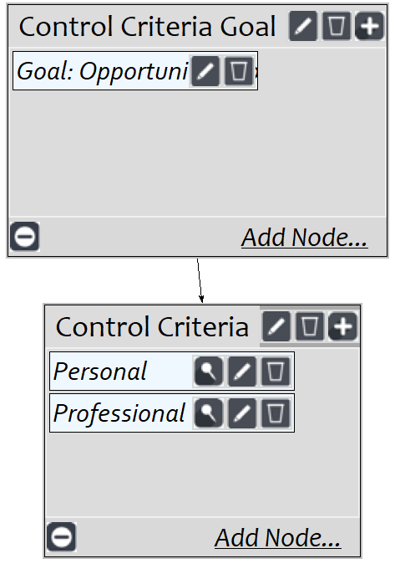
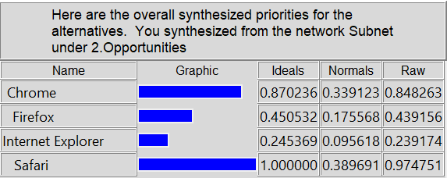
BOCR subnets - Opportunities

Slide 5
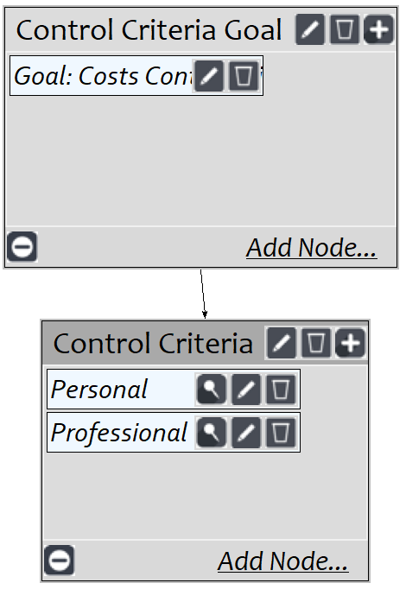
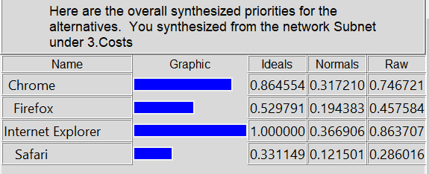
BOCR subnets - Costs

Slide 6
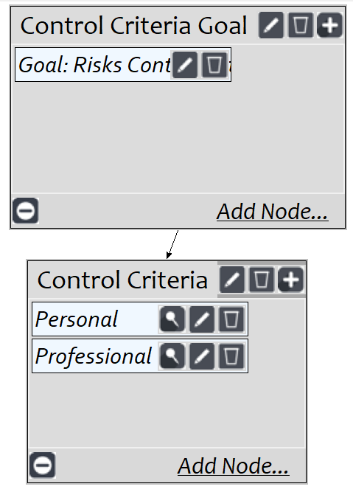
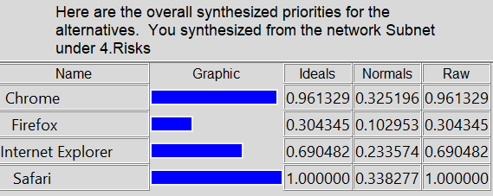
BOCR subnets - Risks

Slide 7
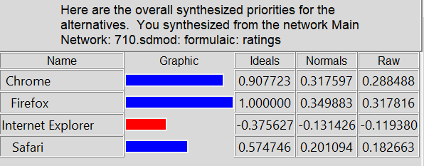
Overall results

