Slide 1
ANP Model for Best Career Decision
Jessica Duda
Nicole Volpi

Slide 2
Career Alternatives
Stay at Current Job
Start a Better Job
Start a New Business

Slide 3
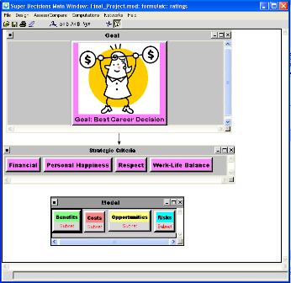
Model Overview
BOCR Model
Alternatives
Stay at Current Job
Start a Better Job
Start a Business
Strategic Control Criteria

Slide 4
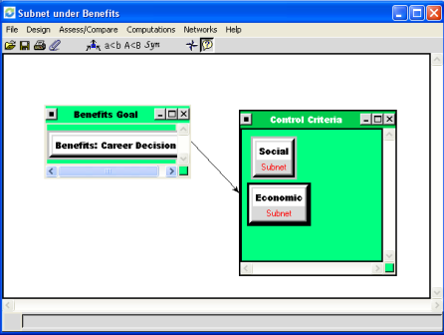
Subnet View
Control Criteria
Social
Economic

Slide 5
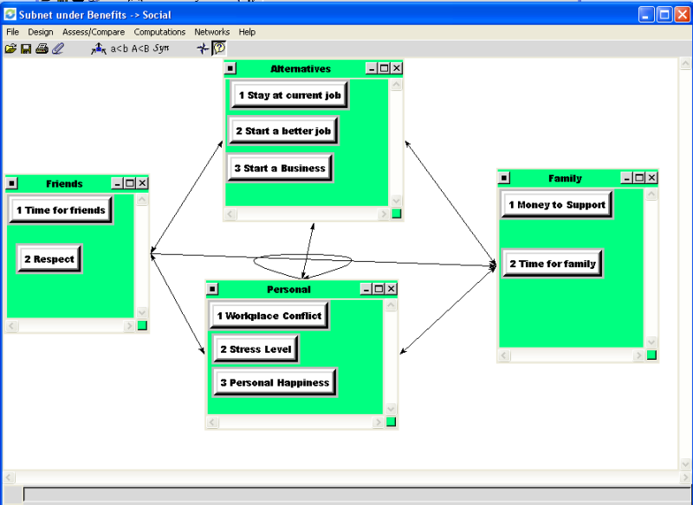
Inter Subnet Example Social-Benefits

Slide 6
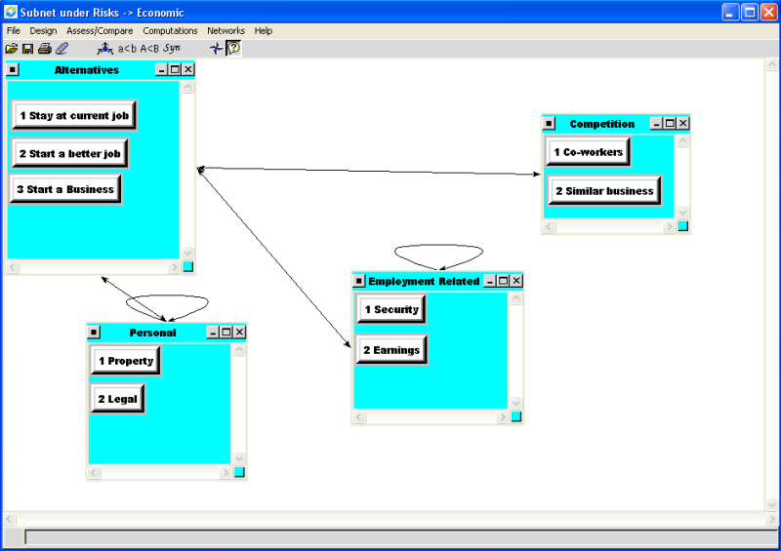
Inter Subnet Example Economic-Risks

Slide 7
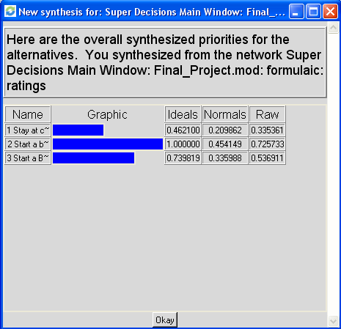
Model Synthesis

Slide 8
BOCR Priorities for Alternatives

Slide 9
Thank you!

