Slide 1
Alternative Fuels in the Automotive World
By: Nick McClelland

Slide 2
Background
Alternative fuels are increasingly becoming a popular topic among many industries, including the auto industry
Current research in alternative fuels
    Hydrogen/Fuel cell
    Electric Vehicles
    Biodiesel
    Ethanol
Cars powered by alternative fuels
  Tesla (electricity)
  Nissan Leaf (electricity)
  Honda FCX Clarity (Fuel Cell)

Slide 3
Alternatives
Four different types of alternative fuels
  Hydrogen/Fuel Cell
  Electricity
  Biodiesel
  Ethanol
The question to ask…
  Which of the alternative fuel technologies should the auto industry pursue as we transition away from our reliance on fossil fuels?

Slide 4
Ratings
 | Benefits | Opportunities | Costs | Risks
Hydrogen/Fuel Cell | Excellent | Excellent | Above Average | Above Average
Electricity | Above Average | Average | Average | Below Average
Biodiesel | Average | Average | Excellent | Below Average
Ethanol | Below Average | Average | Average | Average
Priorities | .524 | .169 | .201 | .106

Slide 5
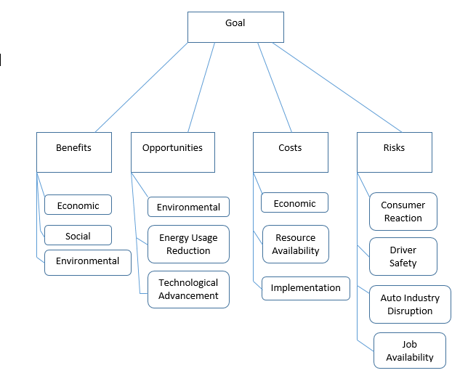
The model – BOCR Network

Slide 6
Benefits Criteria
Control Criteria | Sub-criteria | Description
Economic | Consumer Availability Cost to Implement Cost to sustain | Economic infrastructure of USA How cheap it is to implement new fuel source How cheap it is to sustain the fuel source
Social | Brand Recognition Social Status | Popularity of specific car brands Social standing
Environmental | Low Emissions | How much are emissions reduced
 | Energy | Energy efficiency of new fuel source

Slide 7
Opportunities Criteria
Control Criteria | Sub-criteria | Description
Environmental | Pollution | How much pollution can be reduced
Energy Usage Reduction | Reduced Energy Consumption | How much energy can be conserved with new fuel source
Technological Advancement | Fuel Tech Usage In Other Industries | The ability for the new fuel source to advance other industries

Slide 8
Costs Criteria
Control Criteria | Sub-criteria | Description
Economic | Legislation Infrastructure Profitability Job Availability | Cost of legislation required for new fuel source Cost of restructuring of industry infrastructure The ability to retain profits from new fuel source Amount of available jobs for people
Resource Availability | Patents Physical Materials | Cost of obtaining the patents to implement new fuel source Cost of obtaining necessary physical materials
Implementation | Cost to Implement | Cost of implementing new fuel system and fueling stations

Slide 9
Risks Criteria
Control Criteria | Sub-criteria | Description
Consumer Reaction | Public reception | How enthusiastic the public is for new fuel source
Driver Safety | Safety of Driver | How safe is the driver when using the new fuel source
Auto Industry Disruption Job Availability | Decreased Sales Decreased Production Decreased Profit Margins Decrease in Auto-Industry Jobs | How much might sales decrease How much may production of vehicles be reduced How much may profit margins be reduced How much may job availability be reduced

Slide 10
Criteria and Priorities: Benefits
Merit |  | Criteria | Sub-criteria | Local Priorities | Global Priorities
Benefit |  | Economic | Consumer Availability | 0.67 | .0456
0.37218 |  | 0.183 | Cost to Implement | 0.11 | .0075
 |  |  | Cost to Sustain | 0.222 | .015
 |  | Social | Brand Recognition | 0.263 | .0074
 |  | 0.0752 | Social Status | 0.079 | .0022
 |  |  | Car Ownership | 0.659 | .0184
 |  | Environmental | Low Emissions | 0.800 | .221
 |  | 0.741 | Energy | 0.200 | .0552

Slide 11
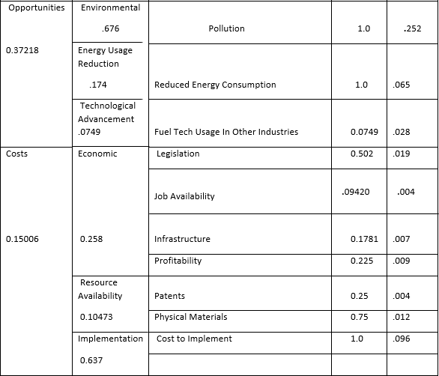
Criteria and Priorities: Opportunities & Costs

Slide 12
Criteria and Priorities: Risks
Risks .10558 |  | Consumer Reaction .60922 | Public Reception | Local Priorities 1.0 | Global Priorities .064
 |  | Driver Safety .08671 | Safety of Driver | 1.0 | .009
 |  | Auto Industry Disruption | Decreased Sales | .34455 | .008
 |  | 0.22176 | Decreased Production | .10852 | .003
 |  |  | Decreased Profit Margins | .54693 | .012
 |  | Job Availability .08231 | Decrease in Auto-Industry Jobs | 1.0 | .009

Slide 13
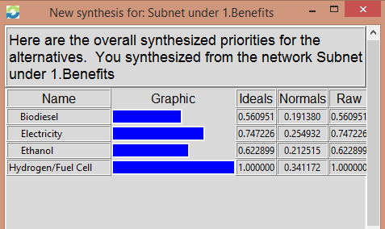
Decision Network
Benefit

Slide 14
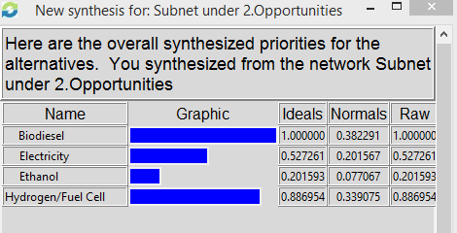
Decision Network
Opportunities

Slide 15
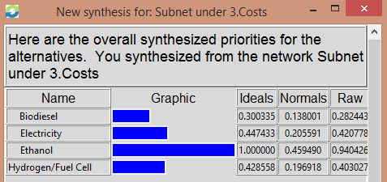
Decision Network
Cost

Slide 16
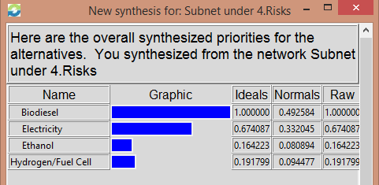
Decision Network
Risks

Slide 17
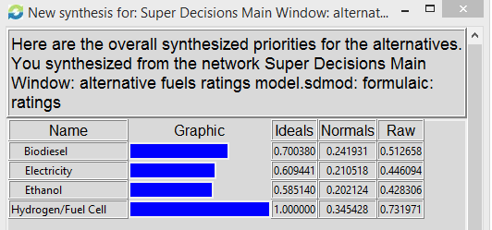
Synthesized Result: Additive Formula

Slide 18
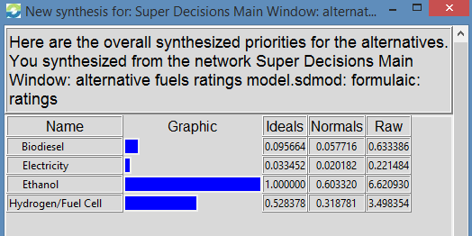
Synthesized Result: Multiplicative Formula

Slide 19
Sensitivity Analysis
Hydrogen/Fuel cell technology was the best choice in every category
Opportunities
  Biodiesel is second best alternative
  Electric becomes the second best alternative as time goes on
Risks
  Initially ethanol and electric have equal risk, but as time went on electricity proves to have fewer risks associated with it when compared to ethanol

Slide 20
Conclusion
The model supports Hydrogen/Fuel Cell technology for a long-term decision
The model strongly supports the Ethanol alternative for a short-term solution
Hydrogen/Fuel Cell technology has the best benefits and opportunities with minimal risks or costs
Ethanol is a strong short-term solution due to its ability to work on many cars on the road today, as well as ease our reliance on fossil fuels

