Slide 1
Analytical Network Process (ANP) Application
Ford Explorer Case
By :
Juan P. Alberio
Suri Mulani

Slide 2
Introduction
In August 9, 2000 the companies Firestone and Ford announced a recall of 6.5 million tires that contained a safety-relate defect.
The recall was the result of an abnormal high rate of treads separations that caused catastrophic rollover crashes that maimed and killed drivers and passengers.

Slide 3
Objective
To determine the optimal decision for Ford Company regarding the Explorer/Firestone conflict

Slide 4
Creating The Model
Alternative Decisions :
Discontinue Explorer Production
Redesign the Explorer Model
Maintain the Production of Explorer Model
Maintain the Production of Explorer Model and Change the Tire Supplier

Slide 5
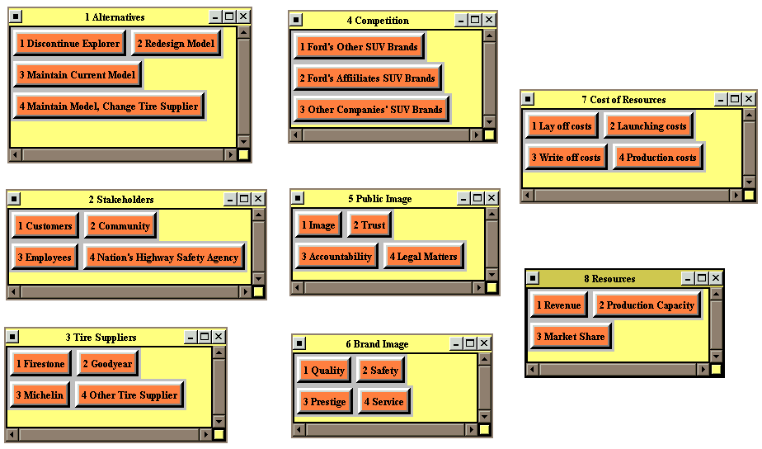
Creating The Model – cont’ed

Slide 6
Procedures
Benefit, Costs and Risks Model

Slide 7
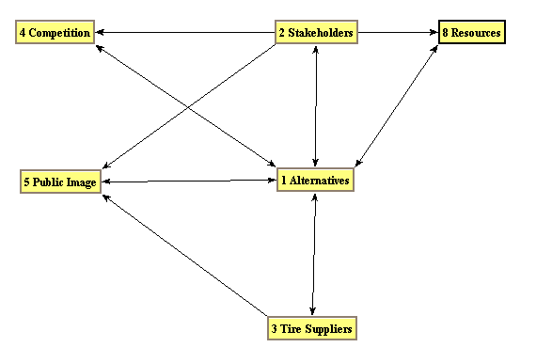
Benefits Model
Economic Benefit

Slide 8
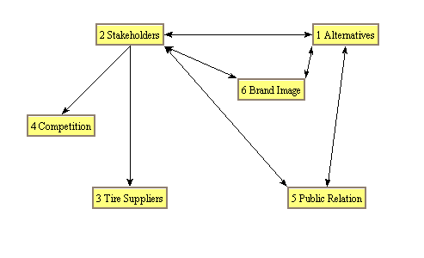
Benefits Model
Social Benefit

Slide 9
Benefits Model
Synthesis of Judgment in the Benefit Model
Economic Benefit
Social Benefit

Slide 10
Benefits Model
Synthesis of Judgment in the Benefit Model
Summary of the Benefit Model

Slide 11
Costs Model
Economic Cost

Slide 12
Costs Model
Political Cost

Slide 13
Costs Model
Social Cost

Slide 14
Costs Model
Synthesis of Judgment in the Costs Model
Economic Costs
Political Costs

Slide 15
Costs Model
Synthesis of Judgment in the Costs Model
Social Costs

Slide 16
Costs Model
Synthesis of Judgment in the Costs Model
Summary of the Costs Model

Slide 17
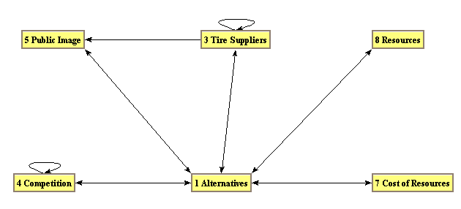
Risks Model
Economic Risks

Slide 18
Risks Model
Social Risks

Slide 19
Risks Model
Synthesis of Judgment in the Risks Model
Economic Risks
Social Risks

Slide 20
Risks Model
Synthesis of Judgment in the Risks Model
Summary of the Risks Model

Slide 21
Sensitivity Analysis
Criteria | Change | Results
Benefits | Increase | Discontinue the model, maintain model & change the tire supplier, redesign model and maintain current model.
Benefits | Decrease | Redesign model, maintain model & change the tire supplier, maintain current model and discontinue the model.
Costs | Increase | Redesign model, maintain current model, maintain model & change the tire supplier and discontinue the model.
Costs | Decrease | Discontinue the model, redesign model maintain model & change the tire supplier and maintain current model.
Risks | Increase | Redesign model, maintain model & change the tire supplier, discontinue the model and maintain current model.
Risks | Decrease | Discontinue the model, redesign model maintain model & change the tire supplier and maintain current model.

Slide 22
Conclusion
“Ford Motor Company should redesign the Ford Explorer Model”

Slide 23
Real-life Decision :
Questions ?

