Slide 1
University of Pittsburgh
Privatize or remain Public?
Richard Kahl
Michael McConegly

Slide 2
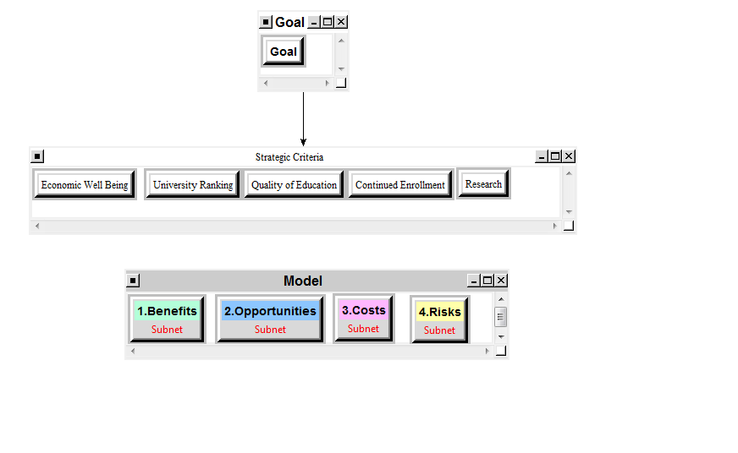
The Model

Slide 3
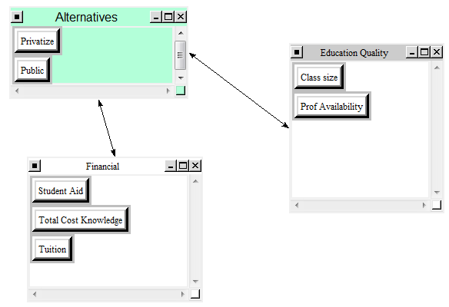
BOCR subnets
Student Benefits under Benefits of BOCR

Slide 4
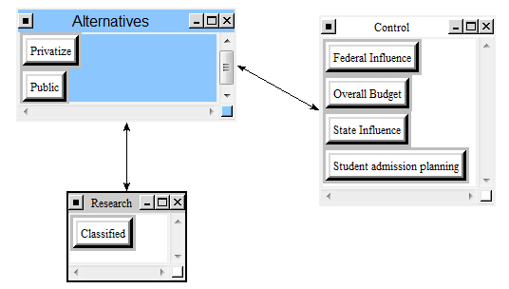
BOCR subnets
Financial Opportunities

Slide 5
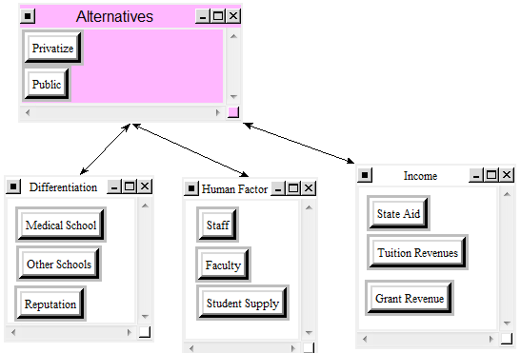
BOCR subnets
Financial Costs

Slide 6
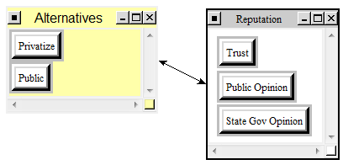
BOCR subnets
Social Risks

Slide 7
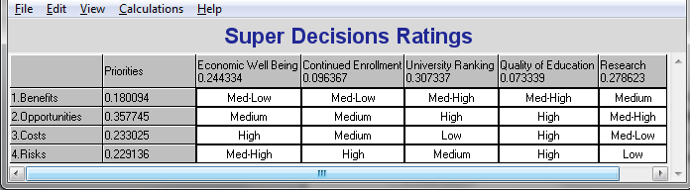
Strategic Criteria
Final Rankings of Criteria
#1) 30.7% - University Ranking
#2) 27.8% - Research
#3) 24.4% - Economic Well Being
#4) 9.6% - Continued Enrollment
#5) 7.3% - Quality of Education

Slide 8


Results
Additive Negative Results:
Multiplicative Results:
Conclusion: University of Pittsburgh should remain public
for both the short and long term

Slide 9
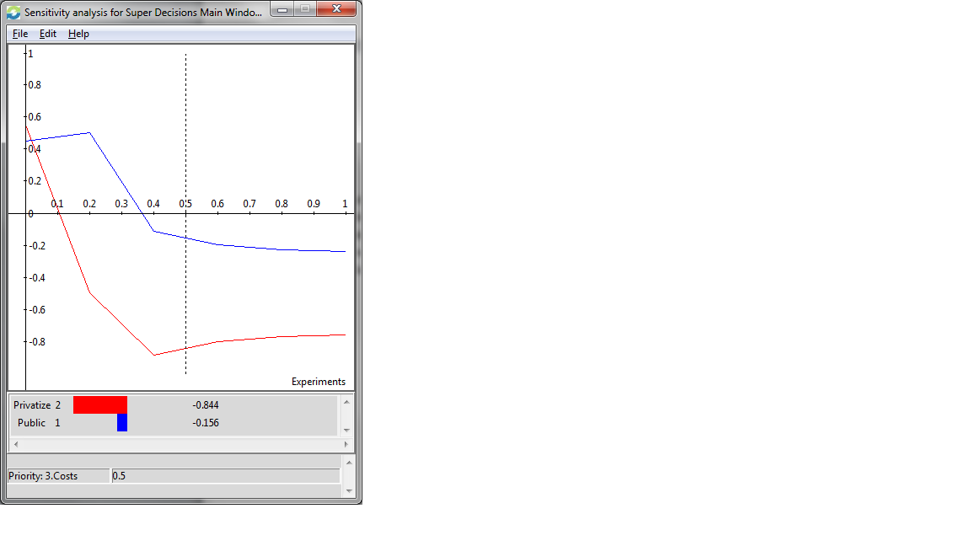
Sensitivity Analysis

