Slide 1
PA Natural Gas Drilling : The Extraction Tax Controversy
Complex ANP/BOCR Model

Slide 2
Background
Pennsylvania is one of the largest natural gas producers in the United States, and until recently, was one of the only Marcellus Shale states that did not impose a severance tax on its drilling companies.
Simply stated, a severance tax is a tax “on the value of production at the point of extraction.”
The major arguments over this issue began in 2010 and have persisted through 2012.
The principal arguments centered around on the impact of the tax on the “fledgling industry,” distribution of the tax revenue between state and local governments, and use of the tax revenue to support the state and local communities.

Slide 3
Alternatives
The analysis performed in this model, attempts to both validate the decision to impose the current tax/fee on drillers, but also considers the likelihood that an actual tax will be assessed in the future and thus can be viewed as a future “tax” or “do not tax” decision model.
1) impose tax or
2) do not impose tax on natural gas extraction

Slide 4
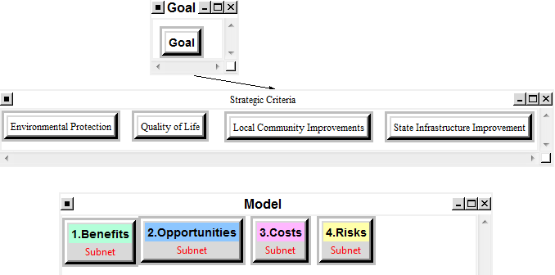
Model

Slide 5
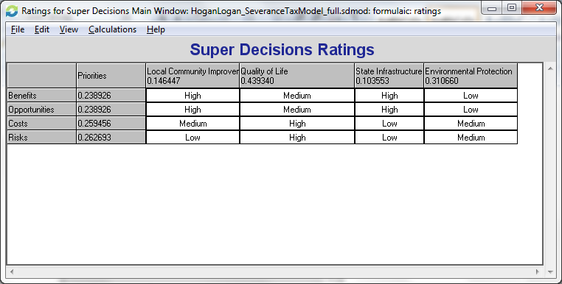
Ratings

Slide 6
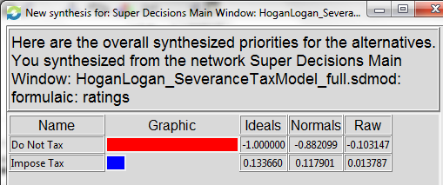
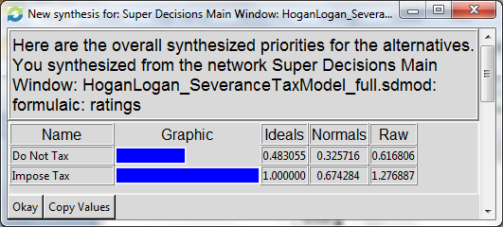
Results
Multiplicative
Additive

