Slide 1
Water Reservoir Selection
To decide water levels:
Low
Medium
High

Slide 2
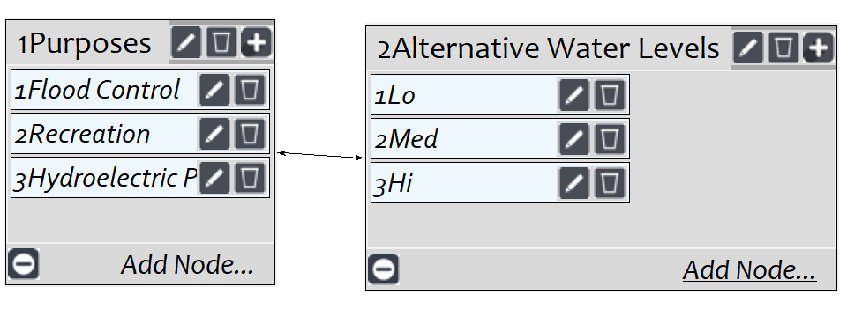
Model

Slide 3
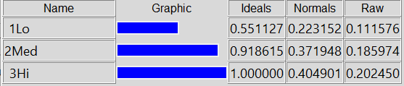
Results

