Slide 1
Bridge Selection
AHP model
Beautiful Bridge or Safe Bridge?

Slide 2
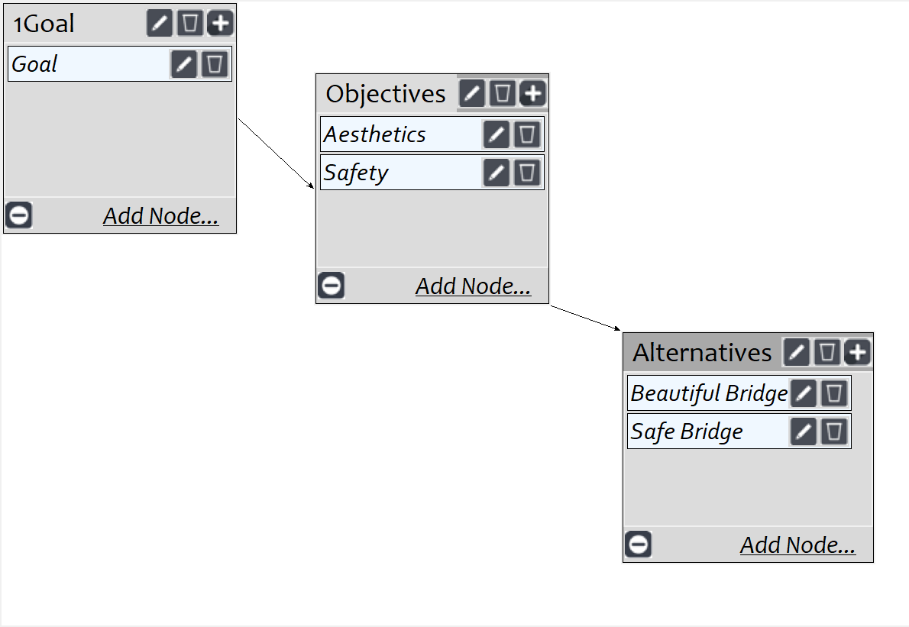
Model
Screenshot of SuperDecisions software Version 3.x

Slide 3

Results

