Slide 1
Decision Making in Complex Environments Final Project
Should Pennsylvania increase the minimum wage?
By:
Mark G. Puzas
Chongjin wang

Slide 2
Goal of the project
To evaluate if state legislators should increase the minimum wage in Pennsylvania by assessing each criteria.
One decision will be selected from the following list of alternatives:
Approve the executive order & increase min. wage to $10.15
Approve & increase the min. wage, but less than $10.15
Turn down the executive order

Slide 3
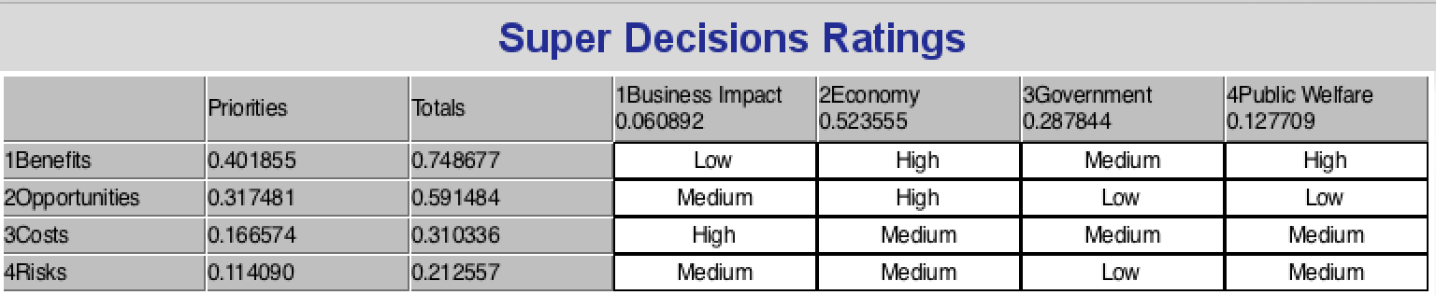
The Complex ANP Model
The Strategic criteria
Business Impact: Whether the minimum wage increase will support the development of business sector.
Economy: Whether the minimum wage increase will be helpful to sustain healthy economy.
Public Welfare: The impact on the low-income families and people who live under the Poverty Line.
Government: Whether the minimum wage increase will be advantageous to Maintain stable government.

Slide 4
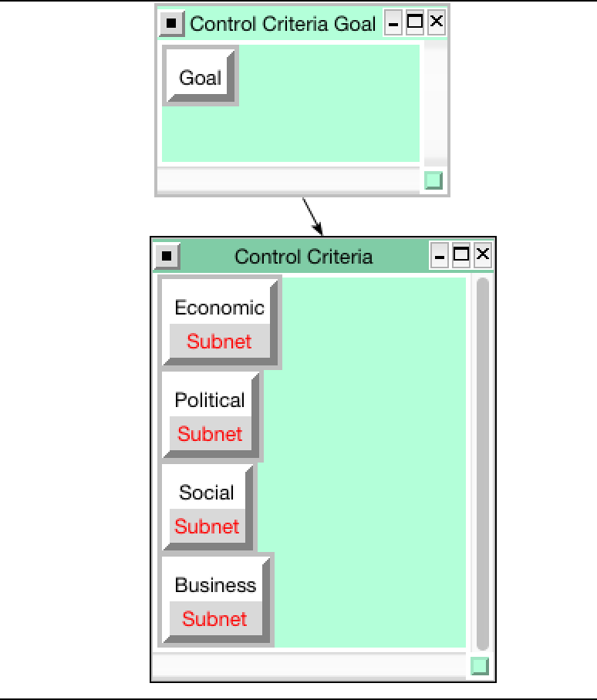
BOCR model
Each of the BOCR subnets contains four control criteria: Economic, Political, Social, & Business

Slide 5
Benefits
Control Criteria | Sub-Criteria | Description
Benefits
Economic | Tax | Impact on tax revenue and government spending budget
 | Employment | Impact on employment rate and work environment, such as employee morale
Political | Local governments | The liability and accountability of local governments
Social | Living Standards | Impact on people who live below the Poverty Line, low-income and medium-income families
Business | Market | Impact on productivity
 | Work Environment | Work performance and customer services

Slide 6
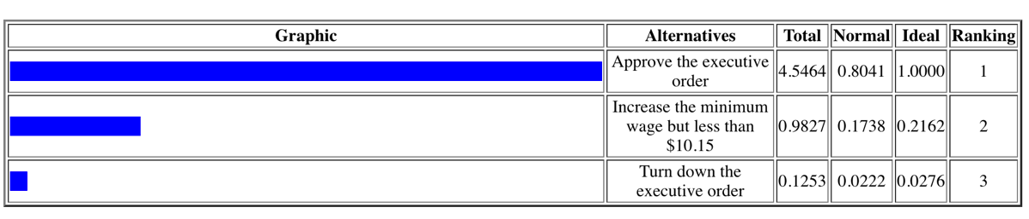
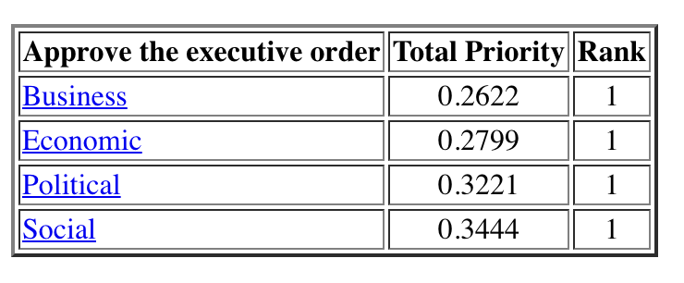
Benefits Results

Slide 7
Opportunities
Control Criteria | Sub-Criteria | Description
Opportunities
Economic | Wage Distribution | The growth of middle class. Move workers from low income to middle class, close the income gap
 | Efficiency | Promote technological innovation to save human resources
Political | Political Party | Democratic party has a chance to increase credibility if the wage increase is a success.
Social | Equity | Alleviate inequalities in earnings and social status.
 | Social Issues | Address social issues such as gender and race
Business | Consumer | Impact on consumer purchasing capacity

Slide 8
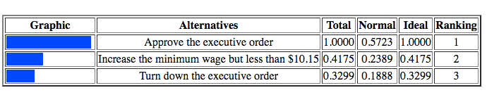
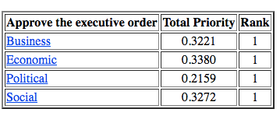
Opportunities Results

Slide 9
Costs
Control Criteria | Sub-Criteria | Description
Costs
Economic | Inflation | A sustained increase in the prices of goods and services
Political | Credibility | If wage increase has a negative effect on job growth, employee retention and productivity
Social | Social Security | Impact on the unemployed population and the income gap
Business | Operation | The burden of increased salaries and benefits, and trainings

Slide 10
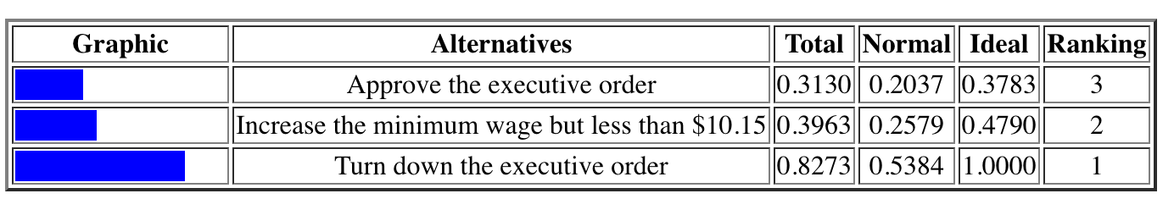
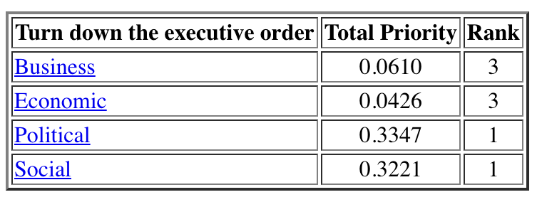
Costs Results

Slide 11
Risks
Control Criteria | Sub-Criteria | Description
Risks
Economic | Jobs | Impact on jobs because of the heavier burden on employers
Political | Political Environment | Stability of political structure among parties; The failure could bring negative impact on reputation of local governments.
Social | Employees | As employers look to cut costs, benefits could be influenced. The potential decrease of employment rate could influence social stability like crimes and homelessness
Business | Market | The impact of price due to the increased costs;

Slide 12
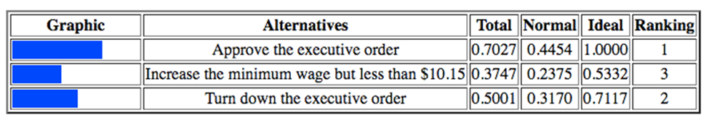
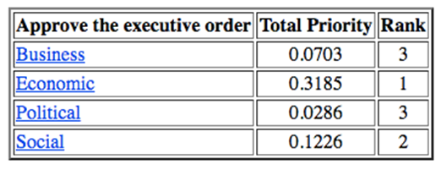
Risks Results

Slide 13
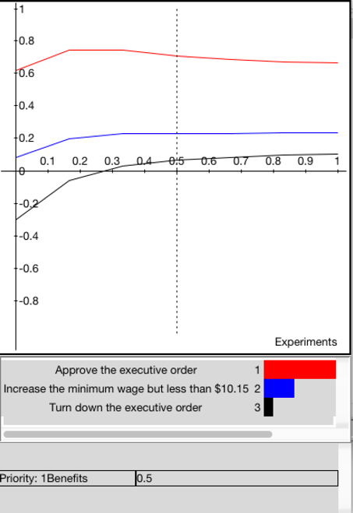
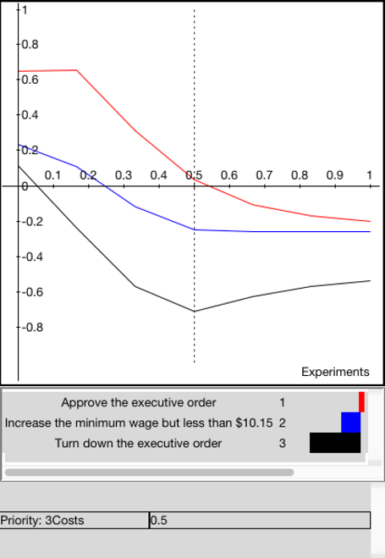

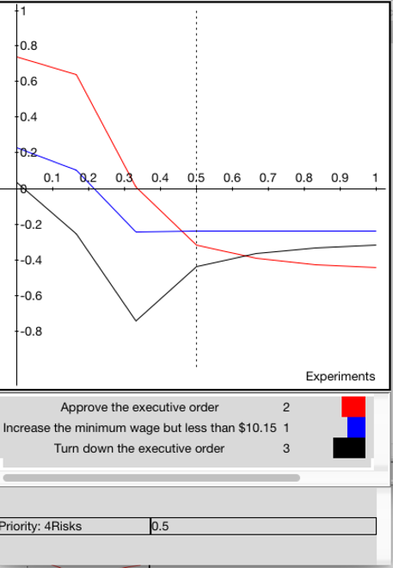
Sensitivity Analysis
Benefits
Costs
Opportunities
Risks

Slide 14
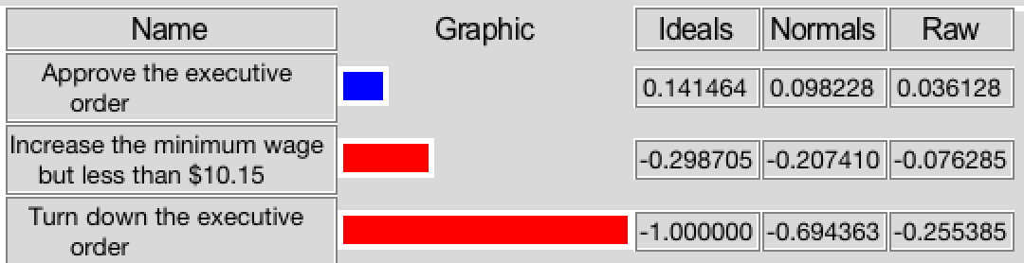
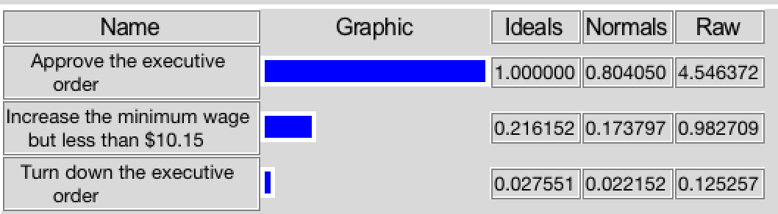
Overall Results
The Result of Additive Negative Formula
The Result of Multiplicative Formula

