Slide 1
ANP BOCR - BEST CANDIDATE FOR THE POSITION OF ALLEGHENY COUNTY
ALTERNATIVES:
Jim Roddey
Cyril Wecht

Slide 2
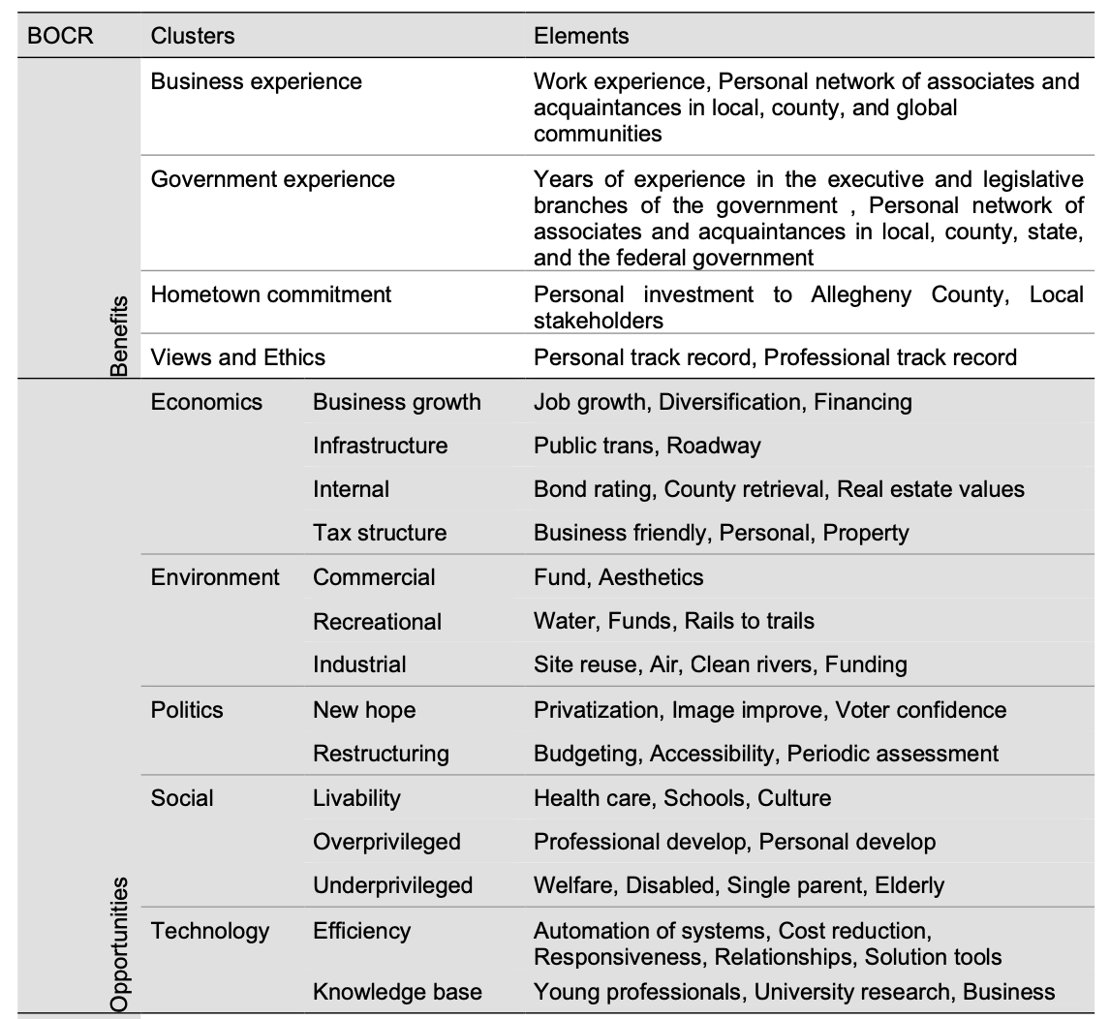
Model – BOCR subnets

Slide 3
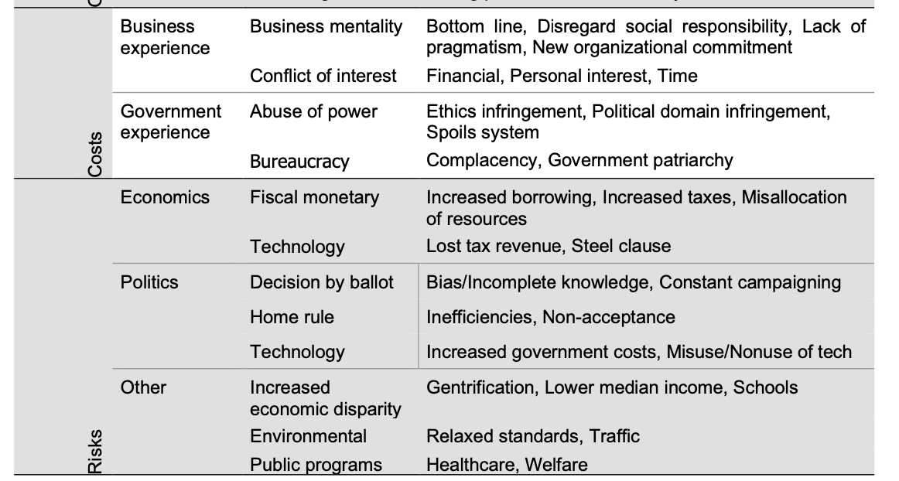
Model – BOCR subnets

Slide 4
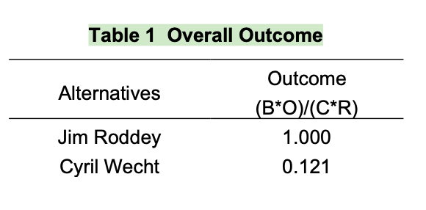
Result

