Slide 1
ANP BOCR - PRIORITIZING SECTORS OF ECONOMY FOR INVESTMENT
ALTERNATIVES:
Agriculture
Electronic industry
Heavy industry
Tourism

Slide 2
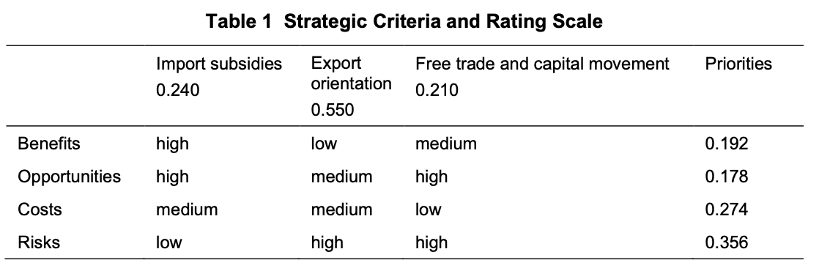
Strategic Criteria

Slide 3
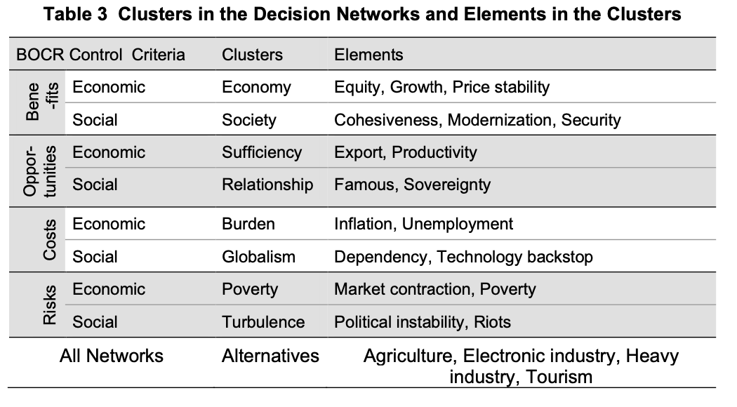
Model – BOCR subnets

Slide 4
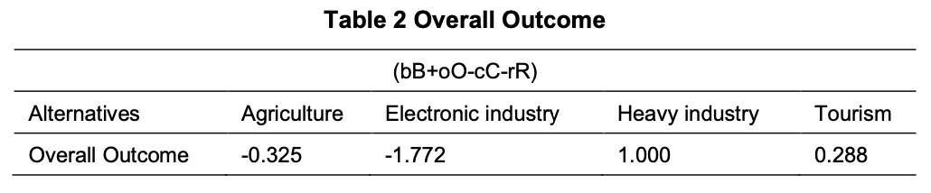
Result

