Slide 1
ANP BOCR - PITTSBURGH’S DOWNTOWN REDEVELOPMENT PROJECT
ALTERNATIVES:
Accept
Reject

Slide 2
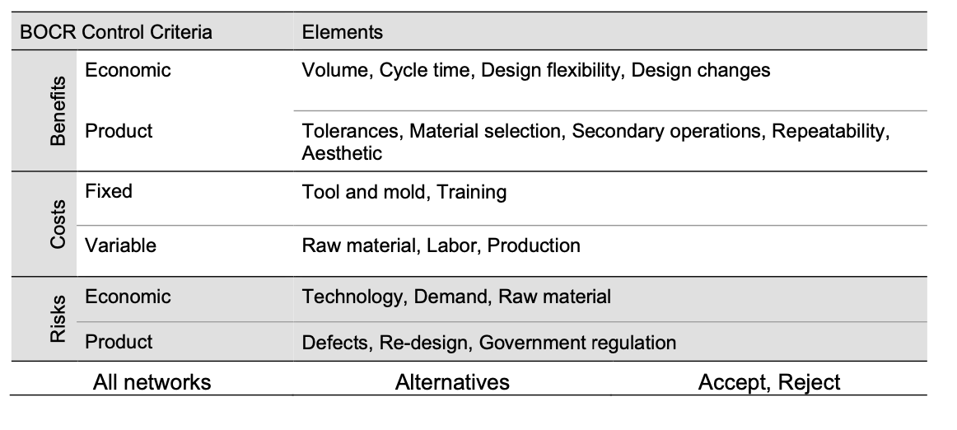
Model – BOCR subnets

