Slide 1
Marcellus Shale Drilling
Christopher Gill
B. Alex Huber
Joshua Shaffer

Slide 2
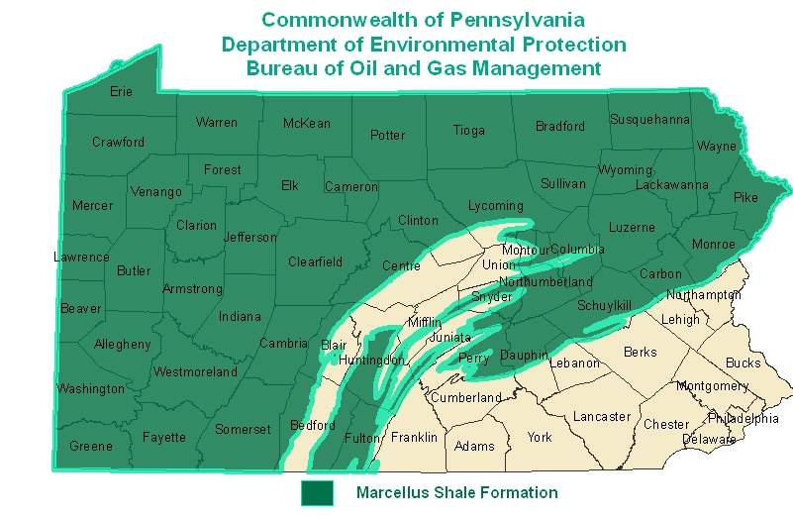
Marcellus Shale
Northern Appalachians of the United States.
Southern New York
Eastern Ohio
West Virginia
North-West Pennsylvania.
>489 TCF ~ 2 to 15 years of sustainable consumption
5,000-9,000ft below the surface
http://www.dep.state.pa.us/

Slide 3
Profitable
Revenue
Economic output:
$2.3 billion in 2008
$3.8 billion in 2009
State/local tax revenues from drilling:
$240 million in 2008
$400 million in 2009
Potentially much more!

Slide 4
Benefits
Benefits
Increase in employment
Local revenues
Potential Energy independence
Lesser emissions from natural gas
Stronger infrastructure

Slide 5
Risks
Drilling costs money
Infrastructure overhaul
Environmental toll
Cost would be passed on to residents
Environmental Risks
Damaged aquifers - “Fracking”
Gas leaks
Catastrophic events
Air quality
Wildlife

Slide 6
Taxes, Profitable?
Pennsylvania
Only state which does not impose a severance tax
Texas – Barnett Shale
Highly successful project with local taxes
Retain profits within the community
14 states with greater natural gas production
ALL have severance taxes
5.2% growth per year on average since 2004

Slide 7
The Decision
Duty of the state to protect
social rights
the environment
Three Alternatives
No Drilling – no large scale increase in drilling
Drilling without taxation
Drilling with taxation

Slide 8
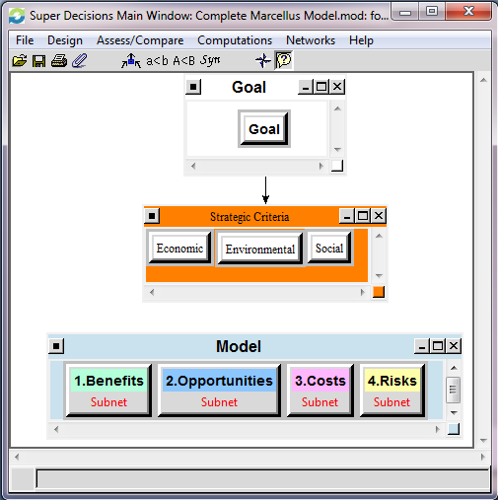
The Model
Complex ANP Model
Benefits
Opportunities
Costs
Risks
Strategic Criteria
Economic
Environmental
Social

Slide 9
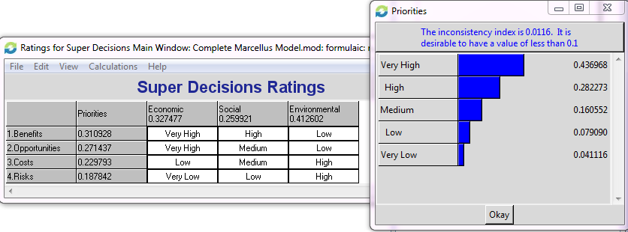
Ratings
Ratings help to appropriately evaluate the influence of our merit nodes

Slide 10
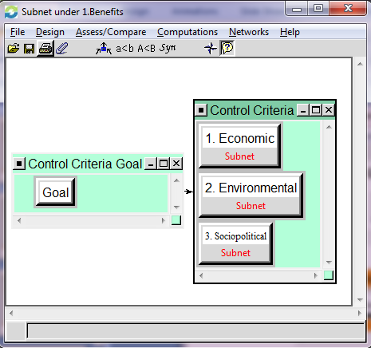
Control
Control Criteria
Economic
Environmental
Sociopolitical

Slide 11
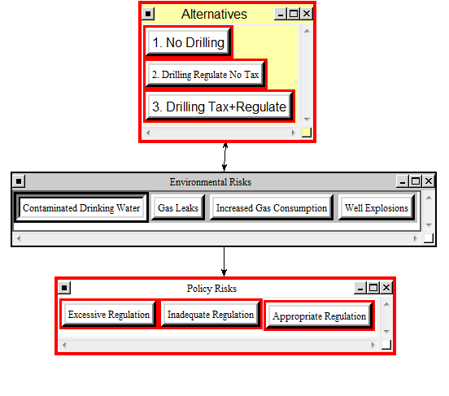
Policy
The Policies influence the Priorities
The extent to which we regulate has impact

Slide 12
BOCR | Control Criteria | Clusters | Elements | Priorities | Global Priorities
Benefits | Economic | Financial | Decrease in Energy Cost | 0.1659 | 0.0276
 |  |  | Increase in shareholder value | 0.1047 | 0.0175
 |  |  | New Jobs | 0.3108 | 0.0518
 |  |  | Tax Revenue | 0.4186 | 0.0698
 | Environmental | Environmental Benefits | Reformation in drilling techniques | 0.3505 | 0.0584
 |  |  | Decrease in 'dirty' fossile fuel dependence | 0.6495 | 0.1083
 | Sociopolitical | Social Benefits | Energy Independence | 0.0517 | 0.0086
 |  |  | Improve quality of life | 0.2312 | 0.0385
 |  |  | Increase in social responsibility | 0.1677 | 0.0280
 |  |  | New Roads/Infrastructure | 0.3304 | 0.0551
 |  |  | Protection policies and assurances | 0.2190 | 0.0365
Opportunities | Economic | Economic Opportunities | Energy Cost Control | 0.0807 | 0.0135
 |  |  | Increase industrial growth and technology | 0.4463 | 0.0744
 |  |  | Profitable mineral rights | 0.1245 | 0.0207
 |  |  | Regional Employment Growth | 0.3485 | 0.0581
 | Environmental | Environmental Opportunities | Improved drilling methods | 0.3317 | 0.0553
 |  |  | Increased Use of Cleaner Energy | 0.4237 | 0.0706
 |  |  | Policy Improvements | 0.2446 | 0.0408
 | Sociopolitical | Social Opportunities | Energy Independence | 0.1484 | 0.0247
 |  |  | Higher Standard of Living | 0.6084 | 0.1014
 |  |  | Reformed Leadership | 0.2433 | 0.0405
Benefit, Opportunity Priorities

Slide 13
BOCR | Control Criteria | Clusters | Elements | Priorities | Global Priorities
Costs | Economic | Economic Costs | Cost of regulation | 0.0991 | 0.0165
 |  |  | Cost/energy to drill | 0.0545 | 0.0091
 |  |  | Decrease property value | 0.1534 | 0.0256
 |  |  | Increased Rural Cost of Living | 0.1206 | 0.0201
 |  |  | Infrastructure cost | 0.3324 | 0.0554
 |  |  | Lost opportunity | 0.2400 | 0.0400
 | Environmental | Environmental Costs | Catastrophic Event | 0.1120 | 0.0187
 |  |  | Damaged Aquifers | 0.4816 | 0.0803
 |  |  | Deforestation/Landscape Impact | 0.1925 | 0.0321
 |  |  | Increased Water Use | 0.2139 | 0.0357
 | Sociopolitical | Social Costs | Earmarks/deficit increase | 0.1624 | 0.0271
 |  |  | Increased Lawsuits | 0.0863 | 0.0144
 |  |  | Infrastructure Wear +Tear | 0.1243 | 0.0207
 |  |  | Local Economy Collapse | 0.6270 | 0.1045
Risks | Economic | Economic Risks | Local Economy Collapse | 0.3774 | 0.0629
 |  |  | Lost Potential Revenue | 0.6226 | 0.1038
 | Environmental | Environmental Risks | Contaminated Drinking Water | 0.5968 | 0.0995
 |  |  | Gas Leaks | 0.2278 | 0.0380
 |  |  | Increased Gas Consumption | 0.1304 | 0.0217
 |  |  | Well Explosions | 0.0451 | 0.0075
 | Sociopolitical | Social Risks | Excessive Policy | 0.1024 | 0.0171
 |  |  | Industrialization of Rural Areas | 0.2882 | 0.0480
 |  |  | Political Shift | 0.0737 | 0.0123
 |  |  | Public Affairs/Protests | 0.5357 | 0.0893
Cost, Risk Priorities

Slide 14
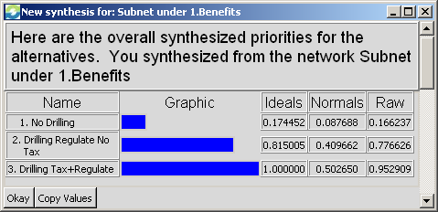
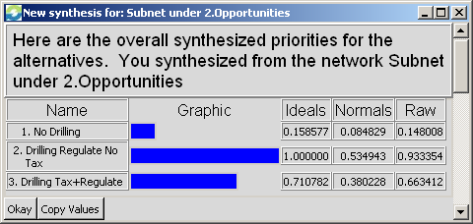
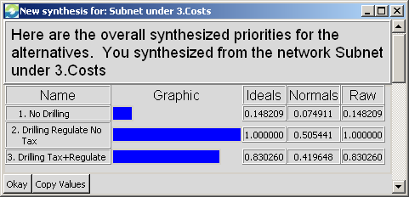
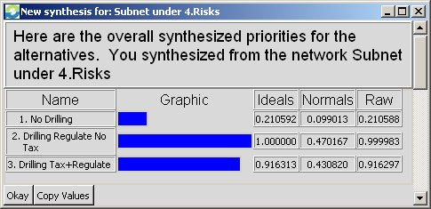
Synthesis (BOCR)
B,O,C,R Synthesized Results

Slide 15
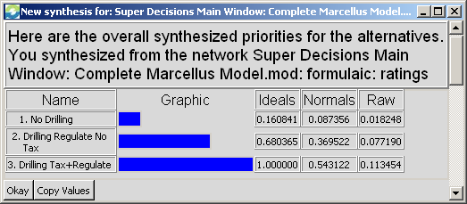
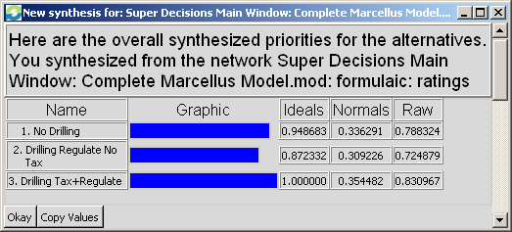
Overall Priorities
Additive (negative) result:
Drill w/tax preferred
Multiplicative result:
Drill w/tax preferred

Slide 16
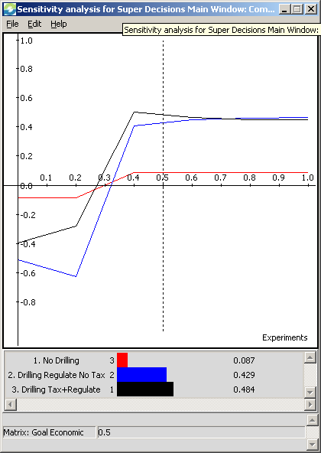
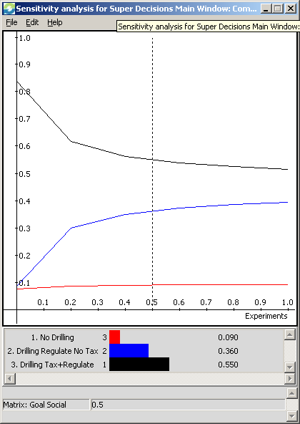
Sensitivity
Drilling options sensitive to economic weight
Low sensitivity to social weight

Slide 17
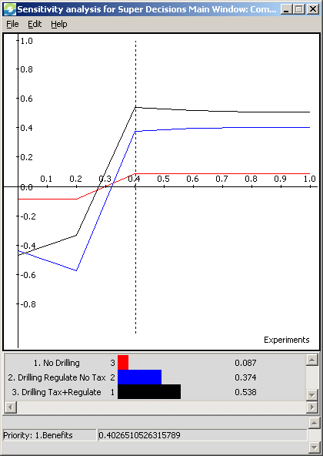
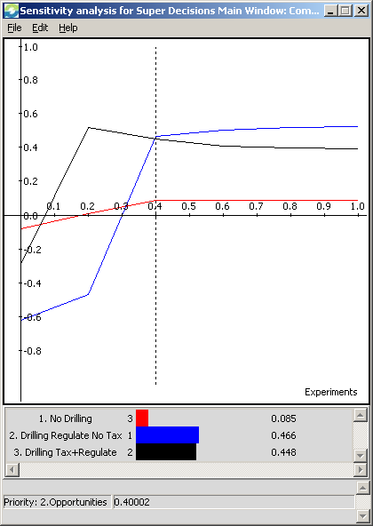
Sensitivity
No tax becomes preferred when Opportunities > 0.40
Tax preferred at most benefit weights

Slide 18
Questions????

