Slide 1
Marcellus Shale Drilling in Southwestern Pennsylvania
Should Drilling Continue?

Slide 2
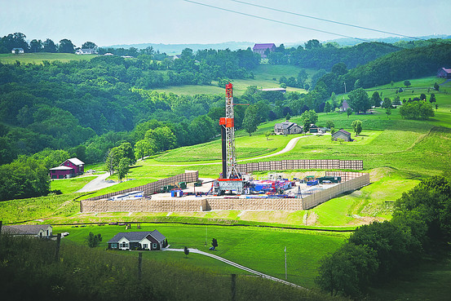
Introduction
Marcellus Shale drilling in Southwestern Pennsylvania is creating a world of opportunity for some, while heightening others’ sense of risk concerning the environment.

Slide 3
Benefits Opportunities
Financial
Corporation
Personal
Social
Amenities
Employment
Development
Financial
Corporation
Personal
Social
Future Development

Slide 4
Costs Risks
Environmental
Pollution Control
Hydraulic Fracturing
Social
Roads
Miscellaneous
Environmental
Pollution Control
Hydraulic Fracturing
Social
Roads
Miscellaneous

Slide 5
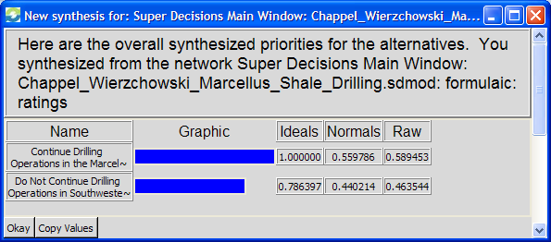
Conclusion
Synthesis using the Additive Formula shows the ‘Continue Drilling’ alternative is preferred (56%) over ‘Do Not Continue Drilling (44%)

