Slide 1
Pittsburgh Public Transportation
How Should Pittsburgh Port Authority Prepare for the Future?
Heather Snyder
Steve strasser

Slide 2
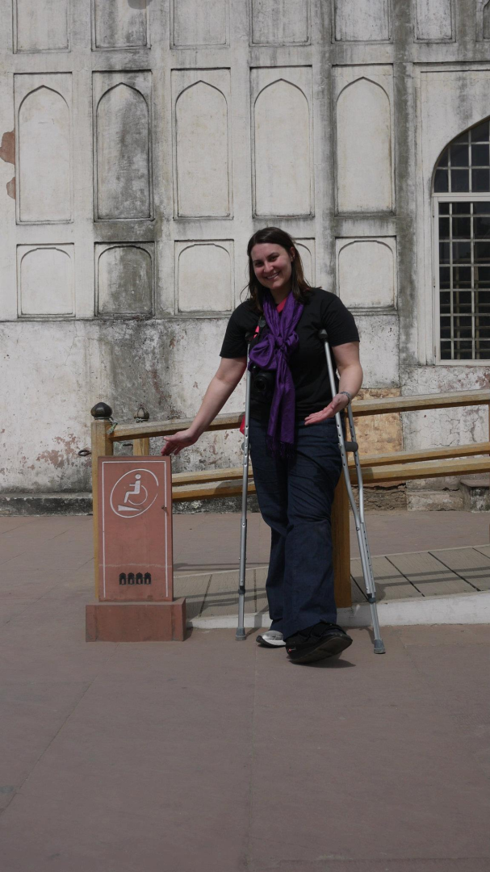
Our problem
Jan. 25: Heather tore her Achilles.
P90X too difficult
Physical Limitation
Cant drive
High on drugs
Forced to become her chauffeur
Forced to take public transit
Port Authority budget cuts

Slide 3
Port authority in trouble
Pittsburgh Port Authority is struggling to meet its financial obligations.
$19 Million in cuts
Route Changes
30 routes cut
37 routes reduced
$64 million operating deficit beginning July 1, 2012

Slide 4
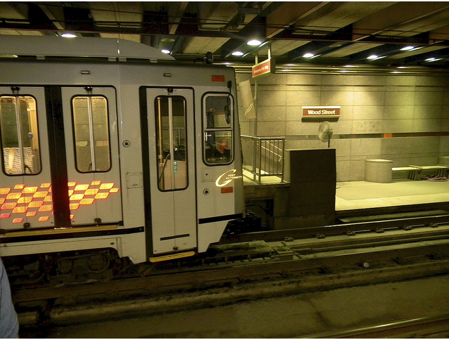
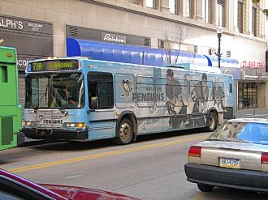
Alternatives
Upgrade the buses
Expand the T train system
Do Nothing

Slide 5
Stakeholders
Consider the wants and needs of those impacted:
The Government
The Transportation Labor Unions
The Public (including riders, drivers and residents)

Slide 6
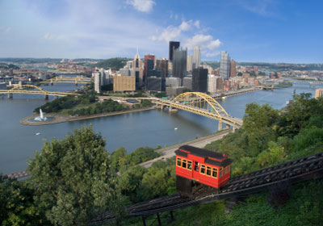
Control Criteria
Consider the alternatives from three criteria categories:
Environmental impact
Social impact
Economic impact
Apply categories to a Benefits, Opportunities, Costs, Risks (BOCR) model.

Slide 7
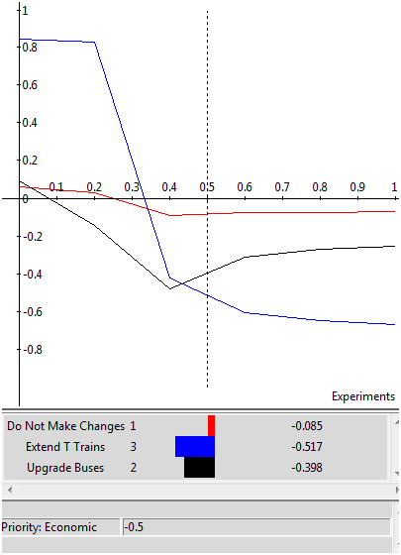
Benefits
Environmental
Energy savings
Reduced pollution
Cleaner Air
Efficient use of land
Social impact
Avoiding traffic
Increased employment
Inter-neighborhood accessibility
Less congested roadways
Time Savings
Economic
Job creation
Local business growth
Increased city revenue
Operating cost reduction

Slide 8

Opportunities
Environmental
Fossil fuel saving
Pollution reduction
City aesthetics
LEED certification
Social impact
Traffic: Car volume on Parkway East and Bus route efficiency
Growth: Employment, Handicapped accessibility, Inter-neighborhood accessibility
Perceptions: “Livability” of City, City aesthetics, Improved sense of community, Morale, World image
Economic
City revenue
City savings
Commercial growth
Economic expansion
Job creation
Tourism
Shopper accessibility

Slide 9
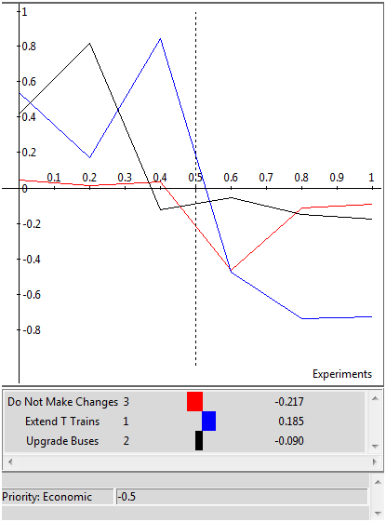
Costs
Environmental
Energy used
Increased Pollution
Limitations imposed on future project resources
Use of land
Social impact
Funding for project takes away from others
Amount of time to complete
Traffic detour/city disturbance during construction
Economic
Costs: Maintenance, Startup, Operating
Jobs
Capital resource allocation

Slide 10
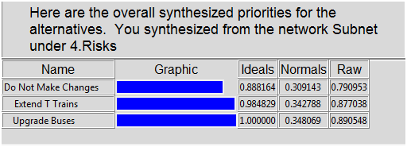
Risks
Environmental
Construction pollution
Emissions
Wasted resources
Social impact
Traffic: Traffic accidents, Wasted commuting time
Perceptions: Brand image, Wasted spending
Rider affordability
Service availability
Economic
Budget impact
Return/loss on investment
Transportation operating costs

Slide 11
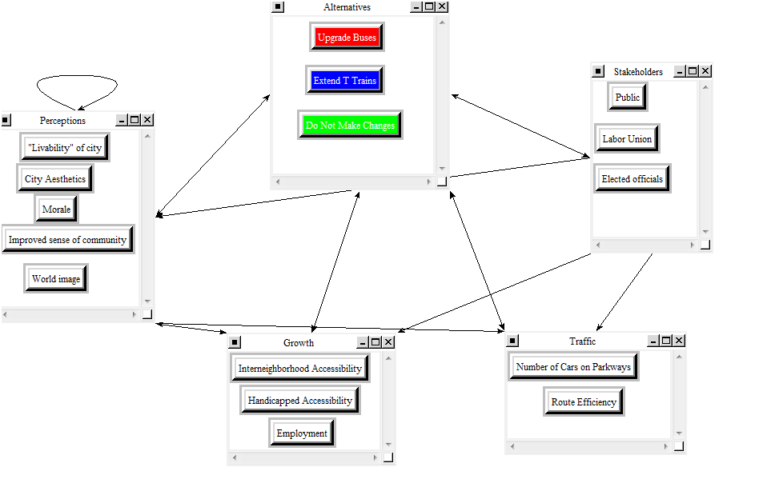
Subnetwork example

Slide 12
Strategic criteria
Benefits to public
Environmental impact
Financial impact
Government benefit
Labor unions impact

Slide 13
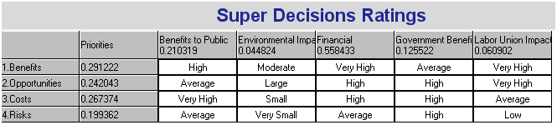
Ratings spreadsheet
Notes:
Since funding for the Pittsburgh Port Authority’s public transportation system is so unstable, we decided that the most important strategic criteria was the financial portion at 56%. The second most important strategic criteria are the ‘Benefits to the Public’ at 21%.

Slide 14

Final recommendation
If the cost rises beyond about 0.33 in regard to priority, “Do Not Make Changes” becomes the best alternative.
If priority of risk, rises to about 0.6, all alternatives become equal
Notes:
expanding the T train is the best alternative. If the cost rises beyond about 0.33 in regard to priority, “Do Not Make Changes” would become the best alternative as a long term solution.
When the priority of risk, rises to about 0.6, all of the alternatives become equal and no alternative becomes significantly more of a priority than the other two alternatives.
If the Pittsburgh Port Authority can finance the alternative of “Extend T Trains” we still believe, based on our model, this will be the best option in the short term, as well as the long term.

