Slide 1
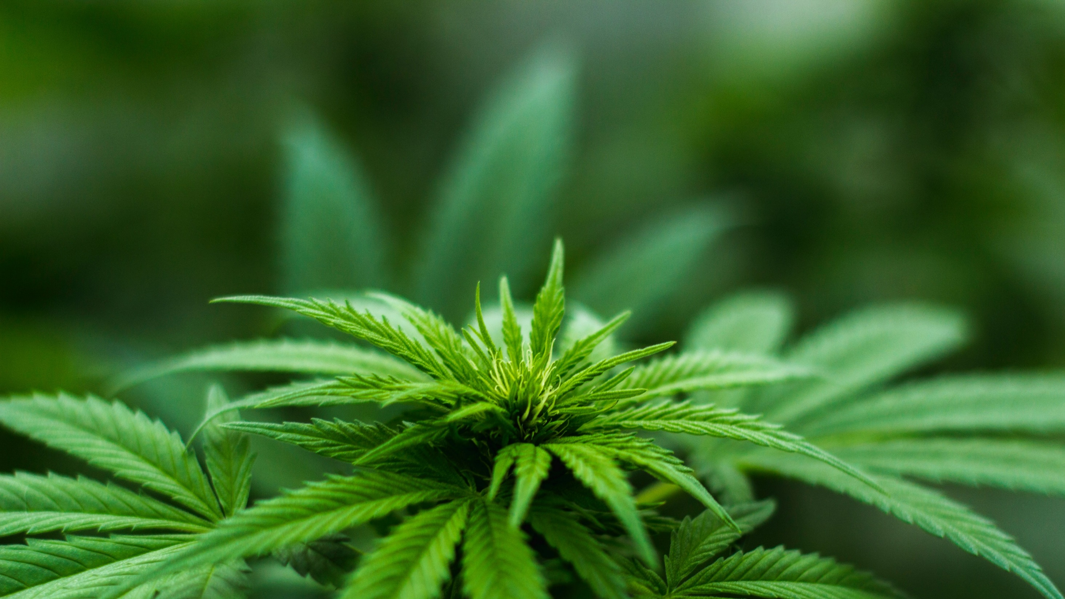
Legalization of Cannabis in the State of Pennsylvania David Likar and Ethan Blanchard

Slide 2

Agenda
Current Overview
Strategic Criteria
BOCR Model Overview
Decision Synthesis
Summary

Slide 3
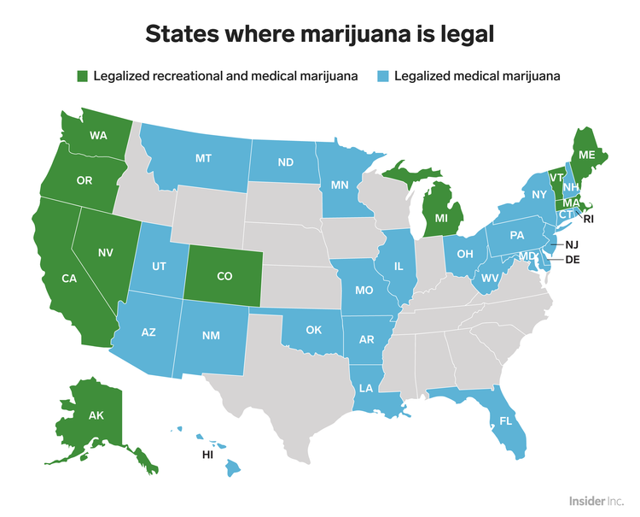
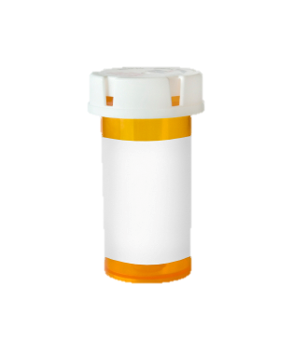
62% | of Americans said they supported legalizing cannabis.
US Department of Health and Human Services (HHS) declared a public health emergency due to opioid abuse.
11.4 million people misuse prescribed opioids
In 2016, opioid overdoses accounted for 42,000 deaths - more deaths that those from car accidents or breast cancer.
1 pill bottle = 10 deaths per day
The illicit market for cannabis is estimated to be worth over $40 billion or more in the US.
Notes:
Ten states and Washington DC, have now legalized cannabis for recreational use for adults over 21. 33 states have legalized medical cannabis.
The US Drug Enforcement Agency (DEA) views marijuana as a Schedule I drug which are defined as drugs with no currently accepted medical use and a high potential for abuse.
Thought hat much of the recent interest in medicinal cannabis is an effect of opioid abuse epidemic.

Slide 4
Strategic Criteria for Decision Making
Public Opinion | Considers the health and well-being of the population, public perception of acceptance of cannabis, and thoughts compared to other addictive substances.
Industry Growth | How does the legalization of cannabis simulate job growth, technical and medical developments, and affect ecological sustainability.
Political Outcome | Factors potential gains of tax revenue versus costs in drug regulation. Also considers public favor of political party and action.

Slide 5
Priorities for Decision Criteria

Slide 6
Likely Short-term Benefits
Economical | Political | Social
Increase state economy | Increase tax revenue | Safe usage/ regulations
Stimulate new industries | Drug regulation/ enforcement | Lower drug-related criminal activity
Job growth | Re-election/ Party Influence | Deliver on public demand

Slide 7
Long-term Opportunities
Economical | Political | Social
University/ Medical Research | Funding for new programs | Deter opioid addiction
Development of smarter manufacturing | Influence federal/other state regulations | Lower drug-related criminal activity
Improve ecological impact | Drug regulation/ enforcement | Safe usage/ regulations
 |  | Improve quality of life

Slide 8
Potential Decision Costs
Economical | Political | Social
Development of regulations/ enforcement | Development of regulations/ enforcement | Protests
Public funding required | Re-election/ Party Influence | Enforcement

Slide 9
Important Risks to Consider
Economical | Political | Social
Economic crashes | Partisan acceptance | Improper usage
Federal legalization | Re-election/ Party Influence | Negative health effects

Slide 10
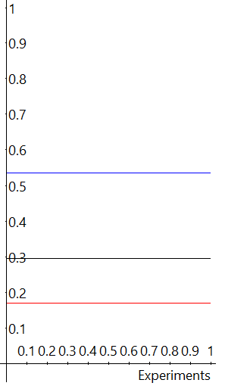
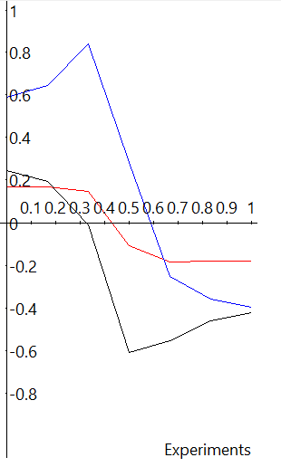
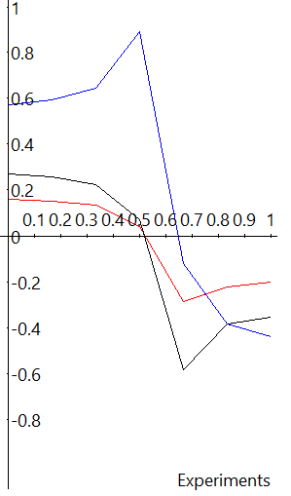
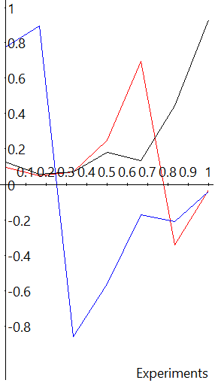
BOCR Model Sensitivity: Political Criteria
Benefits |  | Opportunities | Cost | Risks
No Legalization | Medical Use | Recreational Use

Slide 11
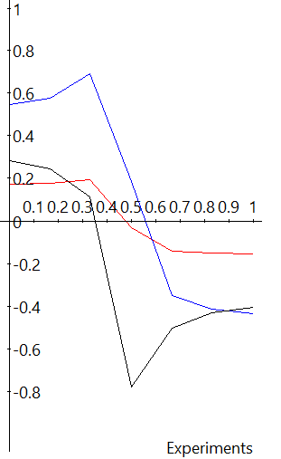
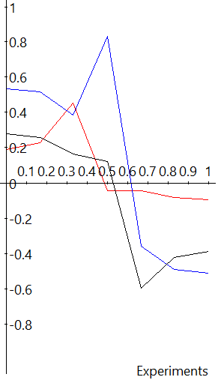
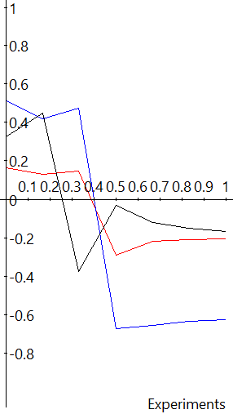
BOCR Model Sensitivity: Social Criteria
Benefits |  | Opportunities | Cost | Risks
No Legalization | Medical Use | Recreational Use

Slide 12
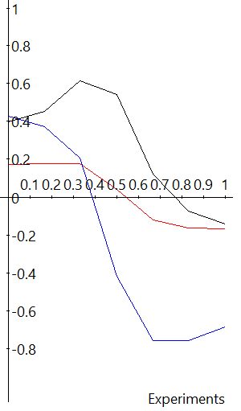
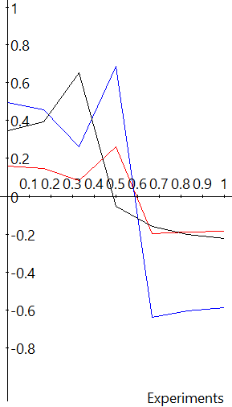
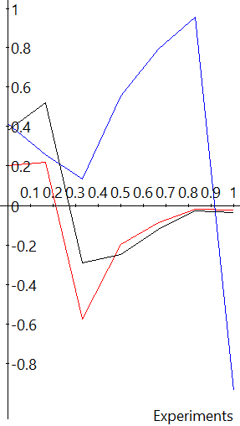
BOCR Model Sensitivity: Economical Criteria
Benefits |  | Opportunities | Cost | Risks
No Legalization | Medical Use | Recreational Use

Slide 13
Model Synthesis Comparison
BOCR Additive Result (Long-term)
BOCR Multiplicative Result (Short-term)

Slide 14
Legalization of cannabis for Medical Use is ideal for both long and short-term criteria
Positives | Demonstrated therapeutic effects for Nausea, Stress-relief, Chronic pain-relief, Anti-depression, and Control of convulsions and spasms.
Challenges | Physicians cannot legally “prescribe” medicinal cannabis In accordance with state laws may certify or recommend patients for treatment Expenses are not reimbursable through government medical assistance programs or private health insurers.

